Slide 1



Getting Back to Back
Alternative behaviors for a Web browser’s Back button
HFWEB June 3, 1999
Saul Greenberg
University of Calgary
Canada
Andy Cockburn
University of Canterbury
New Zealand
This slide deck does not include a live demo shown as part of the presentation

Slide 2
Getting Back to Back
Alternative behaviors for a Web browser’s Back button
HFWEB June 3, 1999
Outline
  how revisitation is supported
  why Back is good
  various Back behaviors
  current / future work

Slide 3
Motivation
People revisit pages with surprising frequency
  ~6 out of 10 pages visited seen before!
    Tauscher & Greenberg
    Catledge & Pitkow

Slide 4
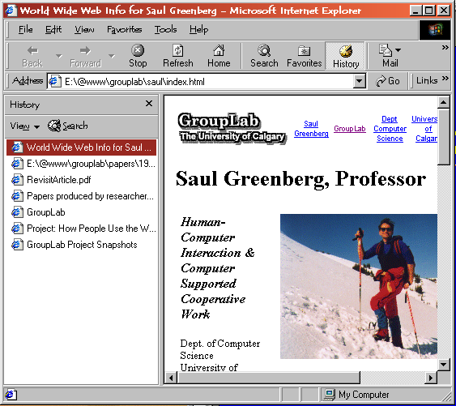
How is Revisitation Supported?
History lists

Slide 5
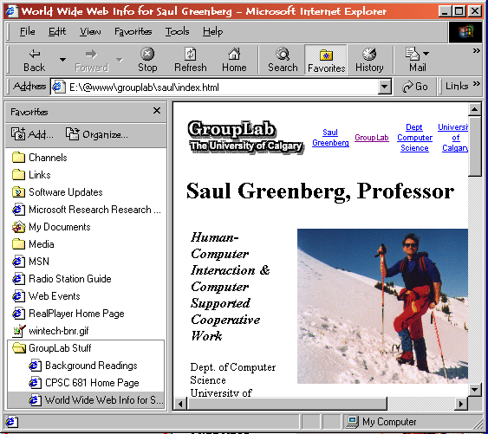
How is Revisitation Supported?
History lists
Bookmarks /
Favorites

Slide 6
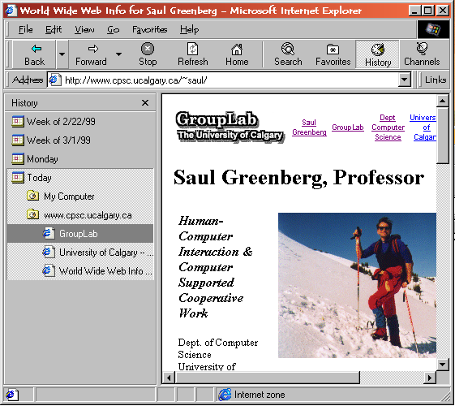
How is Revisitation Supported?
History lists
Bookmarks
Site maps

Slide 7
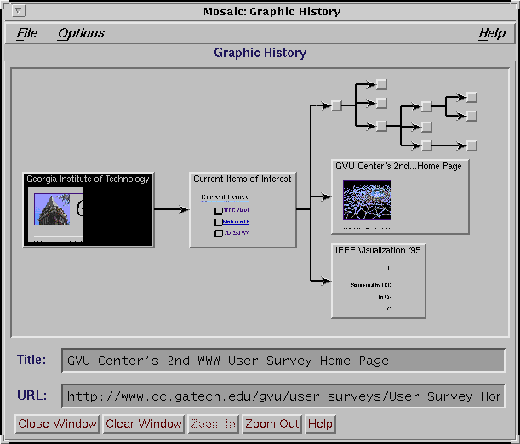
How is Revisitation Supported?
History lists
Bookmarks
Site maps

Slide 8
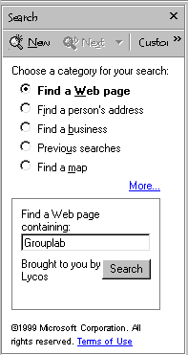
How is Revisitation Supported?
History lists
Bookmarks
Site maps
Searches

Slide 9
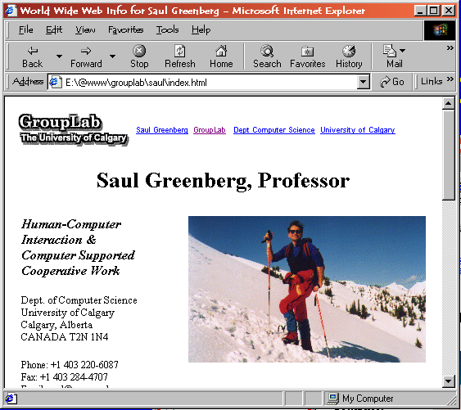
How is Revisitation Supported?
History lists
Bookmarks
Site maps
Searches
Back button

Slide 10
The Lowly Back Button
Pressing Back accounts for
  30 - 37% of all navigational acts!
    Tauscher & Greenberg
    Catledge & Pitkow

Slide 11
Why Back is Good
40%
new
Recency
effect
60%
revisits
43%
10
39%
6
c
29%
2
hub
d
spokes
e f g h

Slide 12
Why Back is Good
Recency
Visual
economy

Slide 13
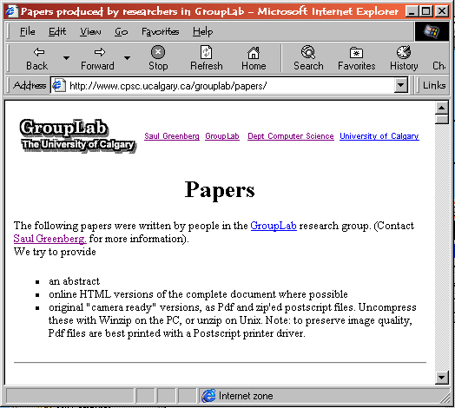
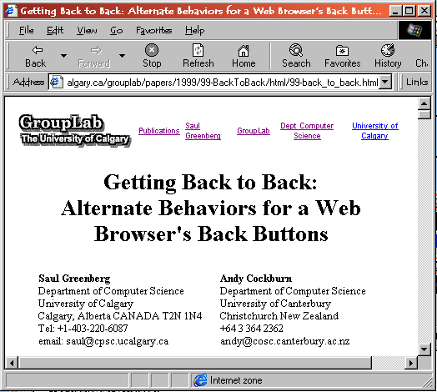
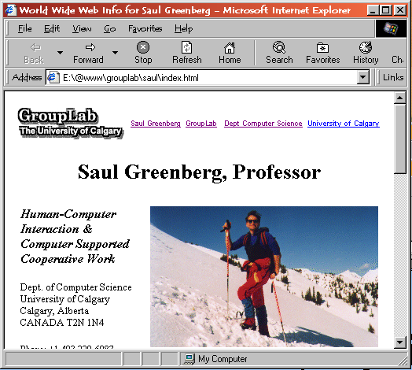
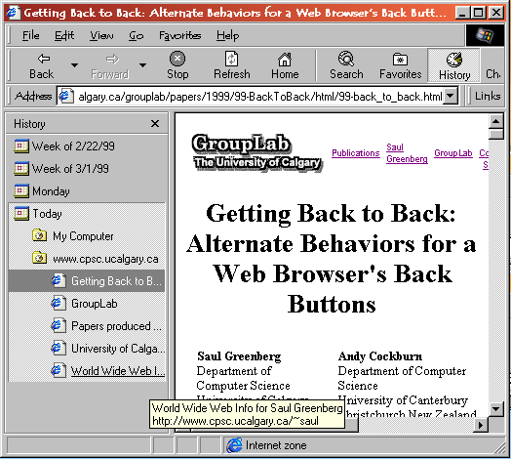
Why Back is Good
Recency
Visual economy
Recognition vs
decision making
  titles
    missing
    inconsistent
    wrong
    no context

Slide 14
Why Back is Good
Recency
Visual economy
Recognition
Robust use with
naïve models
    A test with a biased sample…
    Cockburn & Jones

Slide 15
Research Agenda
Can ‘Back’ have “better” behavior?
  stack
  recency
    adding spokes
    hub and spoke
    temporal re-ordering

Slide 16
Stack
animals
animals
Push
animals
mammals
land
feline
ungulate
cat
User navigates to ‘cats’

Slide 17
Stack
animals
mammals
animals
Push
mammal
mammals
land
feline
ungulate
cat
User navigates to ‘cats’

Slide 18
Stack
animals
land mammals
animals
Push
land
mammals
land
feline
ungulate
cat
User navigates to ‘cats’

Slide 19
Stack
animals
feline
land mammals
animals
Push
feline
mammals
land
feline
ungulate
cat
User navigates to ‘cats’

Slide 20

Stack
animals
cat
feline
land mammals
animals
Push
cat
mammals
land
feline
ungulate
cat
User navigates to ‘cats’

Slide 21
Stack
animals
cat
feline
land mammals
animals
Move
pointer
mammals
land
feline
ungulate
cat
User clicks back twice

Slide 22
Stack
animals
cat
feline
land mammals
animals
Move
pointer
mammals
land
feline
ungulate
cat
User clicks back twice

Slide 23
Stack
animals
cat
feline
land mammals
animals
Pop
mammals
land
feline
ungulate
cat
User selects ungulate.
cat & feline popped off stack

Slide 24
Stack
animals
ungulate
land mammals
animals
Push
ungulate
mammals
land
feline
ungulate
cat
..and ungulate pushed onto it

Slide 25
Stack
  automatically prunes branches
  popped pages cannot be returned to via Back
  model poorly communicated
    surprises
    but people can deal with it

Slide 26
Recency: Adding spokes
  Add all non-Back pages seen to a
  recency-ordered history list
  Back:
    just move a pointer through list

Slide 27
Recency: Adding spokes
...
land
...
add ...
land
feline
cat
cougar
lion
tiger
  → land → feline→ cat

Slide 28
Recency: Adding spokes
...
feline
land
...
add ...
land
feline
cat
cougar
lion
tiger
  → land → feline→ cat

Slide 29
Recency: Adding spokes
...
cat
feline
land
...
add ...
land
feline
cat
cougar
lion
tiger
  → land → feline→ cat

Slide 30
Recency: Adding spokes
...
cat
feline
land
...
land
move
pointer
feline
cat
cougar
lion
tiger
  cat⇐ feline → cougar

Slide 31
Recency: Adding spokes
...
cougar
cat
feline
land
...
add cougar
land
feline
cat
cougar
lion
tiger
  cat⇐ feline → cougar

Slide 32
Recency: Adding spokes
...
cougar
cat
feline
land
...
land
move
pointer
feline
cat
cougar
lion
tiger
  cougar⇐ cat⇐ feline → lion

Slide 33
Recency: Adding spokes
...
cougar
cat
feline
land
...
land
feline
move
pointer
cat
cougar
lion
tiger
  cougar⇐ cat⇐ feline → lion

Slide 34
Recency: Adding spokes
...
lion
cougar
cat
feline
land
...
add lion
land
feline
cat
cougar
lion
tiger
  cougar⇐ cat⇐ feline → lion

Slide 35
Recency: Adding spokes
...
lion
cougar
cat
feline
land
...
land
move
pointer
feline
cat
cougar
lion
tiger
  lion⇐ cougar⇐ cat⇐ feline → tiger

Slide 36
Recency: Adding spokes
...
lion
cougar
cat
feline
land
...
land
feline
move
pointer
cat
cougar
lion
tiger
  lion⇐ cougar⇐ cat⇐ feline → tiger

Slide 37
Recency: Adding spokes
...
lion
cougar
cat
feline
land
...
land
feline
cat
cougar
lion
tiger
move
pointer
  lion⇐ cougar⇐ cat⇐ feline → tiger

Slide 38
Recency: Adding spokes
...
tiger
lion
cougar
cat
feline
land
...
add tiger
land
feline
cat
cougar
lion
tiger
  lion⇐ cougar⇐ cat⇐ feline → tiger

Slide 39
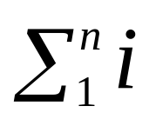
Recency: Adding spokes
  history list is complete
  all pages are reachable
  hub and spoke navigation much more work than stack
    vs. 2n - 1

Slide 40
Recency: Hub and Spoke
As before, but
  add non-Back URLs and its parent hub
feline
cat
cougar
lion
tiger

Slide 41
Recency: Hub and Spoke
...
cat
feline
land
...
add
in order
land
feline
cat
cougar
lion
tiger
  navigate
  ... → land → feline→ cat

Slide 42
Recency: Hub and Spoke
...
cat
feline
land
...
land
move
pointer
feline
cat
cougar
lion
tiger
  cat ⇐ feline → cougar

Slide 43
Recency: Hub and Spoke
...
cougar
feline
cat
feline
land
...
add feline, cougar
land
feline
cat
cougar
lion
tiger
  cat ⇐ feline → cougar

Slide 44
Recency: Hub and Spoke
...
cougar
feline
cat
land
...
add feline, cougar
land
feline
cat
cougar
lion
tiger
  cat ⇐ feline → cougar

Slide 45
Recency: Hub and Spoke
...
cougar
feline
cat
land
...
land
move
pointer
feline
cat
cougar
lion
tiger
  cougar ⇐ feline → lion

Slide 46
Recency: Hub and Spoke
...
lion
feline
cougar
feline
cat
land
...
add feline, lion
land
feline
cat
cougar
lion
tiger
  cougar ⇐ feline → lion

Slide 47
Recency: Hub and Spoke
...
lion
feline
cougar
cat
land
...
add feline, lion
land
feline
cat
cougar
lion
tiger
  cougar ⇐ feline → lion

Slide 48
Recency: Hub and Spoke
...
tiger
feline
lion
cougar
cat
land
...
land
move
pointer
feline
cat
cougar
lion
tiger
  lion ⇐ feline → tiger

Slide 49
Recency: Hub and Spoke
...
tiger
feline
lion
cougar
cat
land
...
add feline, tiger
land
feline
cat
cougar
lion
tiger
  lion ⇐ feline → tiger

Slide 50
Recency: Hub and Spoke
  all pages reachable
  improved efficiency for hub & spoke browsing
    same as stack
  temporal order not maintained
    a→b→c→d→e⇐d⇐c→i {a,b,e,d,c,i} order seen
    {a,b,d,e,c,i} history list

Slide 51
Recency: Temporal Re-ordering
  Back + forward -> add to 2nd history list
  on new navigation
    add pages on 2nd history list
    add new page

Slide 52
Recency: Temporal Re-ordering
mammals
cat
feline
land
mammals
...
add
in order
land
feline
cat
  mammals → land →
  feline→ cat

Slide 53
Recency: Temporal Re-ordering
mammals
cat
feline
land
mammals
...
feline
add
land
feline
ungulate
cat
  cat ⇐ feline ⇐ land → ungulates

Slide 54
Recency: Temporal Re-ordering
mammals
cat
feline
land
mammals
...
land
feline
add
land
feline
ungulate
cat
  cat ⇐ feline ⇐ land → ungulates

Slide 55
Recency: Temporal Re-ordering
mammals
land
feline
cat
feline
land
mammals
land
feline
add
land
feline
ungulate
cat
  land → ungulates

Slide 56
Recency: Temporal Re-ordering
mammals
ungulates
land
feline
cat
mammals
add ungulates
land
feline
ungulate
cat
  land → ungulates

Slide 57
Recency: Temporal Re-ordering
mammals
ungulates
land
feline
cat
mammals
ungulates
land
mammals
land
feline
ungulate
cat
  recency
  stack

Slide 58
Recency: Temporal Re-ordering
  all pages reachable
  hub and spoke efficiency same as stack
  retains ‘correct’ order of pages on list
  navigating further up the tree goes through intervening children

Slide 59
Beyond Back
40%
new
Distant items?
60%
revisits
17%
far
43%
10
39%
6

Slide 60

Beyond Back
Can we integrate...
  Back
    stack
    recency
  History list
  Local search
  Bookmarks/Favorites
    readwear
    dogears
  Shaun
  Kaasten

Slide 61
Summary
Minor improvements to Back worth it
No clear answer yet
  needs user testing
Further design innovations possible
  integrated revisitation facility

Slide 62
For further information...
www.cpsc.ucalgary.ca/grouplab/papers/
  Getting Back to Back
  Beyond the Back button
  How People Revisit Web Pages
    Cockburn, Greenberg, Tauscher

