Slide 1
The Usability of
Transparent Overview Layers
Donald Cox
Jasdeep Chugh
Carl Gutwin
Saul Greenberg
University of Calgary
Canada
Notes:
Test

Slide 2
Outline
Motivation
Transparent overviews
What we did
What we learned

Slide 3
Large Work Surfaces
mm 1234
mm 1234
mm 1234
mm 1234
mm 1234
mm 1234
mm 1234
mm 1234
mm 1234
mm 1234
mm 1234
mm 1234
mm 1234
mm 1234
mm 1234
mm 1234
mm 1234
mm 1234
mm 1234
mm 1234
mm 1234
mm 1234
mm 1234
mm 1234

Slide 4
Overviews
mm 1234
mm 1234
mm 1234
mm 1234
mm 1234
mm 1234
mm 1234
mm 1234
mm 1234
mm 1234
mm 1234
mm 1234
mm 1234
mm 1234
mm 1234
mm 1234
mm 1234
mm 1234
mm 1234
mm 1234
mm 1234
mm 1234
mm 1234
mm 1234

Slide 5
Detail Views (Zooming)
P 3245
P 3255
P 3260
AF 3265
AF 3270

Slide 6
Radar Overviews
mm 1234
mm 1234
mm 1234
mm 1234
mm 1234
mm 1234
mm 1234
mm 1234
mm 1234
mm 1234
mm 1234
mm 1234
mm 1234
mm 1234
mm 1234
mm 1234
mm 1234
mm 1234
mm 1234
mm 1234
mm 1234
mm 1234
mm 1234
mm 1234
P 3245
P 3255
P 3260
AF 3265
AF 3270

Slide 7
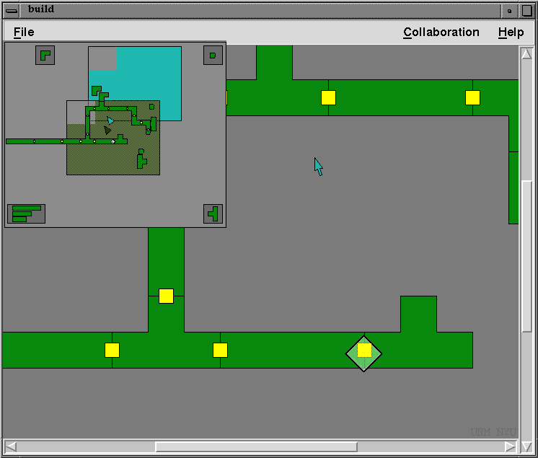

Slide 8
Transparent Overviews
P 3245
P 3255
P 3260
AF 3265
AF 3270

Slide 9
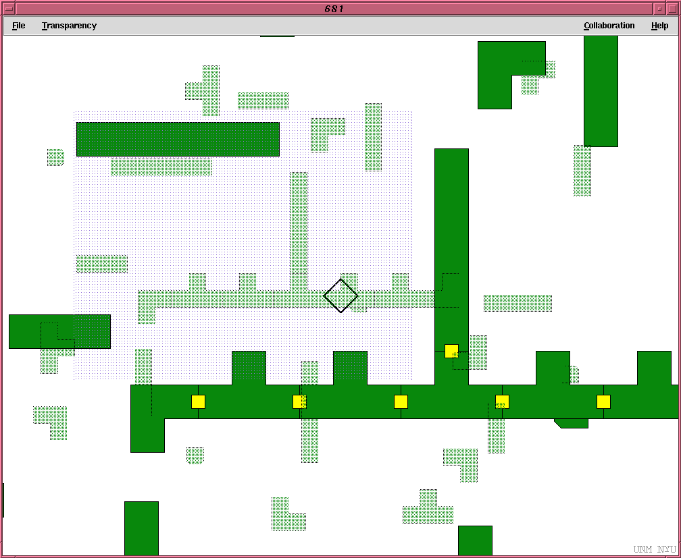
Transparent Overviews
radar
miniature in
overview
detail in
viewport

Slide 10
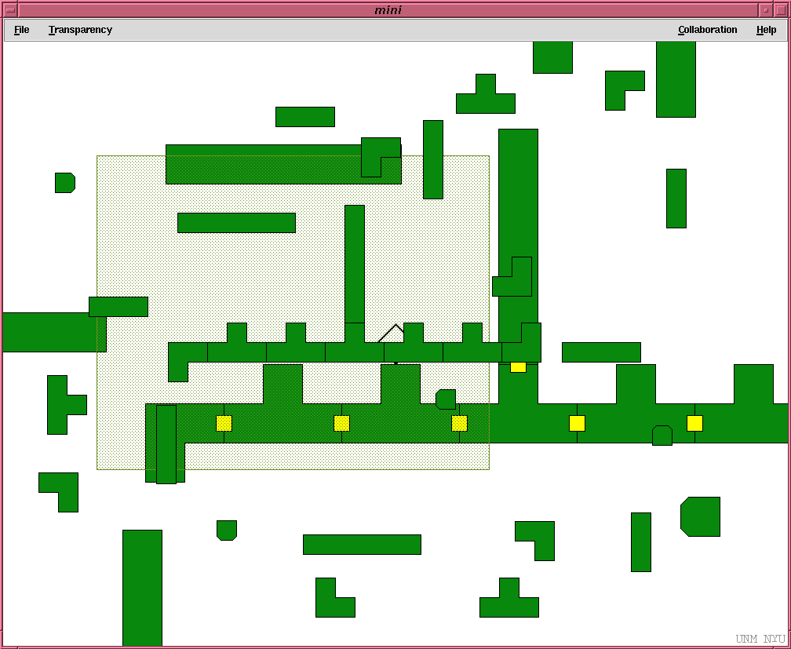
0%

Slide 11
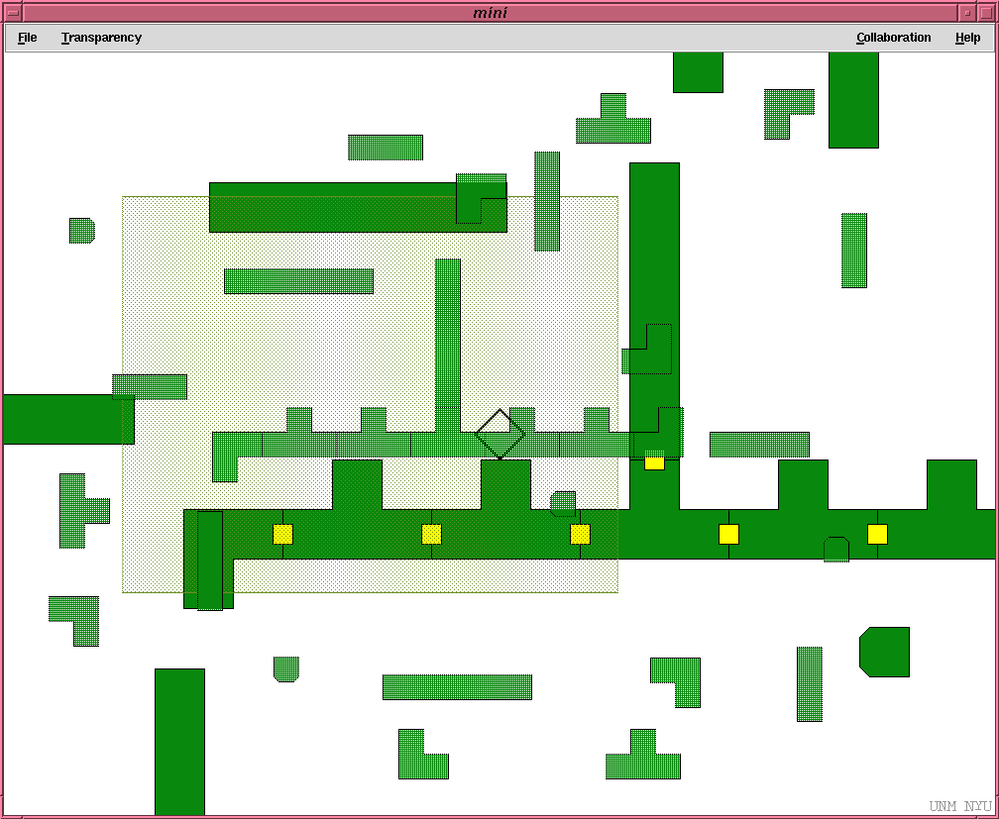
30%

Slide 12
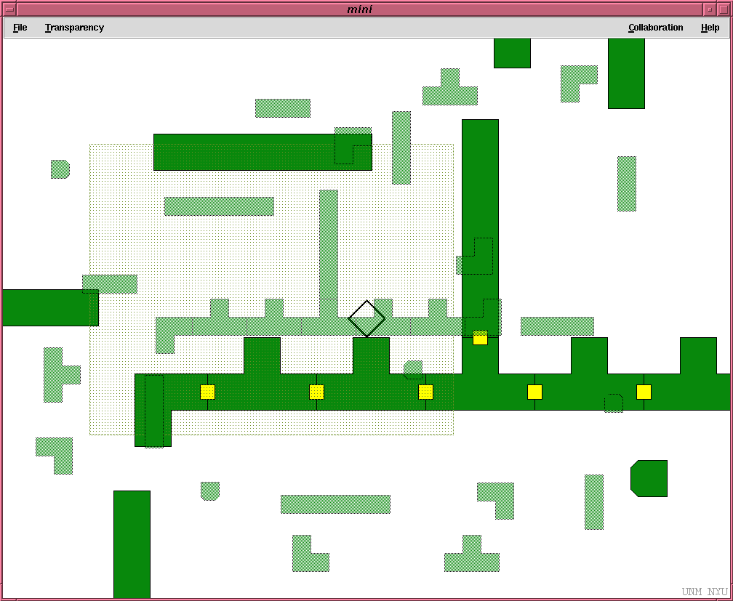
50%

Slide 13
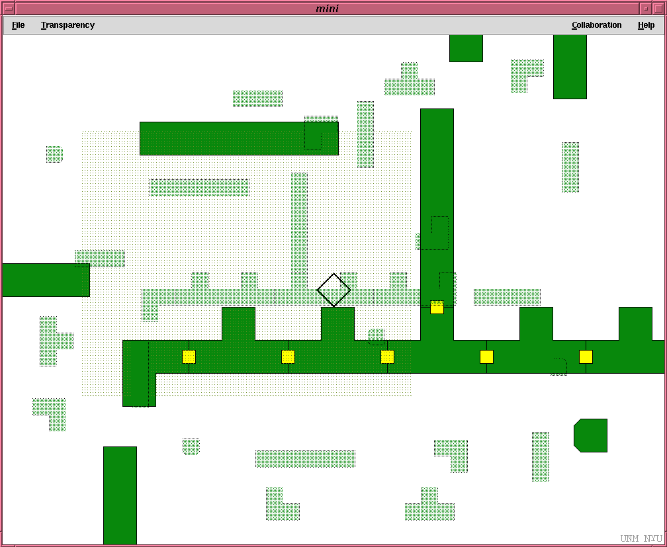
70%

Slide 14

100%

Slide 15

Schematic

Slide 16
An Exploratory Study

Slide 17
Results
Patterns of behaviour
  Overview focus
  Viewport focus
  Switching
    An unexpected problem - incompatible joins

Slide 18
Incompatible Joins
  Quickly repaired
  Caused by forgetting where they are attending
  Users did not mention this as a problem

Slide 19
Conclusion
Transparent overviews proved workable
People exploited both layers appropriately and naturally
50-75% transparency is a good recommendation
But this is just initial work...

Slide 20
Unused slides after here

Slide 21
The Message
People can use transparent overviews to see and manipulate objects within a large visual workspace

Slide 22
The Message
Issues of representation are key to making usable transparent overviews.

Slide 23
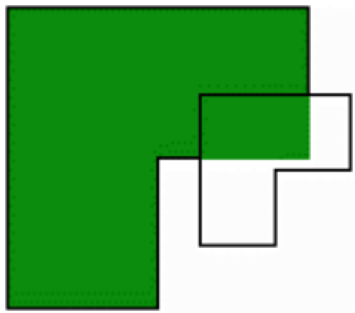

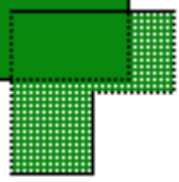

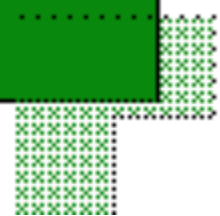


Exploratory Study
Can set different transparency representations
0%
30%
50%
Full
size
70%
100%
schematic

Slide 24
Preferences
Rank-order
  fully transparent view
  70% and 50% transparency
  the rest received low ratings

Slide 25
How Do People Use Them?

Slide 26
The Testbed System
Can set different transparency representations
schem-atic
50%
50%
30%
30%
100%
70%
0%
0%
70%
100%
schematic

Slide 27
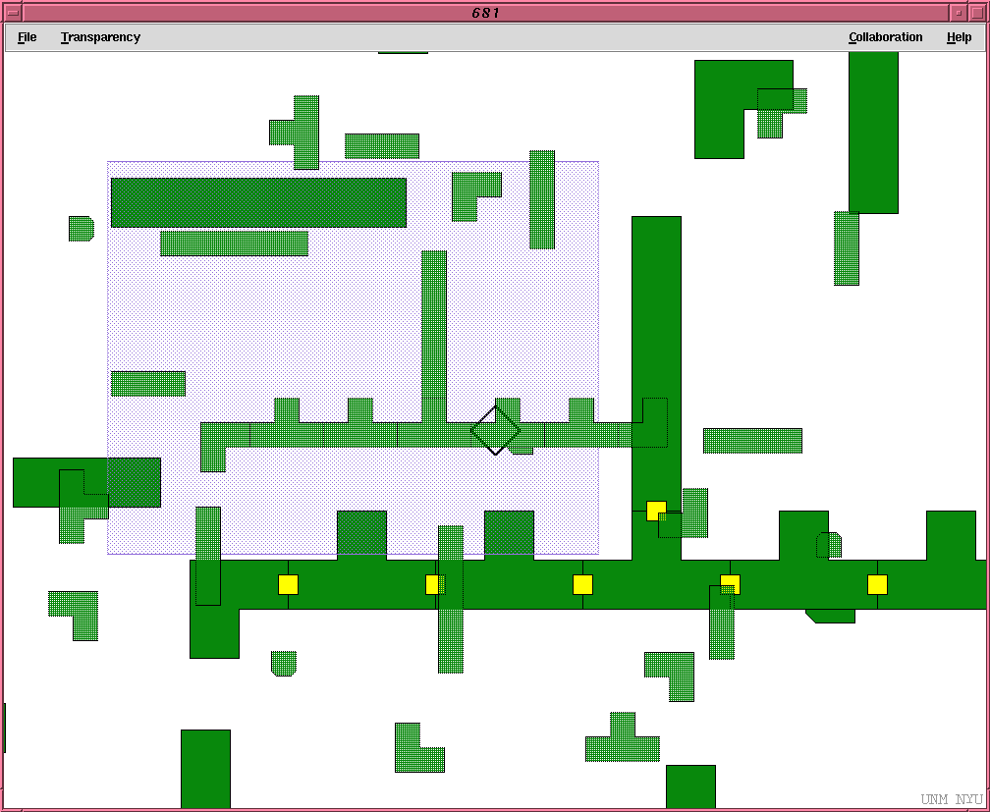
Example
70%
30%

Slide 28
The Testbed System
Pipeline construction system (Use TO image)
  Overview on top, viewport underneath
  Six kinds of pieces
  manipulate in either layer
  weld only in viewport
  workspace is fixed size 4times area of viewport

Slide 29
Transparent Overviews
Advantage
  overview the largest size possible
Problems
  interference between two layers

Slide 30
Experimental Setup (video)
  Six different conditions (Use “animation”)
  All necessary pieces randomly arranged in workspace
  Construct a layout according to provided diagram

Slide 31
Unexpected Problems
Incompatible joins:
  definition
  examples (video)
Why?
  Forgetting - a slip
  Unnatural duality
  Affected by representation

Slide 32
Transparent Overviews
P 3245
P 3255
P 3260
AF 3265
AF 3270

Slide 33
My view (dac)
The original point of the study was about finding the best representation for the transparent overview.
Based on Harrison’s work, I thought that was was important was some notion of contrast.
Thus, there is this trade-off between salient/visibility, contrast, and pixel count
My thought was that a schematic representation would have the same pixel count as as a transparent one, but would have more contrast and hence prove better.
As it turned out, this was not the case because it was hard to manipulate the schematics as I implemented them.
The “best” implementation turned out to be the 50-70% transparent by combination of measures.
What little statistics we do have are based on only 5 participants
That bit about my brother not being impressed by out result
Display versus manipulation
Wonder about (real) tasks and the need for rapid switching
The mismatched join thing is psychologically interesting - even I did it. Something about being in two different places that are the same.
Nifty lead in about compensating for increase in computational power but lagging display capabilities.

