Slide 1
This slide deck does not include videos shown during the presentation
From
Technically Possible to Socially Natural Groupware
Saul Greenberg
University of Calgary
Canada

Slide 2
Socially Natural Groupware
Tight coupling
Loose coupling
Casual
Interaction
Seamless transitions
Real time groupware must be designed around human factors before it can become a socially natural setting for learning, work, and play.
Real time groupware must be designed around human factors before it can become a socially natural setting for learning, work, and play.
Communication
Shared Artifacts
Technically Possible Groupware

Slide 3
Focus: A Shared Groupware Workspace
Tabletops, whiteboards, shared visual areas, games...

Slide 4
Technically Possible Groupware
makes discourse possible
Communication
Technically Possible Groupware

Slide 5
Technically Possible Groupware
makes collaboration possible
makes discourse possible
Communication
Shared Artifacts
Technically Possible Groupware

Slide 6


Technically Possible Groupware
Saul: What about his one? Is this large enough?
Judy: I suppose so...
Saul: What about his one? Is this large enough?
Judy: I suppose so...

Slide 7
The Problem
Early systems awkward compared to physical counterparts
How do we design natural groupware to support what people really do?

Slide 8
Socially Natural Groupware
Tight coupling
support intense collaborations
Communication
Shared Artifacts
makes collaboration possible
makes discourse possible
Technically Possible Groupware

Slide 9
Human Factors of Tight Coupling
Common view
Gestural expression
Express ideas
Simultaneous activity
People coordinate themselves
John Tang, Stanford

Slide 10
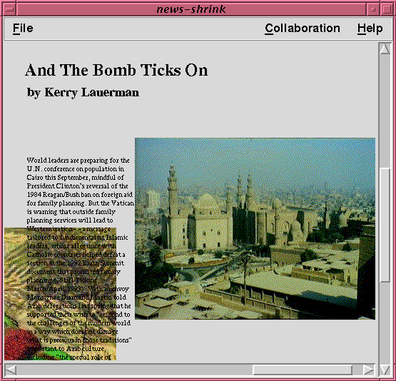
System Design
Explicit identical views
Immediate visible changes
Telepointers
Simultaneous
activity
Social protocols

Slide 11
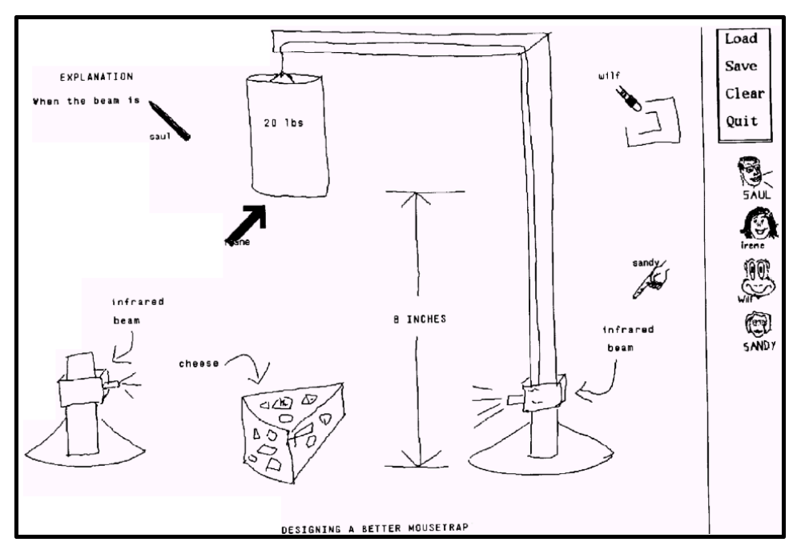
Video: GroupSketch, 1989

Slide 12
Another Problem
People move between tightly and loosely coupled activities
  group and individual aspects to work
Current systems did not support individual actions

Slide 13
Socially Natural Groupware
Tight coupling
Loose coupling
Support workspace awareness
support intense collaboration
makes collaboration and discourse possible
Communication
Shared Artifacts
Technically Possible Groupware

Slide 14
Human Factors of Loose Coupling
Peripheral vision
Glances
Seeing the big picture
Verbal shadowing
Who?
What?
Where?
When?
How?
Workspace Awareness
  up-to-the-moment knowledge about others’ interaction with a shared workspace

Slide 15
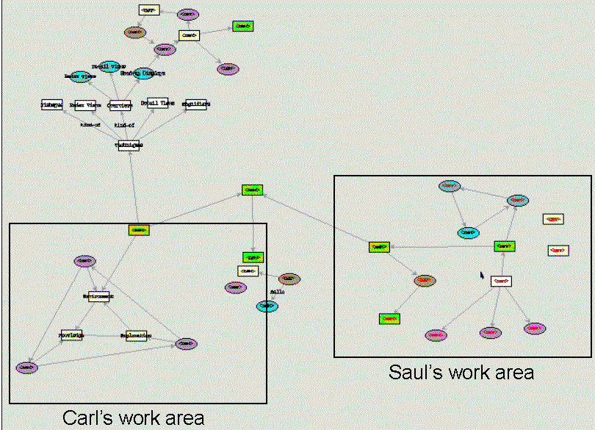
Loose Coupling in Groupware

Slide 16
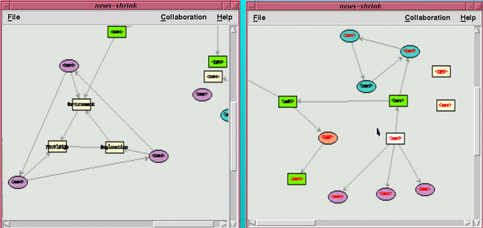
Loose Coupling in Groupware
Awareness lost
  no visible frame of reference
  verbal shadowing out of context
  gestures invisible
  no big picture

Slide 17
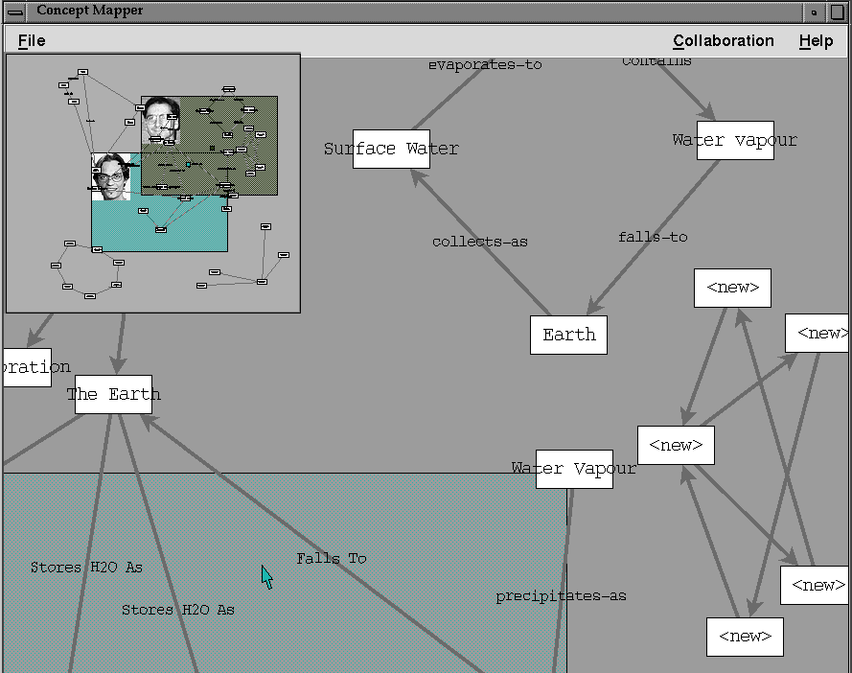
One Solution: Radar Overviews
Provides
identity
location
actions
gestures

Slide 18
Do Overviews work?
Information present
  who is participating
  where they are
  what they are doing
But
  real estate
Research question
  Can we merge overview
  and main view into a
  single window?

Slide 19
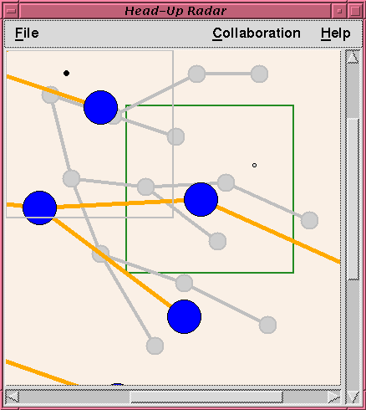
Transparent Layers
Main view
in foreground
Overview
in background

Slide 20
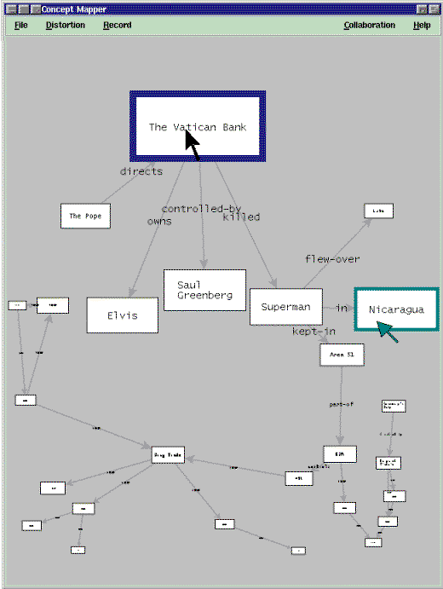
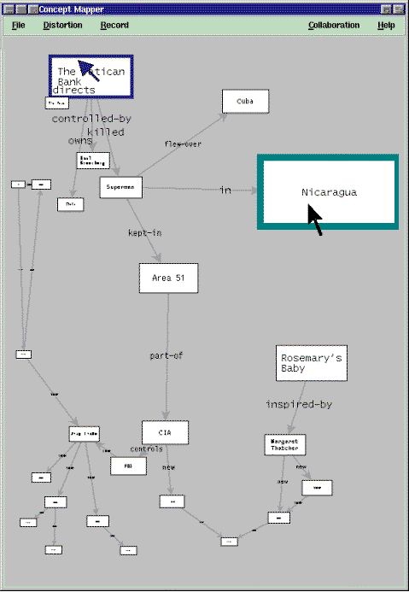

Slide 21
Yet Another Problem
Groupware can only work after people make contact with each other
?

Slide 22
Socially Natural Groupware
Tight Coupling
Loose Coupling
Casual
Interaction
Support the way people contact one another
support workspace awareness
support intense collaborations
makes collaboration and discourse possible
Communication
Shared Artifacts
Technically Possible Groupware

Slide 23
Human Factors: Awareness and Casual Interaction
Questions
  who is around?
  are they available now?
  can they be interrupted?
  how can I initiate contact?
BellCore

Slide 24
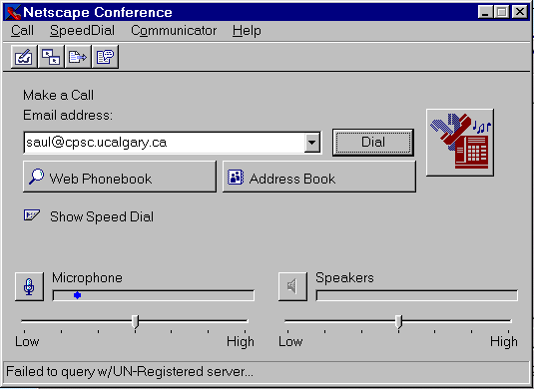
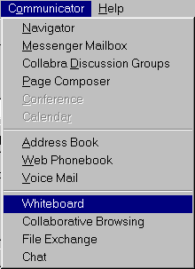
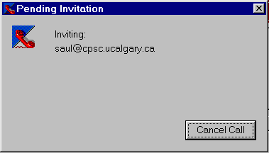
Groupware Tag & Connection Difficulty
how do I get in touch with them?
is the person there?
start a communication channel
start 1 or more groupware applications
load information...
Time

Slide 25
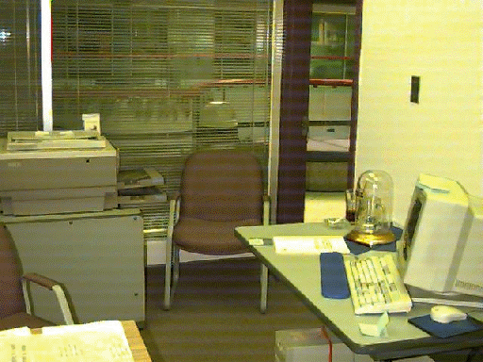
Current Approaches

Slide 26
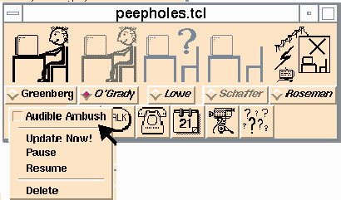
Iconic Indicators

Slide 27
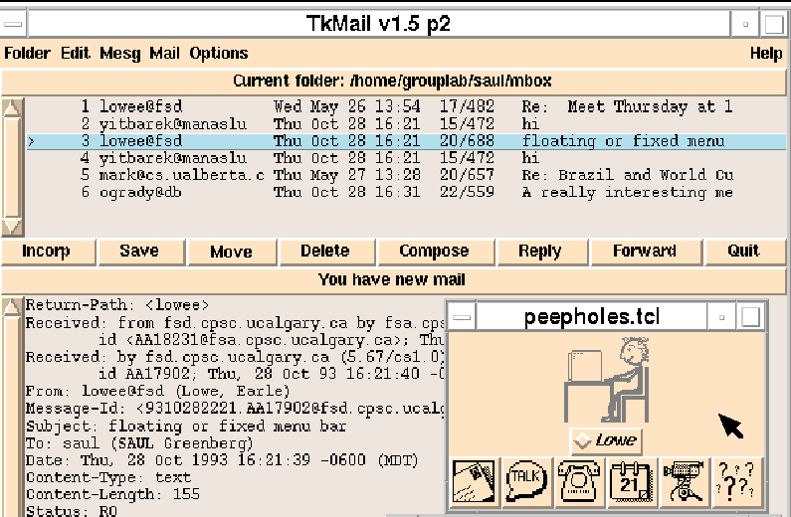
Iconic Indicators

Slide 28
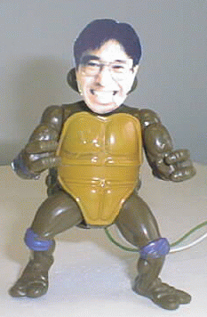
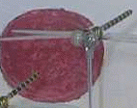
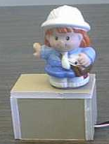
Digital but also Physical Surrogates
Kuzuoka and Greenberg

Slide 29
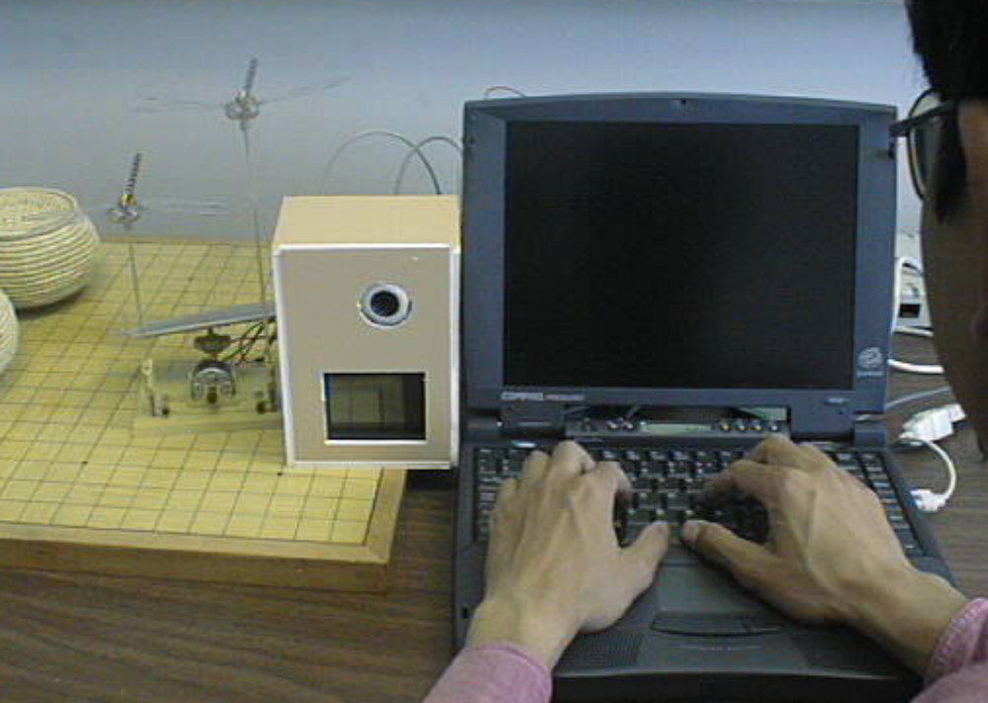
Digital but also Physical Surrogates

Slide 30
Even More Problems
Gaps in groupware
  difficult for people to move between different styles of work
Asynchronous to synchronous work
Single user and multi-user work
Casual interaction to work
gap
gap
gap

Slide 31
Socially Natural Groupware
Tight Coupling
Loose Coupling
Casual
Interaction
Seamless transitions
Provide an integrated environment
support the way people contact one another
support workspace awareness
support intense collaborations
makes collaboration and discourse possible
Communication
Shared Artifacts
Technically Possible Groupware

Slide 32
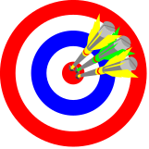


Team Rooms: An Integrated Environment
Physical team rooms
  naturally supports seamless interactions
  a place for
    individual and group work
    face to face meetings
    leaving reminders, notes, work artifacts
    casual meetings and activities
Research ideas
rooms metaphor
meeting room tool?
multiple input devices

Slide 33
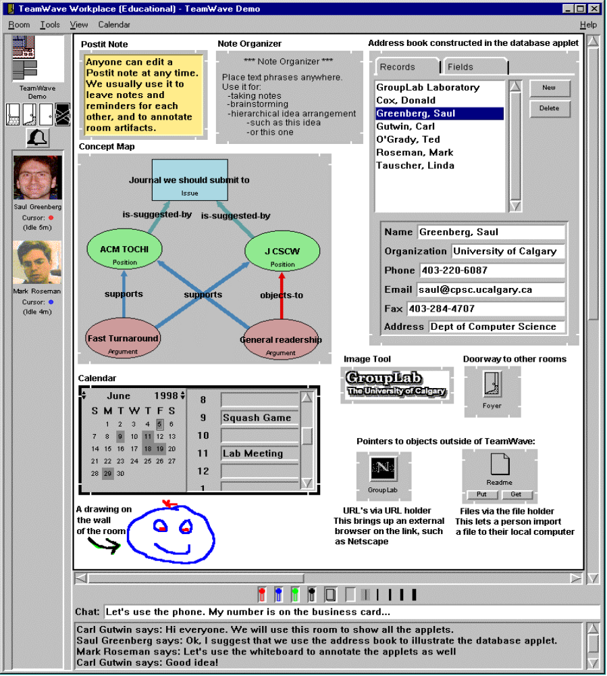
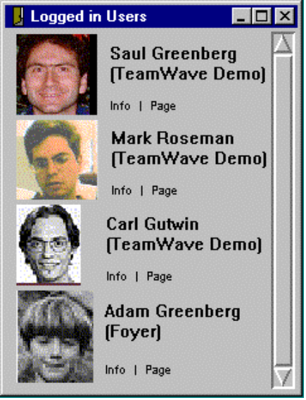
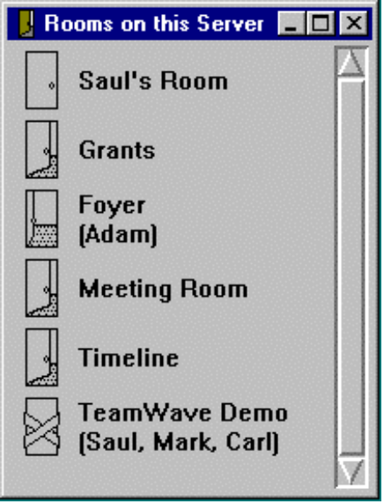

Slide 34
Supporting Single and Multi-User Work
single-user
multi-user
individual work has properties
of group behaviour

Slide 35


Supporting Single and Multi-User Work
Individuals have two roles
  personal worker role
    carry out activities
  personal coordination role
    manage and schedule activities with future self
    to do lists, reminders, scheduling…

Slide 36
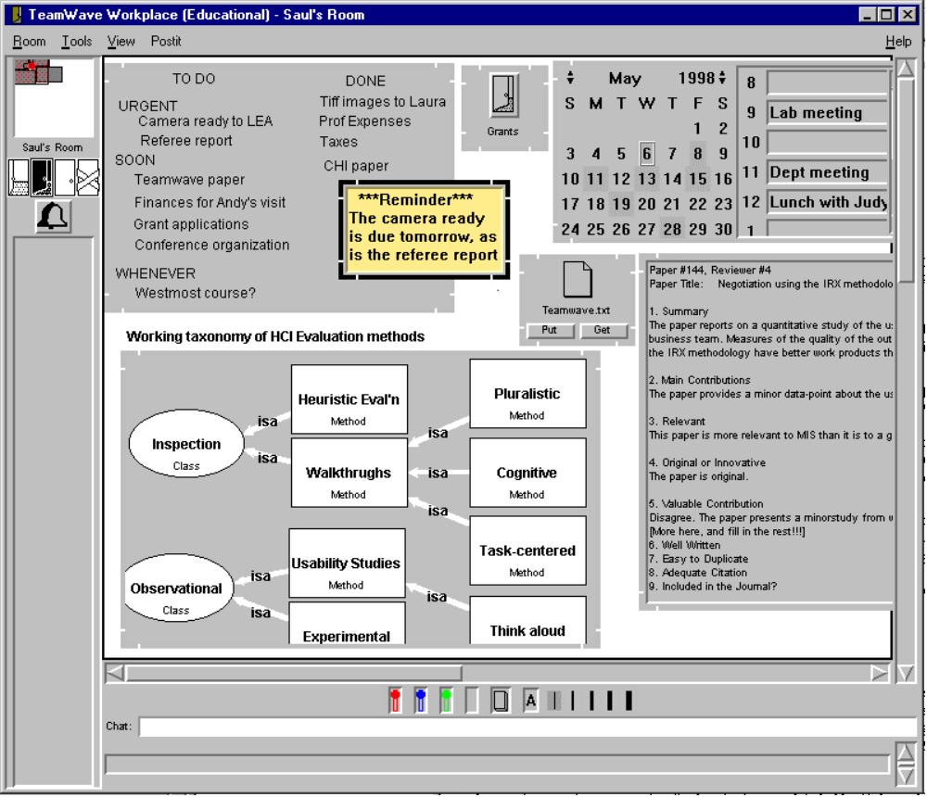
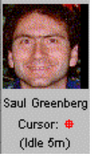
A room for
individual
work

Slide 37
Supporting Asynchronous and Synchronous Work
One environment
  where tools work both synchronously and asynchronously

Slide 38
Supporting Asynchronous and Synchronous Work
Asynchronous
  items can be left in a room for others
    work artifacts
    coordination and management artifacts
Synchronous
  team members in the same room are
  automatically working together

Slide 39
Example: A Formal Meeting
Pre-meeting
During meeting

Slide 40
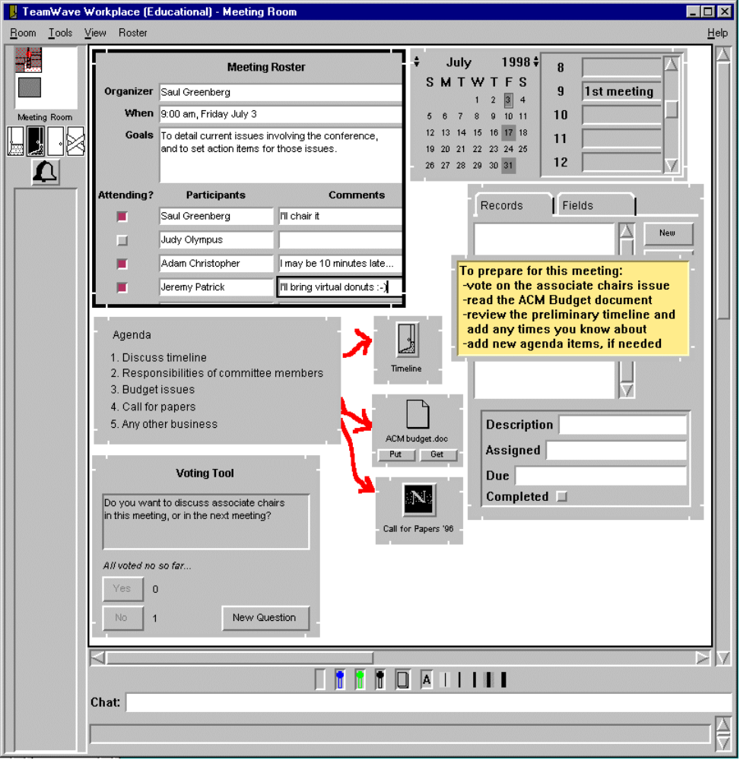
Pre-
meeting

Slide 41
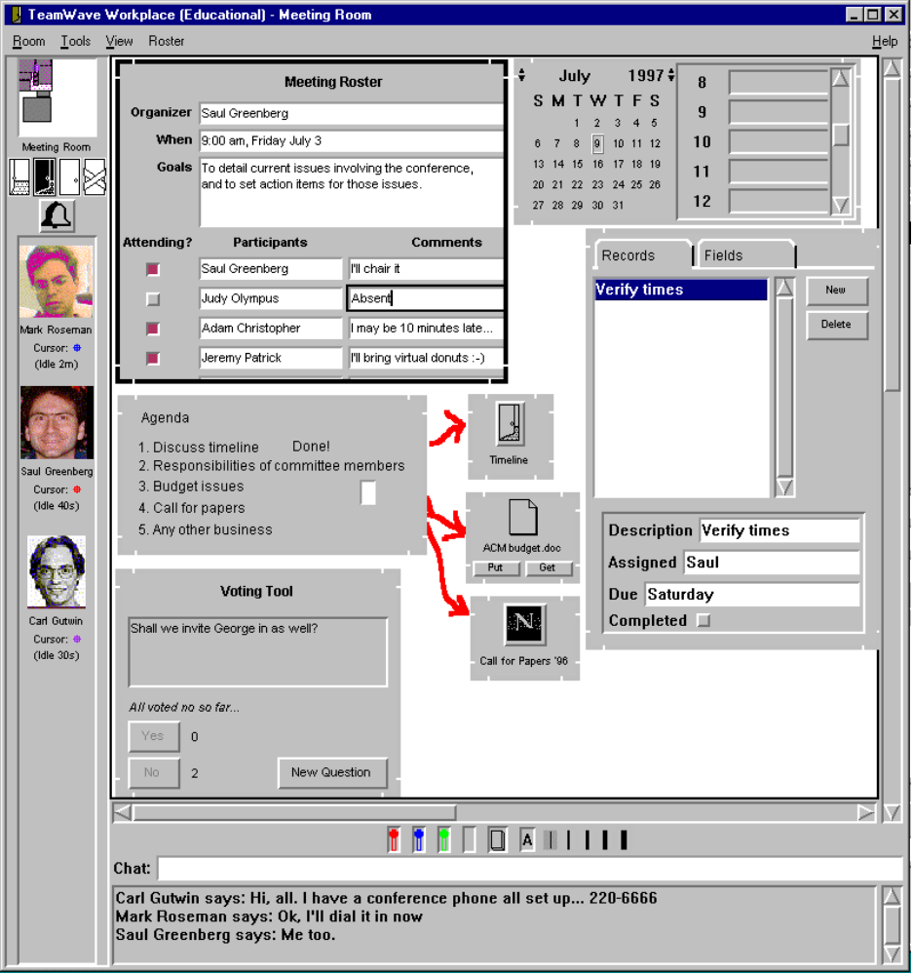
During-
meeting

Slide 42

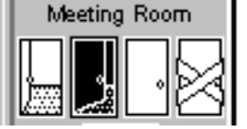
Supporting Transition from Awareness to Work
Who’s around?
What room are they in?

Slide 43
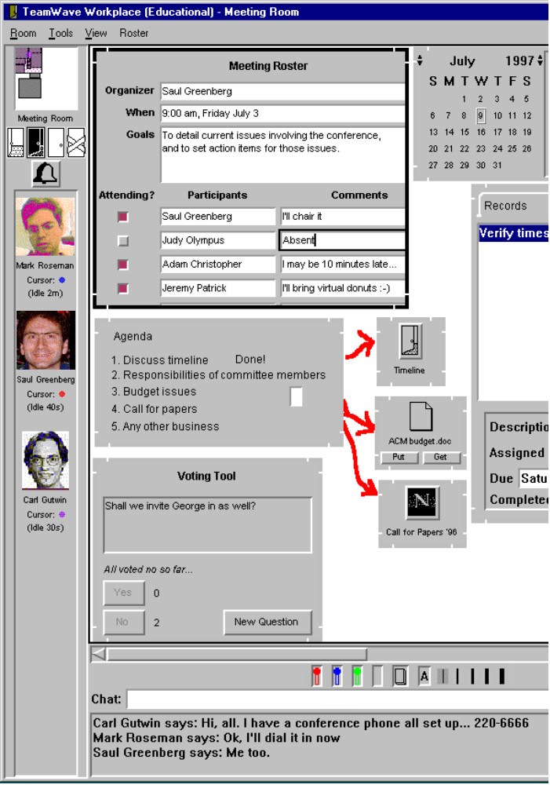
Supporting Transition from Awareness to Work
Can I start working with them?
(Example)

Slide 44
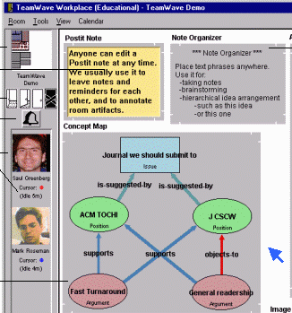
Technically Possible Groupware
Socially Natural Groupware
Saul: What about his one? Is this large enough?
Judy: I suppose so...
Saul: What about his one? Is this large enough?
Judy: I suppose so...

Slide 45
Socially Natural Groupware
Tight coupling
Loose coupling
Casual
Interaction
Seamless transitions
Real time groupware must be designed around human factors before it can become a socially natural setting for learning, work, and play.
Real time groupware must be designed around human factors before it can become a socially natural setting for learning, work, and play.
Communication
Shared Artifacts
Technically Possible Groupware

Slide 46
Further Information
Grouplab:
  http://www.cpsc.ucalgary.ca/grouplab
Publications
  http://www.cpsc.ucalgary.ca/grouplab/papers

