Slide 1
Using a Groupware Space for
Requirements Engineering
Daniela Herlea & Saul Greenberg
University of Calgary
Notes:
Nowadays, as there is an increasing need to support the development of software projects in a distributed setting, in which the customers and developers of the software find themselves in environments that cross organizational and national boundaries, we argue that requirements engineering processes should be supported at distance also. Moreover, we argue that distributed groupware environments that support a cooperative requirements engineering process should be in place so that the stakeholders can negotiate the requirements of the software to be developed.

Slide 2
Outline
Requirements negotiation as a cooperative process
how groupware fits into req. neg.
Teamwave overview
customizing teamwave to requirements
Notes:
Our paper considers ways that groupware can support how a distributed team gathers requirements through a negotiation process.
The talk will present our view on the requirements negotiation process and describe features of groupware systems that are relevant to such a process.
A short video will introduce a particular groupware called TeamWave that has been developed at the Univ. of Calgary, and that meets these design factors.
Then the system is presented as an enabling technology for the req negotiaion. A scenario of use, a customization of TeamWave to the req neg process will be illustrated. And future work will be discussed.

Slide 3
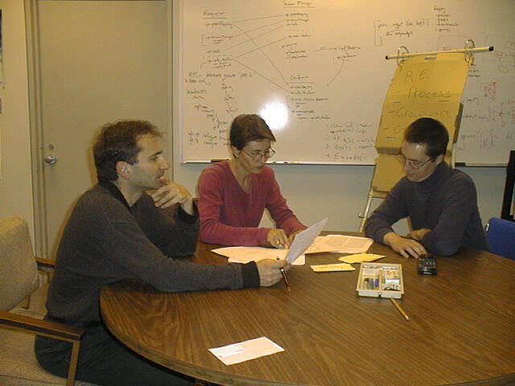
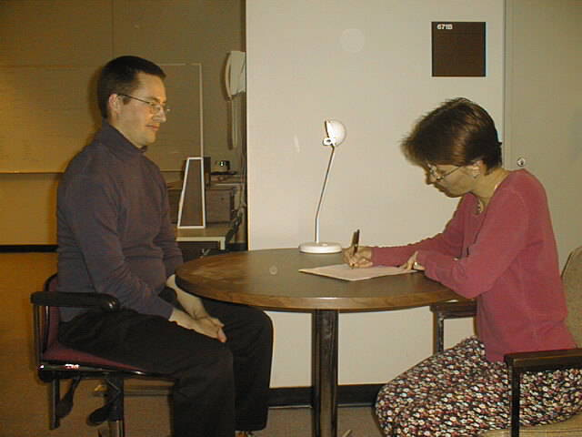
Requirements Negotiation
cooperative process
understanding each other’s views and perspectives
        vs.
Notes:
Our view on the Re process is that negotiation among stakeholders is involved at any stage of the process. Requirements are regarded as the result of a negotiation process that goes beyond the one way transfer of knowledge from the customer to the interviewer. It is actually a highly cooperative process, in which the communication among the participant is much more about developing an understanding of each other’s views and perspectives, about sharing knowledge and about learning as a result of shared experience.

Slide 4
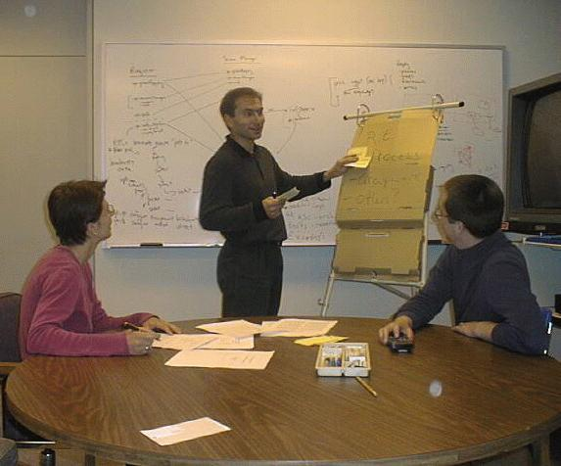
Characteristics of group session approaches*
rich communication medium
coordination and control of shared objects
sharing of workspace
organization of the work
process
decision making
facilitation
* Macaulay, L. “Cooperation, Requirements Analysis and CSCW”
Notes:
Group session approaches to the Requirements engineering process involve the right stakeholders meeting in the same room, eliciting, discussing, analyzing and negotiating requirements.
Macaulay describes a set of general characteristics of group session approaches and I would like to present them here as they represent a start in discussing groupware support for requirements negotiation.
So, group session approaches are characterized by a rich communication medium. A great deal can be achieved when members can see each other and are sensitive to one another’s behavior and reactions. This is very important for the facilitator who uses the visual cues to identify when a problem is developing.
Using the visual cues, members coordinate and control the shared objects and, helped by the facilitator, the group achieves a common understanding of the work process by agreeing on the roles of each individual, setting the agenda, the objectives, deadlines and so on.
Group meetings share the workspace. For example, whiteboards and flipcharts are used during meetings to write down ideas or draw diagrams that are visible to all the participants
Most of the group meetings are decision making meetings, concerning maybe the objectives of the common task of the group or other outcomes of the meeting.
And, as mentioned many times, the facilitator plays a key role in managing the group dynamics, in facilitating the communication during the meeting.

Slide 5
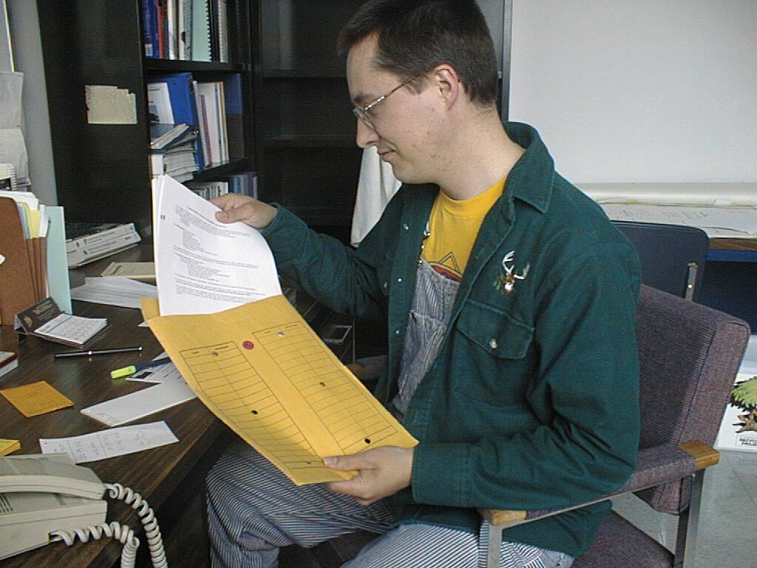
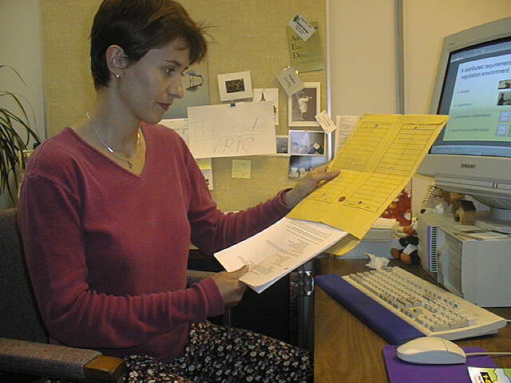
Distributed requirements negotiation
Notes:
However, this rich communication medium breaks down when stakeholders are separated by distance and communication channels include mainly regular mail, electronic mail and telephone. Therefore, we look at features of existing groupware that are relevant to the distributed req negotiation process.

Slide 6

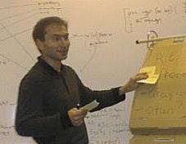
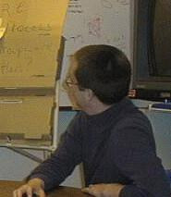
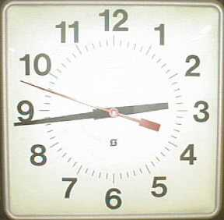
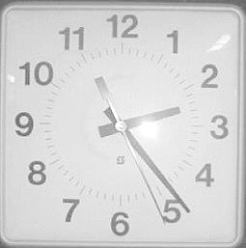
A distributed requirements negotiation environment
teledata
telepresence
synchronous collaboration
asynchronous collaboration
Notes:
While groupware for distributed collaboration is well studied in the area of CSCW and groupware systems have been developed to support different aspects of group session approaches, little attention has been given to and remarkably few studies research the distributed req negotiation process. However, a number of design factors are highly relevant to the req negotiation. They include support for teledata, telepresence, synchronous/asynchronous collaboration:
teledata: which is about bringing materials in the shared workspace, is important for the collaboration over the requirements representations such as diagrams or lists. The participants should be able to work collaboratively as they would do on a shared physical whiteboard, for example. It is also important for the creation, manipulation and coordination of shared objects, essential during discussions of req repr, in the shared workspace. Teledata must be provided to avoid the multiplication of materials, the team members being notified about any changes to the artifacts. Any groupware should prevent the drawing and redrawing of the same task hierarchy diagram, for example.
Telepresence: which is about providing the feeling of being in the same room, is essential in achieving a common understanding of the process, group dynamics, to enrich the communication medium, for the coordination of shared objects.
Synchronous collaboration is important in sharing the workspace and coordination of the shared objects. Any groupware should allow the partic. to access the meeting artifacts, the diagrams or any other shared objects in the meeting, in real time, as they would do in a physical meeting.
asynch collaboration: especially important for distance separated members, working across time zones; they can work individually and contribute to the group

Slide 7
TeamWave
room-based metaphor
supports group and individual work
synchronous/asynchronous collaboration
persistent environment
Notes:
We present TeamWave as an enabling technology for req negotiation process.
The system has been developed at the Univ of Calgary and it implements a room-based metaphor. It supports group and individual work as well, through its collaborative tools present in any room of the system.
The participants can connect to the system and work in a synchronous manner, when telepresence is supported by multiple telepointers visible in the shared workspace, the participants being able to collaboratively manipulate the shared objects in a room, or work in a asynchronous manner, connecting to the system at their choice.
The system provides a fully persistent environment in which not only the content of a room persists, but also versions of rooms and their objects can be retrieved at any time.
The next short video will step you through the features of this system. It has been realized at the Univ of Calgary by its developers.
Show video here.

Slide 8
Customizing TeamWave to RE
creating a meeting space for the requirements process
expressing and negotiating multiple perspectives
    requirements acquisition
    requirements traceability
Notes:
So, it’s been argued that TeamWave can support collaborative activities of a distributed group.
The next part of my talk will describe how TW was customized to support the RE process, by creating a meeting space for the distributed team.The emphasis will be placed on the collaboration of stakeholders with different views and perspectives in the process, during the req acquisition and traceability, two activities identified as major problems in RE.

Slide 9
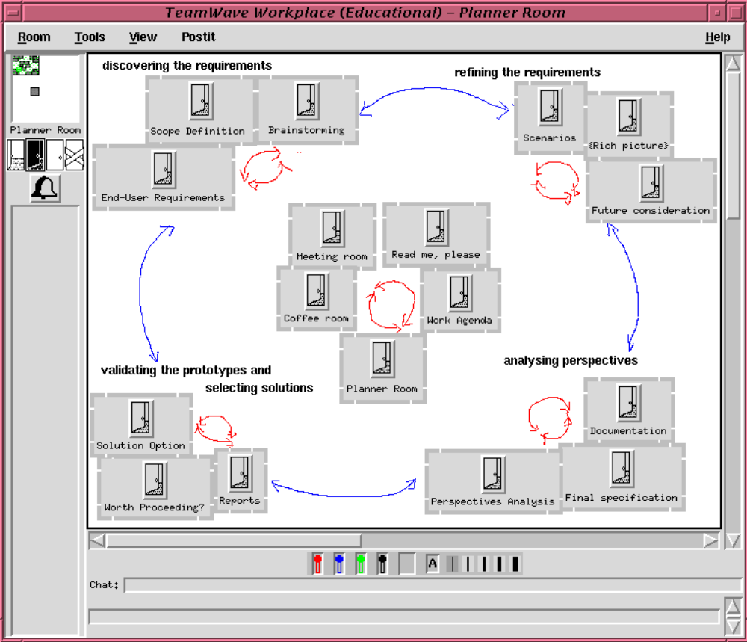
Notes:
The actual system will be shown here. These are slides showing which rooms will be shown, used as backups.
Unlike many other group decision support systems, the room metaphor in TW does not impose any direct support for meeting processes. It is rather the social interaction of the group that dictates what a room can be used for.
The scenario presented here portrays a requirements negotiation process for a library system.
For example, this is the Planner room which has been created to capture the major steps in the RE process. The diagram in the room indicates an iterative process, where the members step through the discovery, refinement of requirements, analysis of perspectives and the discussion of prototypes. What make this special however is that this diagram is actually a navigation space where each icon is a doorway into another room that in turn has been prepared to support a particular activity in the process. For example, our scenario used the Scope definition room during the expression of views over the concept of a book and we’ll go there right now.
Switch to the Scope Definition room by clicking on its icon.

Slide 10
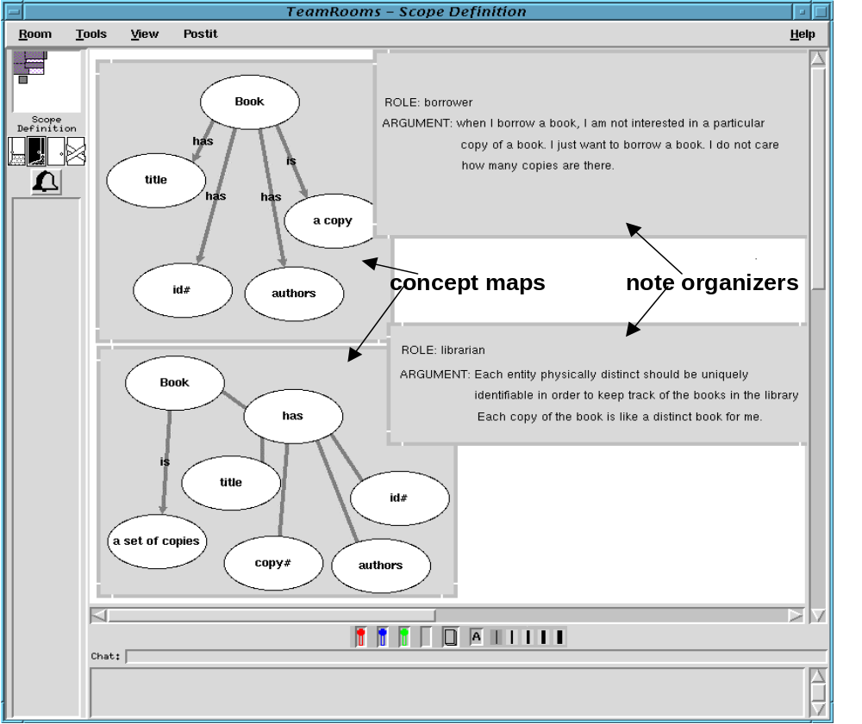
Notes:
In this room, the participants use the concept map tools to express their views on the book concept.
It is important to note that the req negotiation involves stakeholders with different views and expectations over the system to be developed. The identificaiton of these multiple approaches is a critical issue in Re because there are always problem owners, customers and actors and they have different ways they see the world. Understanding the issues for all these roles in the process is critical. People often formulate the problem wrongly or the wrong problem and then the whole process can only be incorrect.
The example of this room describe the real time interaction of participants during the expression of views, using teledata features in Teamwave.
We argue that any virtual environment that aims at supporting a distributed req negotiation should enable not only the description of several perspectives, as the partic. do here by the means of these annotated concept maps, but also to foster the development of mutually comprehensible requirements representation. In TeamWave, stakeholders create these representations in real time, synchronously, being helped by the telepointers in figuring out the other’s gestures in the shared workspace, but they can also simultaneously modify and discuss, negotiate around these representations. The expression of these views can be done in a asynchronous manner as well, as the artifacts are stored in the room, without any change.
The inhabitants of this room can go to the Planner room any time, by clicking on its icon (and click on the icon which is not present in this slide, but will be in the actual room in the system), and participate in the collaboration in other rooms. And switch to the planner room again.

Slide 11
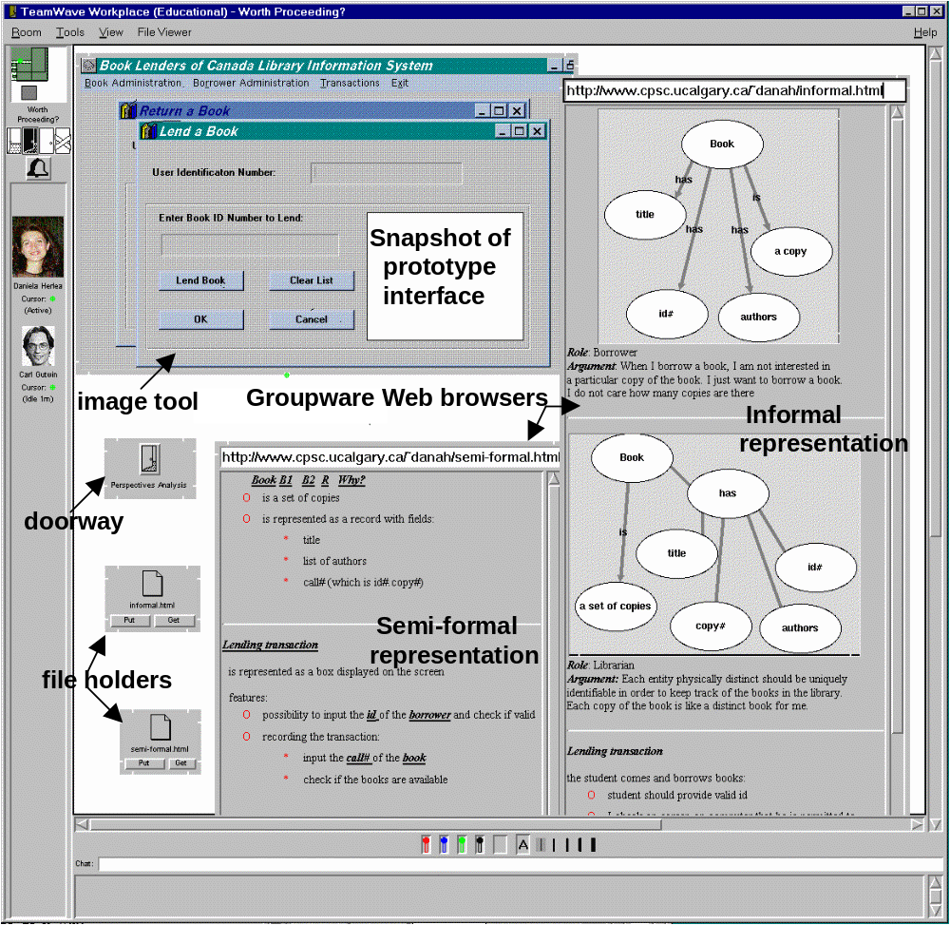
Notes:
When I am back to the planner room, I explain: the participants collaborate this way by connecting to the different rooms of the system. As I mentioned before the negotiation occurs at most of the stages in the RE process. Another negotiation aspect that we looked at in our scenario is the collaboration during the traceability of requirements. Therefore, let’s go to the Worth Proceeding room (by clicking on its icon)
The first issue relevant to groupware is how the system maintains repositories of requirements traces. In this respect, Tw provides “for free” a persistent space and a number of versioning tools.
The fully persistent meeting space means here that any diagrams or sketched ideas remain in the room and can be accessed later in the process.
The system also maintains a version repository of all rooms and their contents. That means that previous versions of req representations such as diagrams, lists can be retrieved at any time.
The second issue relevant to groupware is how partic collaborate while accessing the req documents and artifacts during the req traceability.
In this room, the image tool has been used to display a screen snapshot of the prototype created during the process. The partic. use the Web browser tools with entry pages into requirements documents, produced earlier in the process. They collaborate by browsing and discussing various requirements documents, while seeing how well the interface satisfies them. Following the hypertext links, team members trace the representation of the concept ‘book’, analyzing different perspectives over it, and when conflicts, ambiguities or inconsistencies appear, the team can negotiate these perspectives through the system’s collaborative tools.

Slide 12
Future work
formal evaluation of the team’s effectiveness? *
acquiring shared understanding of requirements
support for the facilitator’s role
better understanding of the face-to-face requirements negotiation meetings
* Grudin, J. “Why groupware applications fail”
Notes:
Therefore, we argued that groupware should be developed to support distributed requirements negotiation. After outlining several general capabilities that groupware should provide, we illustrated by example how systems could support activities specific to RE. This included a creation of a meeting space supporting the overall RE process, as well specific activities such as collaborative expression and negotiation of multiple perspectives.
However, be believe that this research is only a start in understanding groupware support for distributed req negotiation. Further research should include studies of real work settings and a number of issues should be addressed. They include:
How to formally evaluate the effectiveness of the team using the system?
Do people using the system acquire enough of a shared understanding of requirements and perspectives during the process?
What support for the facilitator’s role do we actually need to design?
We believe that a better understanding of the face-to-face req negotiation phenomena should be achieved before we can design effective groupware for distance collaboration during such processes.

