Slide 1
Moving Between
Personal Devices and Public Displays
Saul Greenberg and Michael Boyle
University of Calgary
Canada

Slide 2
Theme
Computer devices should allow people to move from personal, individual work to public, group work and back again.
How do we
  integrate handheld, SDG and workstation groupware
  distinguish personal & public information & manipulation
  handle problems endemic to disconnected groupware
  give people a natural way of thinking about these things

Slide 3
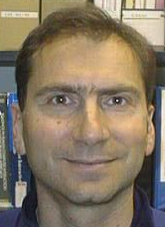

PDAs as Handheld CSCW
Personal disconnected devices to update databases
Data base
Some stuff
Other stuff
Some stuff
Other stuff
Notes:
Personal devices to exchange information
infra-red to exchange business cards
pick and drop
Links to remote computers
see and control remote desktop
Input devices to single display groupware
control conventional applications
control single display groupware
Full partners with other computers

Slide 4
PDAs as Handheld CSCW
Personal devices to exchange information
Some stuff
Notes:
Personal devices to exchange information
infra-red to exchange business cards
pick and drop
Links to remote computers
see and control remote desktop
Input devices to single display groupware
control conventional applications
control single display groupware
Full partners with other computers

Slide 5
PDAs as Handheld CSCW
Personal devices to exchange information
  IRDA
S o m e
s t u f f
Some stuff
Notes:
Personal devices to exchange information
infra-red to exchange business cards
pick and drop
Links to remote computers
see and control remote desktop
Input devices to single display groupware
control conventional applications
control single display groupware
Full partners with other computers

Slide 6
PDAs as Handheld CSCW
Personal devices to exchange information
  IRDA
  Pick and Drop
Some stuff
Some stuff
Notes:
Personal devices to exchange information
infra-red to exchange business cards
pick and drop
Links to remote computers
see and control remote desktop
Input devices to single display groupware
control conventional applications
control single display groupware
Full partners with other computers

Slide 7
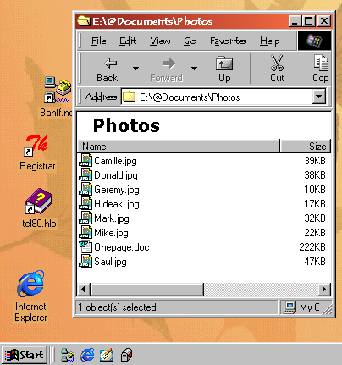
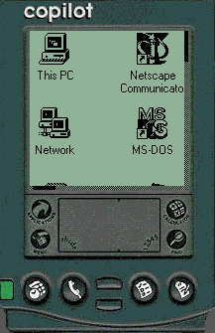
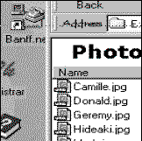
PDAs as Handheld CSCW
Link to remote personal computer
  PalmVNC, Berkeley

Slide 8
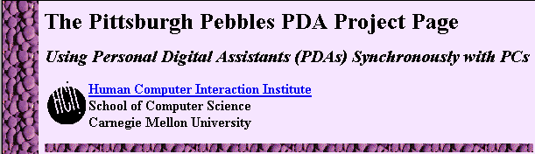
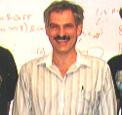
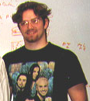


PDAs as Handheld CSCW
Input devices to single display groupware (Pebbles)
  control conventional applications
  control groupware

Slide 9
PDAs as Handheld CSCW
Equal partner integrated with other computers
Research ideas
pdas as groupware
meeting room tool?
disconnected computing?
Research ideas
pdas as groupware
meeting room tool?
disconnected computing?
personal
work
public
work
distributed
work
disconnected
work

Slide 10
Personal and Public Artifacts
Personal
  owned and manipulated by one and only one person
Public
  created and manipulated by cooperating group memebers
  group ownership
Fluid light-weight movement between the two
  showing, copying, giving, exchanging, sharing, proximity, spatial placement...
  not access control!

Slide 11
Scenario
From: “saul greenberg” <saul@cpsc.ucalgary.ca>
To: mboyle@cpsc.ucalgary.ca,
george@acs,
tom@smarttech.com
Hi, everyone
I’d like to meet tomorrow at 1:00 to talk about our new usability laboratory , and what equipment we will have to buy.
Can you think about this for a bit? A list of particular equipment, including some pros and cons may help get things going.
Saul

Slide 12
Personal Work
While Michael is taking the bus home...
So, what
do I need?

Slide 13
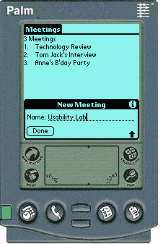
Personal Work
Michael creates a new "meeting" space

Slide 14
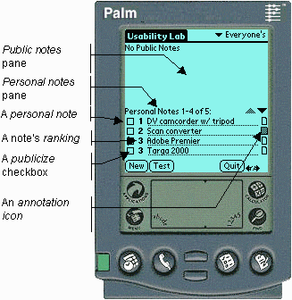
Personal Work
He adds some personal notes and ranks them

Slide 15
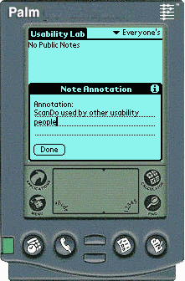
Personal Work
He annotates several notes

Slide 16
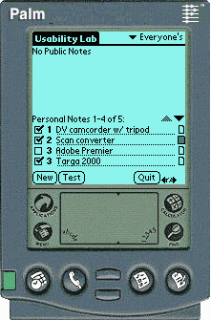
Personal Work
He marks some notes for publicizing

Slide 17
Personal Work
Others add/modify their personal notes during the evening

Slide 18
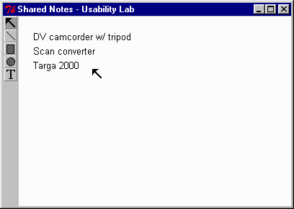
From Personal to Public
Michael happens to be the first to arrive

Slide 19
From Personal to Public
Michael happens to be the first to arrive

Slide 20
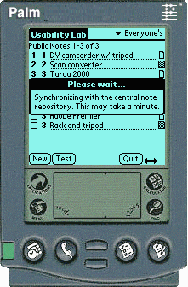
From Personal to Public
Michael happens to be the first to arrive

Slide 21
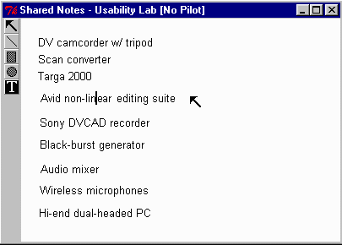
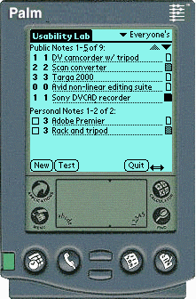
From Personal to Public
Other people arrive and join in

Slide 22
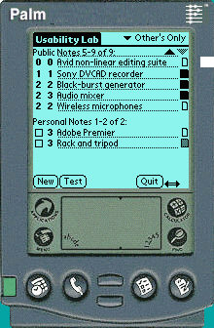
From Personal to Public
Other people arrive and join in

Slide 23
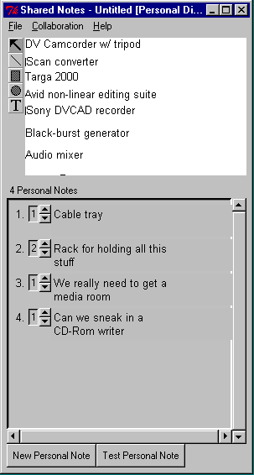
From Personal to Public
People can be located in other rooms / offices

Slide 24
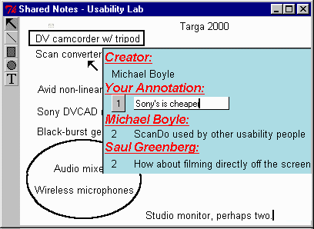
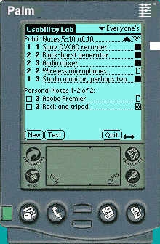
The Public Arena
Anyone can add notes, modify annotations
  modify notes only on public displays

Slide 25
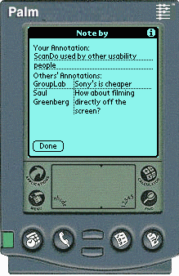
The Public Arena
Anyone can add notes, modify annotations
  modify notes only on public displays

Slide 26
The Public Arena

Slide 27
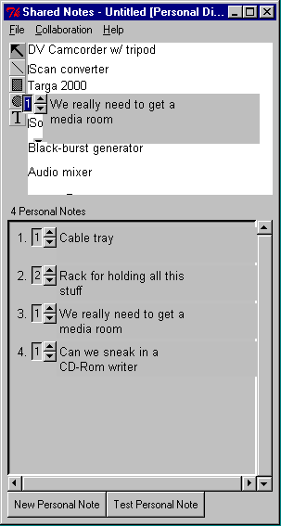
The Public Arena

Slide 28
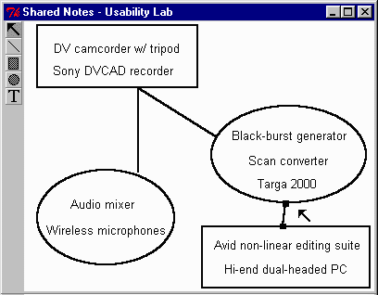
Between Meetings
Disconnected and occasionally connected work

Slide 29
Pushing the design space
Should the PDA, SDG, W/S be equal partners?
  PDA not just an input device!
  PDA: personal and part public
  SDG: public only
  W/S: personal and public

Slide 30
Pushing the design space
Should each device be treated as a different entity enabling different acts?
  PDA, SDG, W/S as equal partners?
  Powers differ!
    only large devices given spatial manipulation capabilities
    but information is lost
      spacial layout (PDAs)
      order (SDG, W/S)
  Interaction techniques differ
    moving to public:
      checkmark (PDA)
      drag 'n drop (W/S)
      none (SDG)

Slide 31
Pushing the design space
Should people take explicit action to publicize notes?
  PDA, SDG, W/S as equal partners?
  Different entities, different acts?
  If all notes automatically publicized, then
    information becomes all or nothing
    people will not put down 'risky' information
  acts as a scratch space
  other action possibilities:
    pick 'n drop

Slide 32
Pushing the design space
Should the system explicitly distinguish between personal and public information?
  PDA, SDG, W/S as equal partners?
  Different entities, different acts?
  Explicit action to publicize notes?
  semantically different
  personal and public notes are visually separated on PDA, W/S
  cannot edit and manipulate notes in the same way

Slide 33
Pushing the design space
Should the flow from personal to public be one way?
  PDA, SDG, W/S as equal partners?
  Different entities, different acts?
  Explicit action to publicize notes?
  Distinguish personal/public information?
  unlike real life, in groupware it is not clear what is an original and what is a copy
  leads to synchronicity problems when disconnected
  SharedNotes:
    only original notes, no copies
    people can view the public copy
    weird!

Slide 34
Pushing the design space
Should the system have personal aspects of public information?
  PDA, SDG, W/S as equal partners?
  Different entities, different acts?
  Explicit action to publicize notes?
  Distinguish personal/public information?
  One-way flow from personal to public?
  Note text:
    completely public
    loses sense of identity
  Annotations and rankings:
    personal, identity
  Average ranking:
    influenced by personal

Slide 35
Pushing the design space
Where should the 'master' public information reside?
  PDA, SDG, W/S as equal partners?
  Different entities, different acts?
  Explicit action to publicize notes?
  Distinguish personal/public information?
  One-way flow from personal to public?
  Personal aspects of public information
  The big problem:
    disconnected computing
  Now:
    lives in central repository
    assumes public displays always linked to it
  Instead
    distributed information?
    no master repository?

Slide 36
Theme
Computer devices should allow people to move from personal, individual work to public, group work and back again.
How do we
  integrate handheld, SDG and workstation groupware
  distinguish personal & public information & manipulation
  handle problems endemic to disconnected groupware
  give people a natural way of thinking about these things

