Slide 1
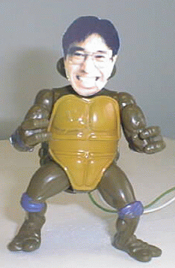
Mediating Communication through
Physical but Digital
Surrogates
Hideaki Kuzuoka Saul Greenberg
University of Tsukuba University of Calgary

Slide 2
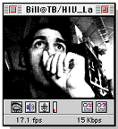
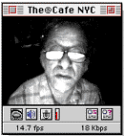
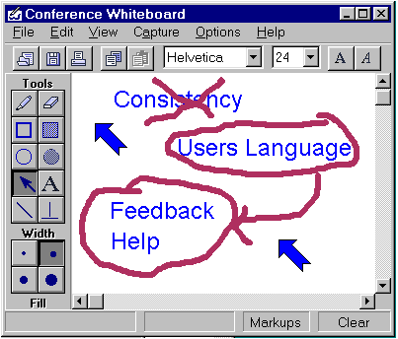

Real time groupware for distributed teams

Slide 3


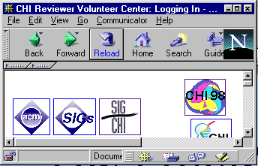
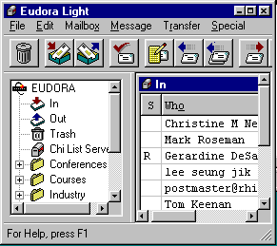


Problem 1:
My computer is a busy place!

Slide 4


Problem 2:
Its separate from my physical world
in the box
the physical world

Slide 5
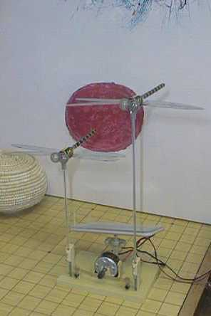
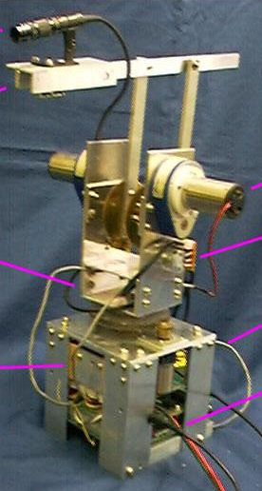
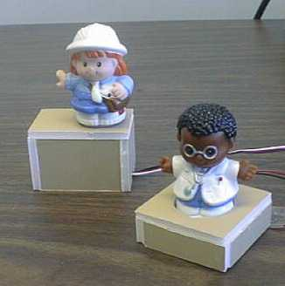
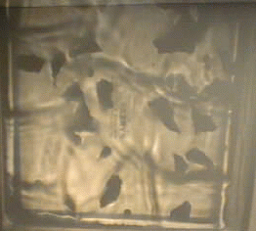
Out of the Box
Groupware

Slide 6
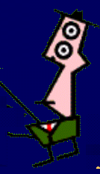

Case Study:
Remote Instruction
Co-located

Slide 7
Case Study:
Remote Instruction
Distance-separated

Slide 8
Example 1: GestureCam
Tele-operation of robot
Built for remote instruction
Embodiment gives
  presence
  body language
  gaze awareness
  gestural expression
  real world interaction

Slide 9
Case Study 2:
Remote Casual Awareness
The glue behind casual
interaction
Awareness questions
  who is around?
  are they available now?
  can they be interrupted?
  how can I initiate contact?

Slide 10
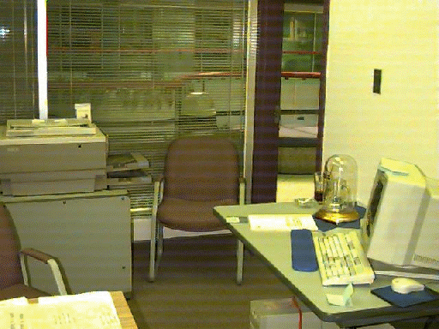
“In the Box” Approaches
Mark’s office
Media Spaces, glances

Slide 11
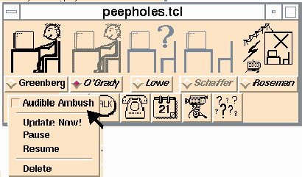
“In the Box” Approaches
Iconic indicators (keyboard + mouse)

Slide 12
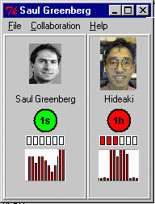
Moving “Out of the Box”
Iconic indicators
idle time
motion

Slide 13
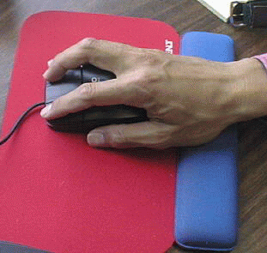
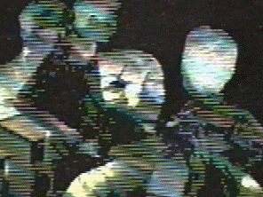
“Out of the Box” Approaches
Input
Doll manipulation
Motion detection
Computer activity

Slide 14
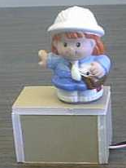
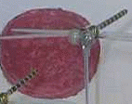
“Out of the Box” Approaches
Output
Dolls
Active Models
Light patterns

Slide 15
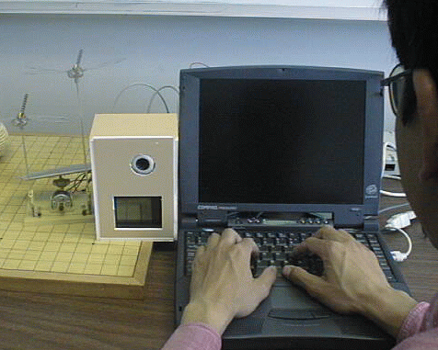
“Out of the Box” Approaches

Slide 16
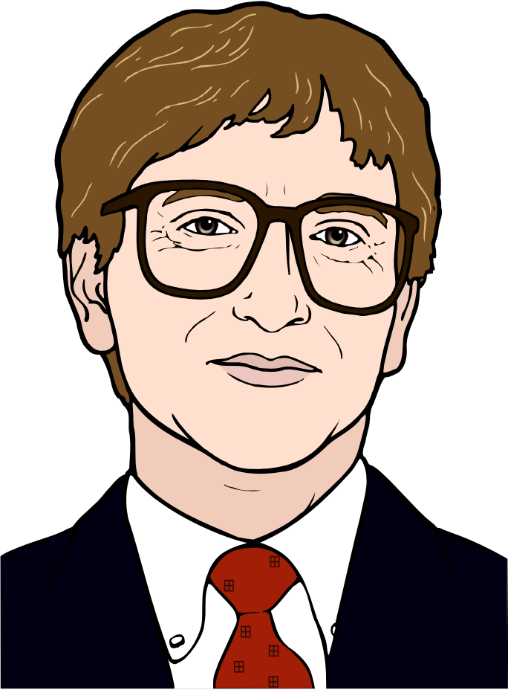
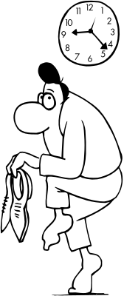
Mitigating privacy concerns

Slide 17
Mitigating privacy concerns
  capture selected information from environment
    explicit acts
    instrumentation
      heat sensor to capture touch
      video differencing for motion
      proximity sensors for distance
      light sensor for object manipulation
      keyboard/mouse,
    hiding “rich” information

Slide 18
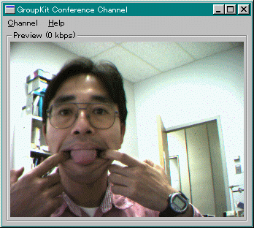

Slide 19
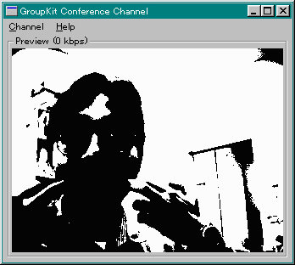

Slide 20
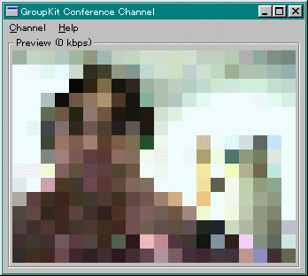

Slide 21
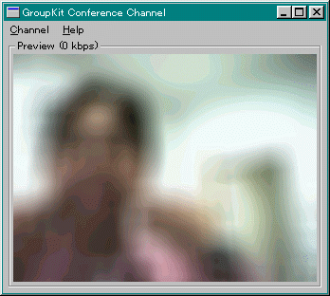

Slide 22
Mitigating privacy concerns
  capture only selected information
  activity abstraction
human activity
surrogate activity
transformation

Slide 23
Mitigating privacy concerns
  capture only selected information
  abstraction
  reciprocity
    if I see you, you see me

Slide 24
Mitigating privacy concerns
  capture only selected information
  abstraction
  natural use of space
    proximity drives quality of communication channel

Slide 25
The Design Space
Embodied characteristics:
  what aspects of the actor should the surrogate embody?
GestureCam Awareness surrogates
  presence • presence
  body language • activity
  gaze awareness • availability
  gestural expression • spatial relationships

Slide 26
The Design Space
Output:
  what is the surrogate’s appearance?
GestureCam Robot
Video images
Active Hydra
Wind chimes
Dragonfly
Light show
Dolls
literal
abstract

Slide 27
The Design Space
Input:
  how is the surrogate controlled?
GestureCam waldo
Computer activity
Motion detection
Doll manipulation
Facing a camera
Proximity
explicit
implicit

Slide 28
Surrogates Supporting Work

Slide 29
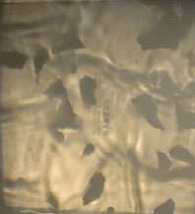
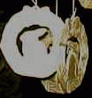
Surrogates Supporting Art (Aesthetics)

Slide 30

Conclusions
Mediate communication via surrogates
Work
  literal surrogates
Art
  abstract surrogates
A personal interactive installation?

