Slide 1
Revisitation Patterns in World Wide Web Navigation
Linda Tauscher and Saul Greenberg
University of Calgary
Notes:
This presentation reports on users’ revisitation patterns to World Wide Web pages, and their use to lay an empirical foundation for the design of history mechanisms in Web browsers.
This research was performed for my master’s thesis at the University of Calgary in the Department of Computer Science. It builds upon work that my thesis supervisor, Saul Greenberg, conducted for his PhD thesis. Saul examined the use of history within the Unix command line operating system.

Slide 2
Overview
Introduction / Objectives
Data Collection
Results: How People Revisit Web Pages
Conditioning the Distribution
Discussion
Conclusion
Notes:
Our presentation today will address the following topics:
We start by stating the objectives of our empirical research, and briefly explain how we collected the data.
Next, we summarize the important results we obtained from our analyses.
We also used the data collected to evaluate different methods of presenting history; we describe these methods and summarize how effective each is.
Finally, we conclude by discussing the empirically-based generalizations of how users revisit pages that we formulated as a result of our research.

Slide 3
Introduction
History mechanisms allow people to revisit pages viewed previously
History mechanisms can mitigate impact of:
  vast amounts and poor structure of information
  resource use
  cognitive and physical navigation burdens
Current history mechanisms are based on ad-hoc approaches
Notes:
History mechanisms within the context of Web browsers, and for the purposes of this research, allow people to revisit pages viewed previously.
If pages are revisited often, we believe that history mechanisms can:
1. help the user navigate through the vast amounts and poor structure of WWW information by providing easy access to info. previously visited.
2. decrease resource use by supplanting search engines for finding new pages, and eliminating navigation through intermediary pages.
3. Reduce a user’s cognitive and physical navigation burden; pages can be returned to with less effort, and history mechanisms can show users where they have been.
However, we believe that today’s design of history mechanisms based on ad-hoc approaches.
1. They do not take advantage of previous research into history support within Uis.
2. Their designs are not based upon actual studies of how people revisit Web pages.
3. Their actual use has been examined only superficially.

Slide 4
Objectives
Understand people’s revisitation patterns when navigating the WWW
Evaluate current approaches, validate successful solutions, suggest alternatives
Provide guidelines for effective browser history design
Notes:
Our goal is to place the design of history mechanisms within browsers on a more empirical footing. We had 3 sub-goals:
1. We wanted to… <see above>. There is little empirical data currently available. And history mechanisms are only useful if users repeat their activities - in this case, if users actually do revisit Web pages.
2. We wanted to… <see above>.
3. We wanted to… <see above>. These are discussed in my thesis and a journal paper currently in publication.

Slide 5
Data Collection
Xmosaic 2.6 modified to capture user’s browsing activity
Volunteer participants used browser for 6 weeks
Participants were practiced Web users
Quantitative data derived from logs of 23 participants
Qualitative data gathered via interviews
Notes:
To collect data for our research we modified the source code for Xmosaic 2.5 to capture the user’s browsing activity.
Our volunteer participants, who were practiced Web users, used the browser for 6 weeks. They browsed as they normally would have with their preferred browser during that time.
Our quantitative data was hence dervied from the logs of 23 participants. We also did follow-up interviews at the end of the study to gather qualitative data.

Slide 6
Results
Recurrence of Web page visits
Growth of URL vocabulary
URL visit frequency as a function of distance
Frequency of URL accesses
Locality
Longest Repeated Sequences
Notes:
Our paper summarizes results from 6 analyses pertaining to the reuse of Web pages, that is, the revisit of pages that the user has previously seen.
Today we will touch upon the first 4 of these.

Slide 7
Recurrence of Web page visits
Recurrence rate R
  probability that any URL visited is a repeat of a previous visit
University of Calgary: R = 58% (σ = 9%)
Catledge and Pitkow: R = 61% (σ = 9%)
Web browsing is a recurrent system
  users predominately repeat activities invoked before (Greenberg, 1993)
Notes:
As I stated earlier, history mechanisms are only useful if users actually repeat their activities. Though current Web browsers do have a history feature, we do not know how often people revisit Web pages.
Recurrence rate provides this statistic. Recurrence rate is the probability that any URL visited is a repeat of a previous visit.
We calculated R for both our data (all 23 subjects) and data from a study conducted by Catledge and Pitkow in August of 1994. Our values are very close: 58% and 61%.
This result qualifies Web browsing as a recurrent system. Greenberg coined this term to characterize systems where users predominately repeat activities they had invoked before.

Slide 8
Growth of URL vocabulary
URL vocabulary
  number of unique URLs visited thus far vs. number of total URLs visited
Findings
  users incorporate new URLs into their repertoire at a regular rate
  revisits fairly evenly distributed
  local variations highlight browsing patterns
Notes:
The second pattern of page reuse we examined concerns the growth of URL vocabulary. This pattern shows the distribution of old and new page visits over time.
URL vocabulary is the # of unique URL visited vs. the # of total URLs visited at any point along the user’s browsing timeline.
We represented this data as a graph for each subject. We also plotted major navigation actions as separate curves above the URL vocabulary curve. This gave us additional insights into different browsing patterns users engaged in.

Slide 9
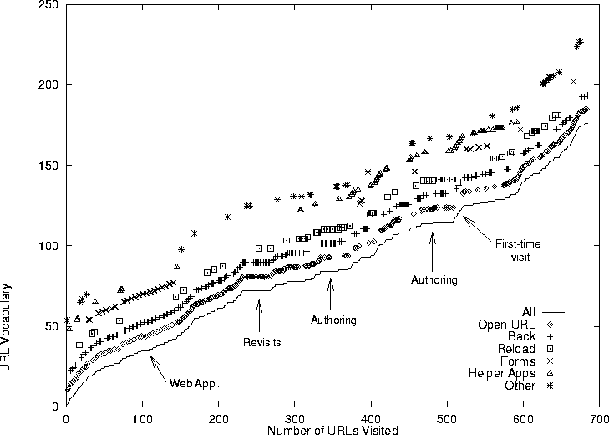
URL Vocabulary for participant 15
Notes:
This is the vocabulary graph for one of our subjects. The x-axis represents the browsing timeline - a point for each URL visited; while the y-axis represents the number of unique URLs visited. The first curve represents the vocabulary overall, and the other curves show when the most common navigation actions were invoked.
These curve show that:
1. users incorporate new URLs into their repertoire at a regular rate (the URL vocabulary curve grows in a linear and positive fashion)
2. revisits to pages are fairly evenly distributed ( the vocabulary curve is fairly linear overall, but local variations to the slope are also evident)
3. local variations highlight browsing patterns (such as the authoring of pages,
revisits to Web pages, first-time visits, and use of Web forms-based applications).

Slide 10
Web page visit frequency as a function of distance
Distance determined by
  no. of items between current URL being visited from its first match on the history list
Recency effect
  previous 6 or so URLs contribute the majority of pages visited next
Notes:
For any URL visited, the probability that it has already been seen by the user is quite high, that being 58%. But how do particular URLs contribute to this probability? Do all URLs visited have a uniform probability of recurring or do the most recently visited URLs skew the distribution?
To answer these questions, we calcuated the recurrence rate at particular distances; that is, we counted the number of URLs between the current URL and that last time it was seen by the user.

Slide 11
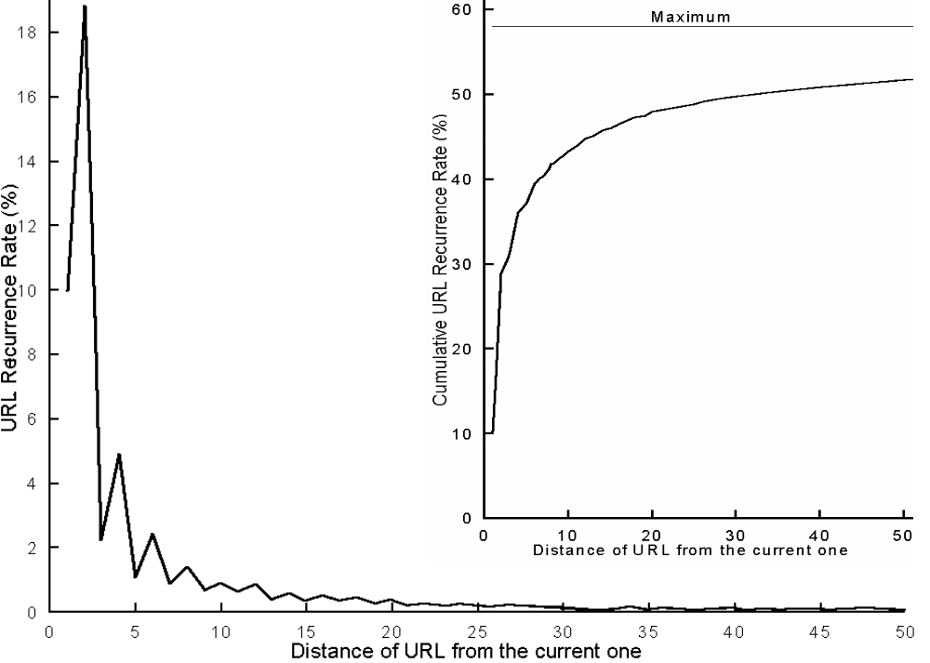
URL recurrence rate as a function of distance (all participants)
R as running sum
Notes:
This figure plots recurrence rate as a function of distance for distances up to 50.
A distance of 1 occurs when the user reloads the current page or clicks a named anchor on the page to go to another part of the page.
A distance of 2 occurs when the user revisits a page seen 2 pages back, often by performing a Back action.
We found a strong recency effect in that the previous 6 or so URLs contribute the majority of pages visited next. For example, there is a 39% probability that the next URL visited will be found in a set of the last 6 URLs visited, as can be seen by the inset plot which shows this statistic as a running sum. Recall that the maximum recurrence rate is 58%.

Slide 12
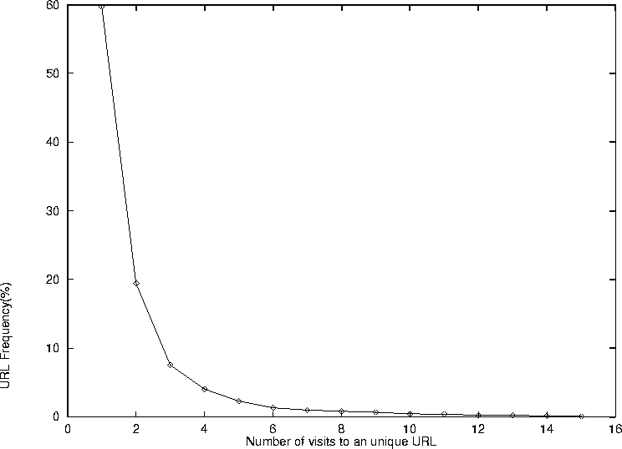
Frequency of URL visits for all participants
Notes:
The final pattern that we will talk about today is frequency of URL accesses. This graph plots for all 23 subjects, the percentage of URLs that were visited a certain number of times.
We see that 60% of URLs were visited once, 19% were visited twice, 8% were visited 3 times.
This pattern was evident for all subjects. There were very few URLs that subjects visited frequently, yet there are many URLs that were only visited a small number of times.

Slide 13
Conditioning the Distribution
Objectives
  increase recurrence probabilities over a set of a given size
  evaluate methods currently in use
Method categories
  recency ordered history lists
  frequency ordered history lists
  stack-based approaches
  hierarchically structured history lists
Notes:
Another set of analyses we performed involved evaluating various approaches for presenting a history of pages previously visited. We refer to this as conditioning the distribution because we are trying to increase the probability that a set of URLs previously visited will contain the next page the user will visit.
We compared 8 different methods that fall into one of four categories:
1. history lists that order items based upon recency of visit
2. methods based up frequency of visit
3. methods that follow the stack-based approach used by many of today’s popular browsers
4. methods that structure items hierarchically e.g. into sublists

Slide 14
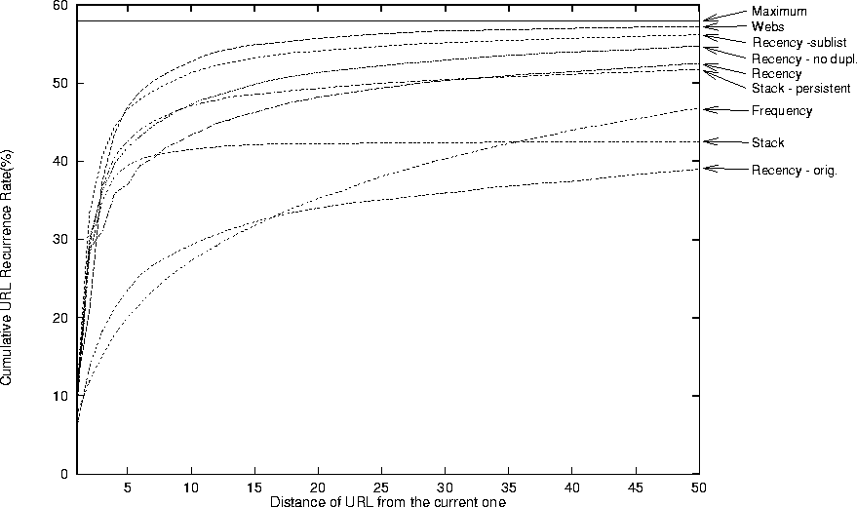
Cumulative probabilities of recurrences over distances up to 50
R_{D10}
Notes:
This plot summarizes our results of evaluating these 8 approaches.The important results are:
1. The current stack-based method is the 3rd worst performer at a distance of 10, though it is slightly better than strict recency at very short distances (eg. 5). It becomes worse as the list grows longer since this method does not retain URLs between session. Doing this (the persistent stack) does lead to better long term results. However, there are problems with the conceptual model for the stack approach, as Cockburn and Jones discovered in their usability study.
2. A recency based approach offers a simpler conceptual model, and it performs reasonably well particularly if duplicates are removed from the list and saved only in their latest position.
3. Hierarchically structuring through context-sensitive Web subspaces (91% effective for distance=10) or recency-based hyperlink sublists are the best performers. But there is greater physical and cognitive effort of selecting items from sublists.
4. Frequency ordering is the worst predictor of the 8 evaluated for short lists. This method suffers from instability when their are few items, and excessive inertia when many pages have been visited.

Slide 15
Discussion
Users revisit a considerable number of Web pages
  58% probability that next page visited was previously seen
  Web browsing is a recurrent system
Notes:
Based on our results, we formulated some empirically-based generalizations of how users revisit pages using features found in a typical WWW browser such as Mosaic.

Slide 16
Discussion
New pages incorporated into repertoire at regular rate
  local variations in growth rate
  local variations in use of navigation activities
Notes:
While many pages are revisited, users continually incorporate new pages into their repertoire at a regular rate.
Local variations in vocabulary growth rate and use of navigation activities indicate the presence of different browsing activities.

Slide 17
Discussion
Users visit few Web pages frequently
  fall into certain definable categories
Users exhibit considerable recency of visits
  explains why Back is frequently used
Users revisit pages not accessed recently
Notes:
Categories of frequently visited pages include:
personal pages, start-up documents, indices, search engines, individual and organization home pages, Web applications, navigation pages, authored pages
The major contributions to the recurrence distribution are provided by the last few pages visited; there is a 39% chance that the next page visited has already been seen by the user; there is a 74% probability that a revisited page will be one of the 6 most recent pages.
Back comprised 30% of all navigation actions over all users for the duration of the study.
15% of recurrences are not covered by a list of the last 10 URLs visited. Still, doubling or tripling the size of the list does not increase its coverage much.

Slide 18
Discussion
Stack-based method can be improved upon
Back button is effective and simple to use
Notes:
There are methods for presenting a history of previously visited pages that are more predictive and useable than the current stack-based approach. A simple recency based list with duplicates removed is more predictive and likely much more usable. Even more predictive methods were found although their usability needs to be determined.
Perhaps the Back button could be improved further by basing it on a recency rather than a stack model.

Slide 19
Future research
Evaluate cognitive and physical effort of alternative history list methods
Access impact of different HTML and browser articfacts e.g. frames
Validate design principles
Notes:
There are still many unanswered questions.
First, the cognitive and physical effort of the various history list methods should be evaluated.
Second, the impact of new HTML and browser artifacts should be considered. The version of Mosaic that we used did not display frames. However, we suspect that the results we obtained would not change dramatically.

