Slide 1
Workspace Awareness in
Distributed Groupware
Note: Videos shown at the conference are not included in this file
Carl Gutwin, Saul Greenberg, Mark Roseman
University of Calgary

Slide 2
The Message
Groupware will only approach the richness of face-to-face collaboration by supporting workspace awareness

Slide 3
Outline
The problem: awareness and groupware
Workspace awareness
Awareness widgets
Usability study

Slide 4
Awareness in Collaboration
Communication
Making Contact
Negotiation
Coupling
Awareness
Anticipation
Assistance
Coordination

Slide 5
Distributed Groupware

Slide 6
Our View of Groupware
Allows collaboration to be natural
Awareness
of others
Shared artifacts
Make collaboration possible
Communication

Slide 7
Kinds of Awareness
Informal
Conversational
Workspace
Structural

Slide 8
Workspace Video

Slide 9
Workspace Awareness
Up-to-the-minute knowledge about others’ interaction with a shared workspace

Slide 10
Supporting WA
What information is important for maintaining awareness?
Does it work?
Can it be transformed to a groupware setting?
How should the information be displayed in groupware?

Slide 11
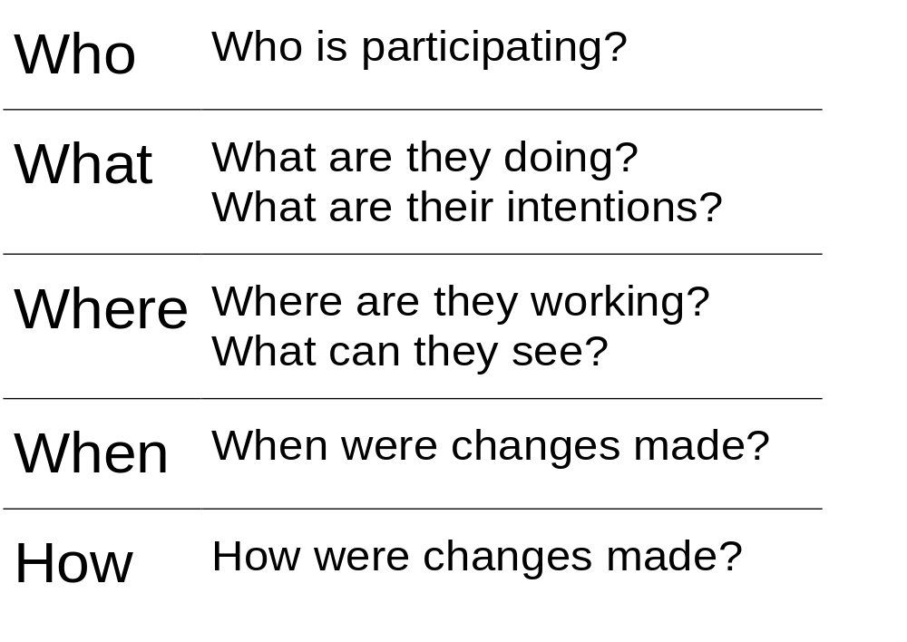
Information

Slide 12
Translation
Reduced perceptual information
Poorer communication
Computers hide things!
Techniques like relaxed-wysiwis

Slide 13
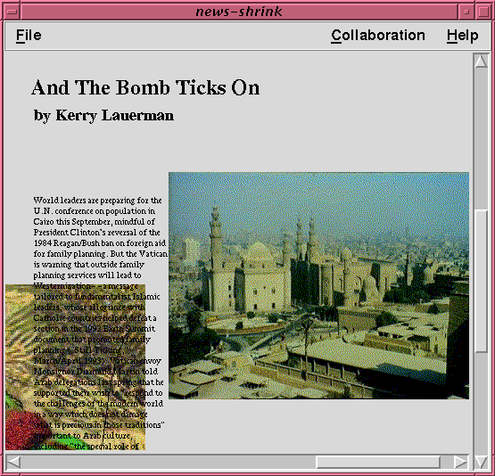
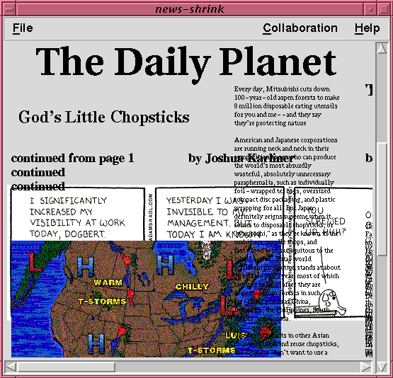
Relaxed WYSIWIS Views

Slide 14
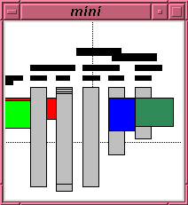
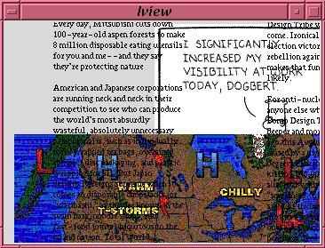
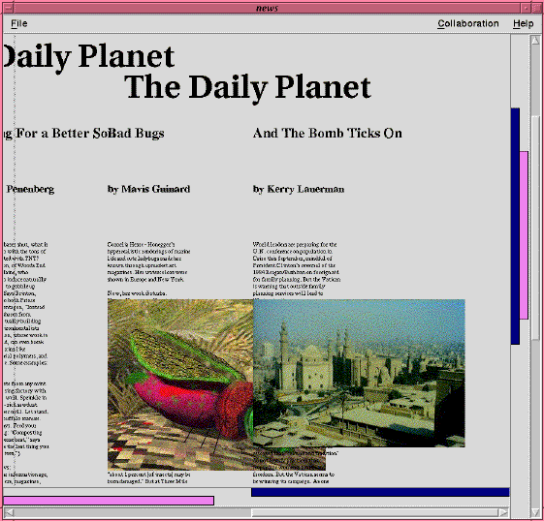
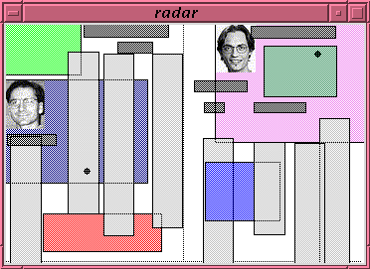
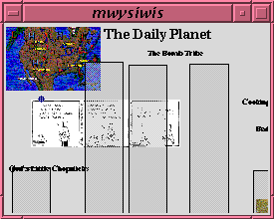
Display

Slide 15
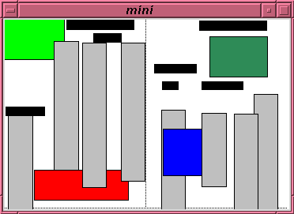
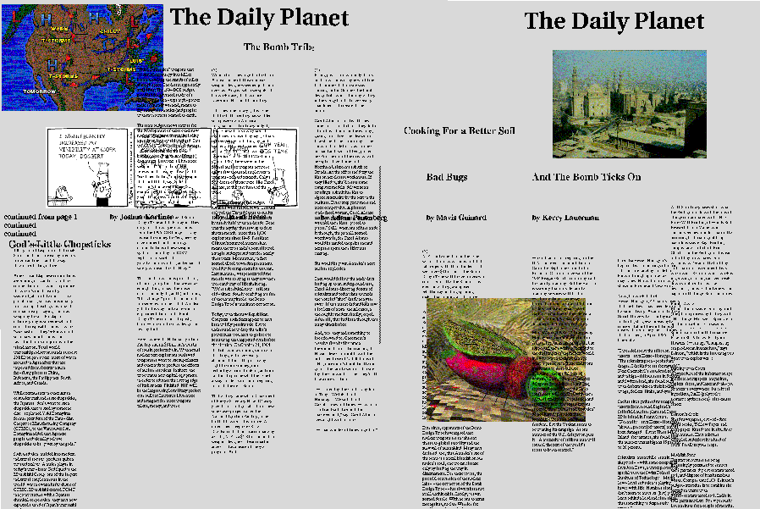
Overviews

Slide 16
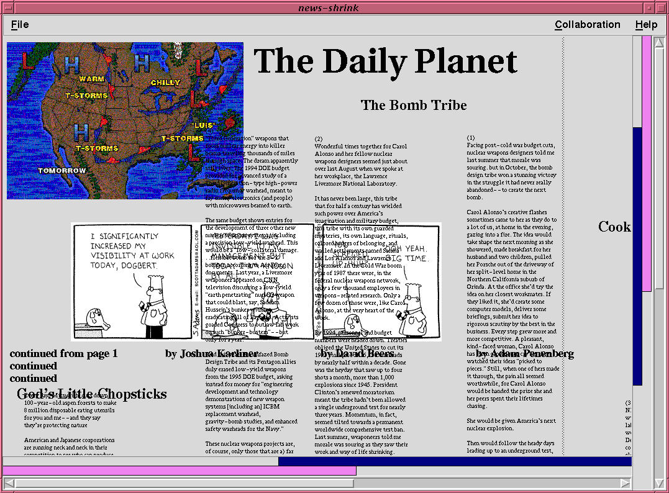
Detail Views

Slide 17
Awareness Widgets Video

Slide 18
Usability Evaluation

Slide 19
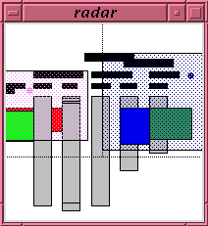
Configurations
4
1
2
3

Slide 20
Issues
Information content
Ease of interpretation
Value, distraction, and screen space

Slide 21
Results
Overviews were very successful
Detail view was too detailed!
Interpretation problems with scrollbar
All participants completed the task

Slide 22
Underlying Principles
Fit to task
Familiarity of representation
Individual and group support
Link between perception and action

Slide 23
Summary
Informal
Workspace
Conversational
Structural
Several types of awareness affect group work

Slide 24
Summary
Awareness
of others
Shared artifacts
Communication
Awareness is a consideration beyond basic communication and artifact sharing

Slide 25
Summary
Who?
What?
Where?
When?
How?
Designers must consider what elements are important and how to display them

Slide 26
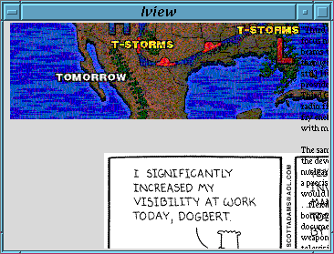
Summary
Awareness can be supported in groupware with special widgets and techniques

Slide 27
For more information...
http://www.cpsc.ucalgary.ca/projects/grouplab
Thanks to:
Intel Corporation Research Council
Natural Sciences and Engineering Research Council of Canada

Slide 28
The Message (again)
Designers must support workspace awareness if groupware is to get beyond the utilitarian state of the art

