Slide 1
Design Guidelines for Effective WWW History Mechanisms
Linda Tauscher and Saul Greenberg
University of Calgary
This talk accompanied a paper, and was presented at:
Tauscher, L. and Greenberg, S. (1996) Design Guidelines for Effective WWW History Mechanisms. In Microsoft Workshop, Designing for the Web: Empirical Studies. Microsoft Corporation, Redmond, WA. October 30
©Linda Tauscher & Saul Greenberg

Slide 2
Overview
Introduction / Objectives
Data Collection
Results
Conditioning the Distribution
Design Guidelines
Conclusion

Slide 3
Introduction
History mechanisms allow people to revisit pages viewed previously
History mechanisms can mitigate impact of:
  vast amounts and poor structure of information
  resource use
  cognitive and physical navigation burdens
Current history mechanisms are based on ad-hoc approaches
Notes:
Current history mechanisms based on ad-hoc approaches
do not take advantage of previous research into history support within UIs
designs are not based upon actual studies of how people revisit Web pages
actual use has been examined only superficially

Slide 4
Objectives
Understand people’s revisitation patterns when navigating the WWW
Evaluate current approaches, validate successful solutions, suggest alternatives
Provide guidelines for effective browser history design

Slide 5
Data Collection
Xmosaic 2.6 modified to capture user’s browsing activity
Volunteer participants used browser for 6 weeks
Participants were practiced Web users
Quantitative data derived from logs of 23 participants
Qualitative data gathered via interviews

Slide 6
Results
Recurrence of Web page visits
Growth of URL vocabulary
Web page visit frequency as a function of distance
Frequency of URL accesses
Locality
Longest Repeated Sequences

Slide 7
Recurrence of Web page visits
Recurrence rate R
  probability that any URL visited is a repeat of a previous visit
University of Calgary: R = 58% (σ = 9%)
Catledge and Pitkow: R = 61% (σ = 9%)
Web browsing is a recurrent system
  users predominately repeat activities invoked before (Greenberg, 1993)

Slide 8
Growth of URL vocabulary
URL vocabulary
  number of unique URLs visited thus far vs. number of total URLs visited
Findings
  users incorporate new URLs into their repertoire at a regular rate
  revisits fairly evenly distributed
  local variations highlight browsing patterns

Slide 9
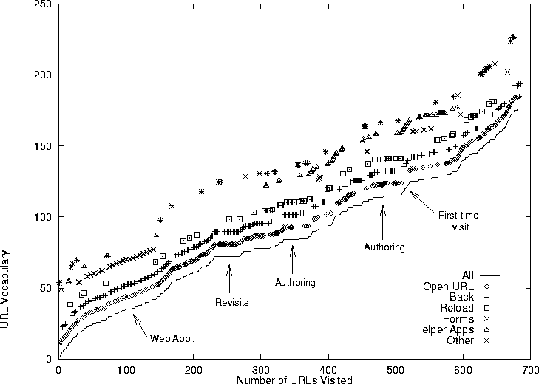
URL Vocabulary for participant 15

Slide 10
Web page visit frequency as a function of distance
Distance determined by
  no. of items between current URL being visited from its first match on the history list
Recency effect
  previous 6 or so URLs contribute the majority of pages visited next

Slide 11
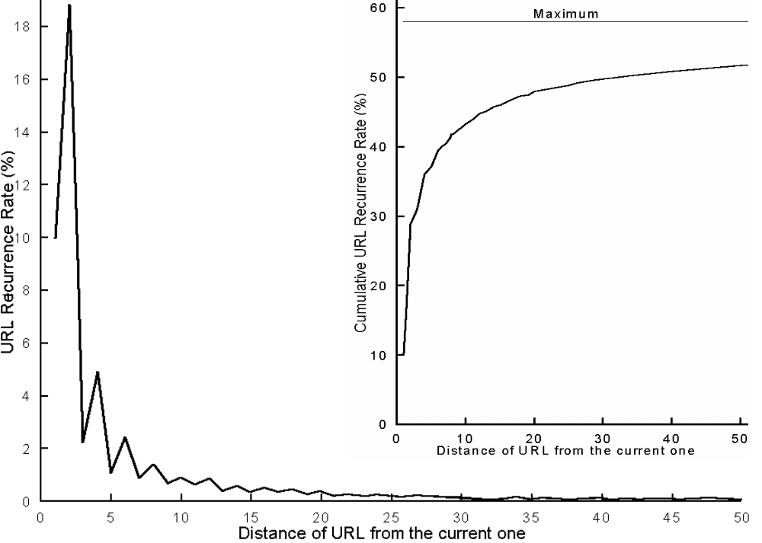
URL recurrence rate as a function of distance (all participants)
R as running sum

Slide 12
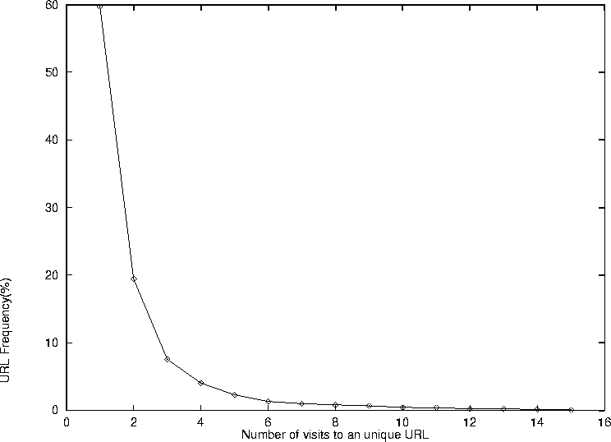
Frequency of URL visits for all participants

Slide 13
Conditioning the Distribution
Objectives
  increase recurrence probabilities over a set of a given size
  evaluate methods currently in use
Method categories
  recency ordered history lists
  frequency ordered history lists
  stack-based approaches
  hierarchically structured history lists

Slide 14
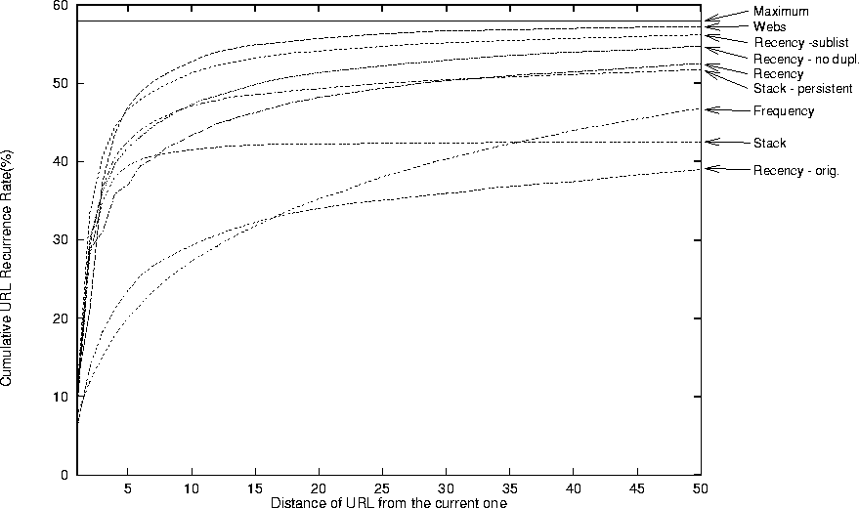
Cumulative probabilities of recurrences over distances up to 50
R_{D10}

Slide 15
Design Guideline #1
Maintain records of URLs visited, and allow users to recall previous URLs from those records
  Web browsing is a recurrent system (R = 58%)
  a history mechanism has value

Slide 16
Design Guideline #2
It should be cheaper, in terms of physical and cognitive activity, for users to recall URLs from a history mechanism than to navigate to them via other methods
  attempt to predict the next URL selection
  clearly distinguish the best predictions
  minimize the number of physical actions to retrieve URL from history
  provide clues to Web space structure

Slide 17
Design Guideline #3
A selectable history list of the previous 10 URLs visited provides a reasonable set of candidates for reuse
  accounts for 43% of all Web pages visited
  consider screen real estate, and cognitive overhead of scanning items
  user able to predict if URL will be on the list

Slide 18
Design Guideline #4
Other strategies for presenting the history list, particularly pruning duplicates and hierarchical structuring, increase the probability of it containing the next URL
  26% of recurring total are not covered by last 10 items
  more difficult to recall and/or locate these URLs

Slide 19
Design Guideline #5
History based on recency is not effective for all possible recalls because it lists only a few previous events; alternative strategies must be supported
  a few URLs are frequently visited

Slide 20
Design Guideline #6
URLs already recalled through history should be easily reselectable
  implicit: recency method
  explicit: highlight item

Slide 21
Design Guideline #7
History items should have a meaningful representation
  URLs versus titles
  display length

Slide 22
Design Guideline #8
Support grouping of URLs into high-level Web tasks, and switching between tasks
  context-sensitive Web subspaces
  recency ordered hyperlink sublists

Slide 23
Design Guideline #9
Allow end-user customization of history data
  customize attributes of history items
  save portions of browsing history

Slide 24
Conclusion
Empirical data
  justifies need for browser history mechanisms
  provides foundation for design guidelines
Current stack-based model can be improved upon

Slide 25
Future research
Evaluate cognitive and physical effort of alternative history list methods
Access impact of different HTML and browser articfacts e.g. frames
Validate design principles

