Slide 1

Note: Slide deck does not include videos shown during the presentation
Children’s Collaboration Styles in a
Newtonian Microworld
Andy Cockburn
University of Canterbury
Saul Greenberg
University of Calgary

Slide 2
Overview
The Message
  Children using a collaborative microworld show extremes in collaboration styles, from conflict to smooth interaction
Outline
  microworlds and TurboTurtle
  kids collaboration styles

Slide 3
Exploratory learning

Slide 4
“Single User” Microworlds

Slide 5
Collaborative Microworlds

Slide 6
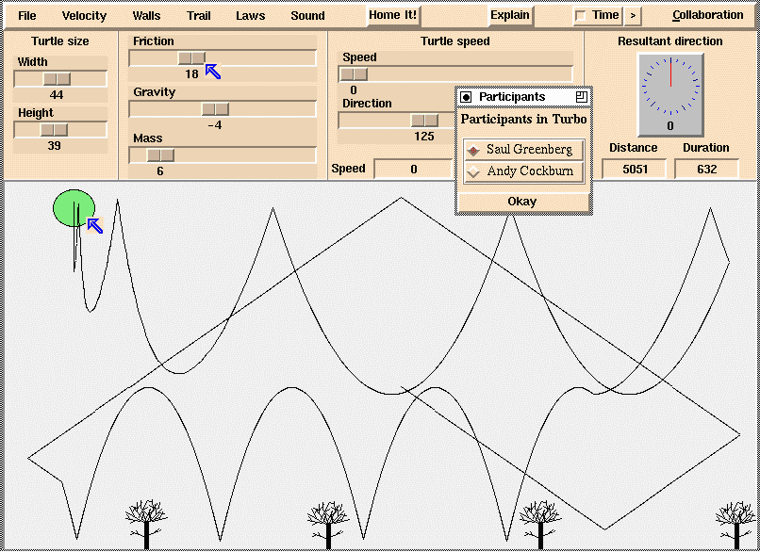
TurboTurtle

Slide 7
Video
TurboTurtle

Slide 8
The Study
Child 1
Child 2
Observer

Slide 9
Collaboration Styles
Parallel
Sequential
Independent
Domination

Slide 10
Parallel Style
continuous discussion
simultaneous access
fluid sharing
vocal about actions

Slide 11
Sequential Style
negotiated turn-taking
serial action

Slide 12
Independent Style
1 pair
almost no conversation
used as “single user” system
struggled against each other

Slide 13
Domination Style
overwhelmed partner
rapid speech and action
but invitations to join...

Slide 14
Breakdowns (?)
Conflicts over task manipulations
  creates opportunities for conversations
  silence leads to confusion
Repair through mutual awareness
  mediate conflicts through natural social skills
  immaturity at negotiating control

Slide 15
Implications
Collaboration style a social process
  not microworld artifact
Implications
  give children freedom to develop and explore the simulation with their own styles
  add structure to minimize risk of detrimental breakdown

Slide 16
Summary
Children using a collaborative microworld show extremes in collaboration styles
  from conflict to smooth interaction
Design microworlds to be
  flexible to afford good social processes
  structured to minimize bad ones

Slide 17
For more information
http://www.cpsc.ucalgary.ca/
projects/grouplab
  Research funded by:
    National Science and Engineering Research Council
    Erskine Fellowship
    Intel Research Council

Slide 18
Extra slides…...

Slide 19
Discussion
Collaborations worked when children
  negotiated their interactions
  used mutual awareness and breakdowns as opportunities
Collaborations failed when children
  dominated or ignored one another
  fought for control

