Slide 1

TeamRooms:
Groupware for Shared
Electronic Spaces
Mark Roseman
Saul Greenberg

Slide 2
Models of Groupware
groupware as meetings
  video conferencing, shared whiteboards
groupware as process
  workflow, GDSS
groupware as place
  conventional team rooms
  MUDs, wOrlds, CommonPoint

Slide 3
Characteristics of Places
persistence
synchronous and asynchronous
standard tools
custom tools

Slide 4
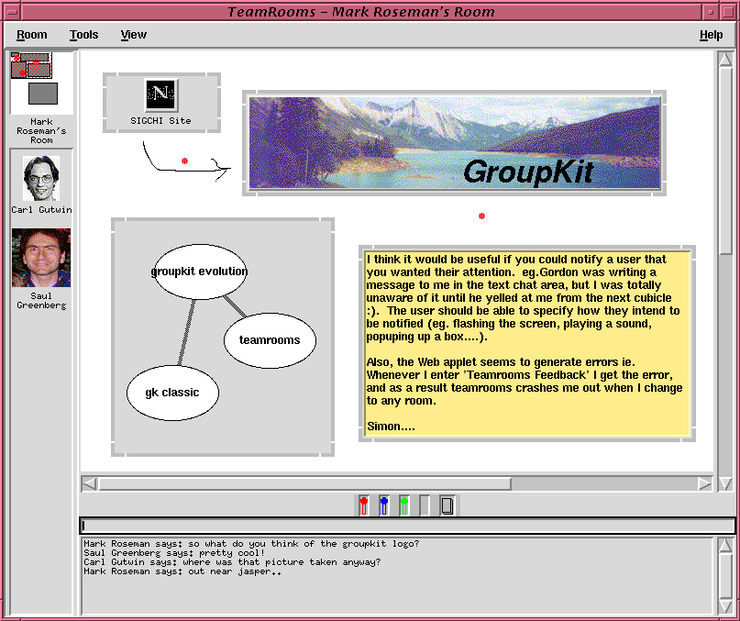
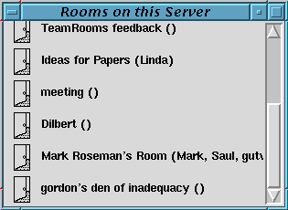
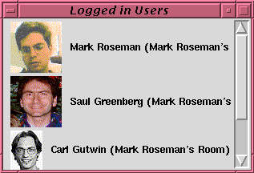
shared whiteboard
applets
rooms
users
chat tool

Slide 5
An excerpt of the Teamrooms video was shown here

Slide 6
Feature Summary
all room artifacts persistent
synchronous and asynchronous
standard tools always available
custom tools via GroupKit applets
no audio or video (but could add)
Unix, Mac (Windows soon)

Slide 7
More Information…
http://www.cpsc.ucalgary.ca/
projects/grouplab/teamrooms
Special thanks to Intel
Corporation and NSERC.

