Slide 1
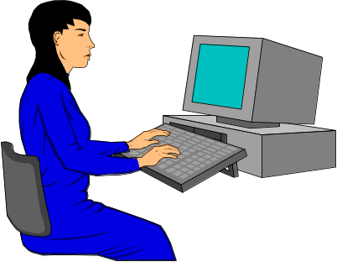
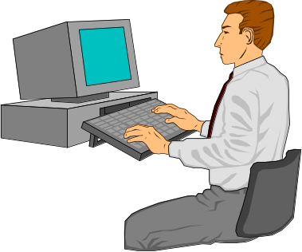
Semantic Telepointers for
Groupware
Note: Slide deck does not include system videos shown during the presentation
Saul Greenberg
Carl Gutwin
Mark Roseman
Department of Computer Science
University of Calgary, Canada
Notes:
1

Slide 2
The message
Telepointers:
embody people’s gestures
provide opportunities for
  supplying awareness information
  handling display differences
raise unresolved issues

Slide 3
Outline
Gestures: motivation and history
Awareness of activity
  overloaded cursors
Management of display differences
  mapping functions

Slide 4
Gestures
Observations of small groups (Tang 1989)
  20% listing of text
  45% drawing of images
  35% gesturing through hand motions

Slide 5
Gestures
Important for
  expressing ideas
  mediating interaction
  deixis

Slide 6
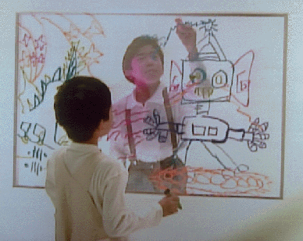
Gestures in video groupware
(Tang, Ishii ~1989)

Slide 7
Gestures through cursors
Surrogate for
  hand gestures
  gaze direction
“Telepointers”

Slide 8
Gestures through telepointers
(Engelbart, 1968)
Terminal 31
1. Overview
2. The mouse
3. Groupware
-shared terminals
-audio-video
-tracking spot
tracking
spots

Slide 9
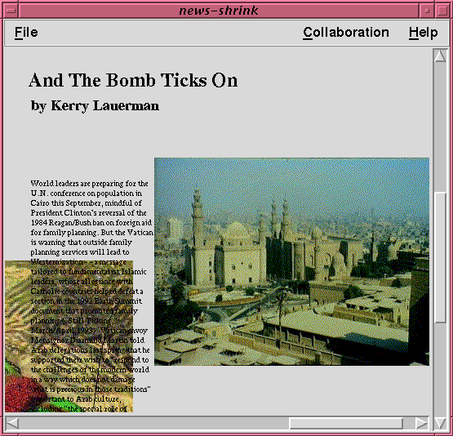
Telepointers today

Slide 10
Awareness in groupware
Hard to do
  who is around?
  where are they?
  what are they doing?
  what have they done?
feed
back
feed
through

Slide 11
Overloaded telepointers
Add semantic information to the telepointer:
  identity who
  mode & state what is possible
  action what is being done

Slide 12


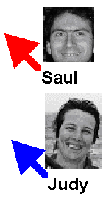

Identity
color
name
photo
arbitrary

Slide 13




Modes
System state
Selection
Drawing
Gesture

Slide 14


Make small actions larger

Slide 15
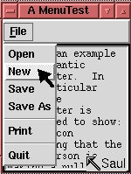
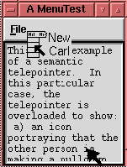
Make large actions smaller

Slide 16
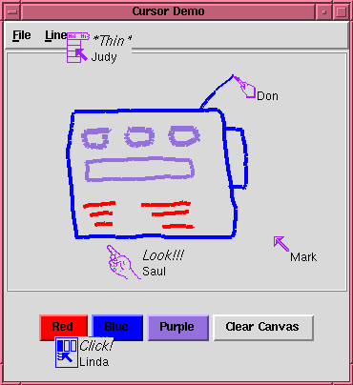
Example

Slide 17
Issues
Clutter
  excessive information
Human factors
  information must be useful
Semantics
  must be programmable / part of toolkit

Slide 18
Identical views

Slide 19
Display differences
Participants can have different views
  by viewport and scale
  by format
  by representation

Slide 20
Differing viewports / scales
Approach:
  map telepointers to world vs window coordinates
Issues
  telepointers may not be visible

Slide 21
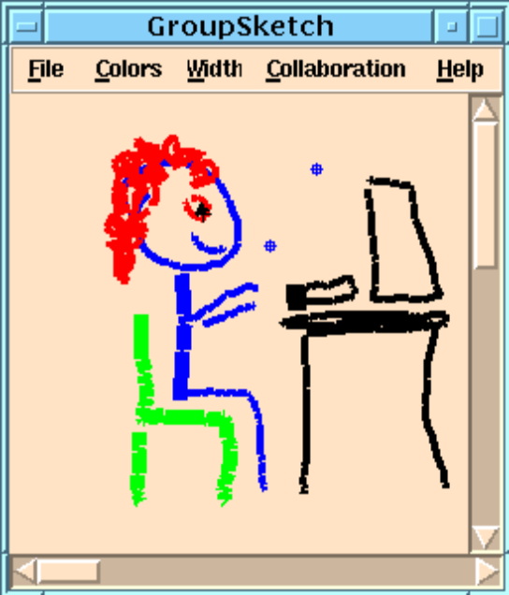
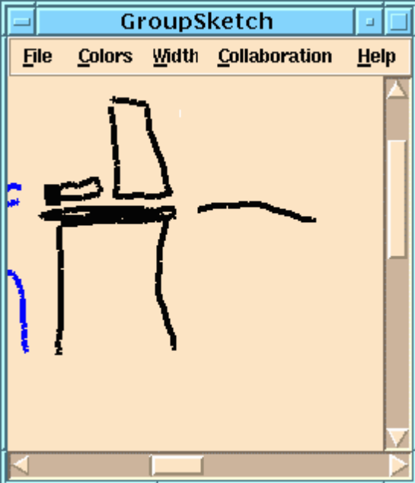

Differing viewports
Saul’s View
Carl’s View

Slide 22
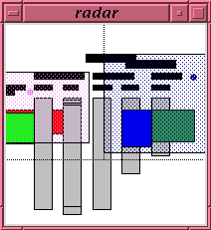
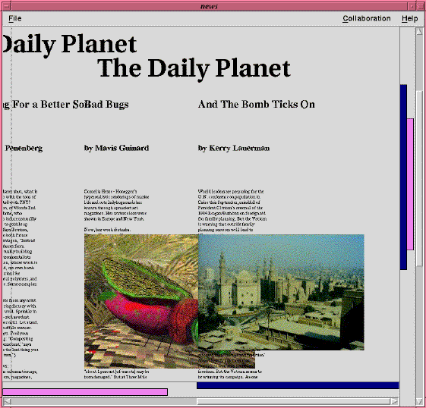
Differing scales
Overview widgets

Slide 23
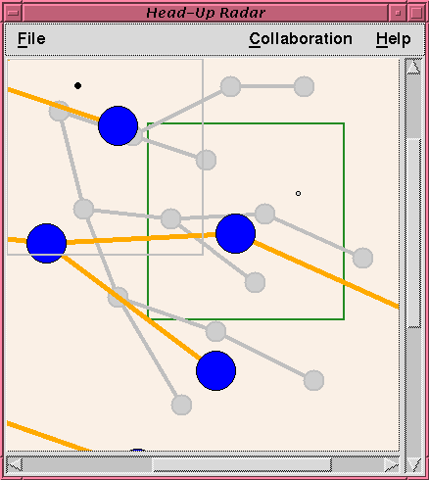
Differing
scales
Main view
in foreground
Overview
in background

Slide 24
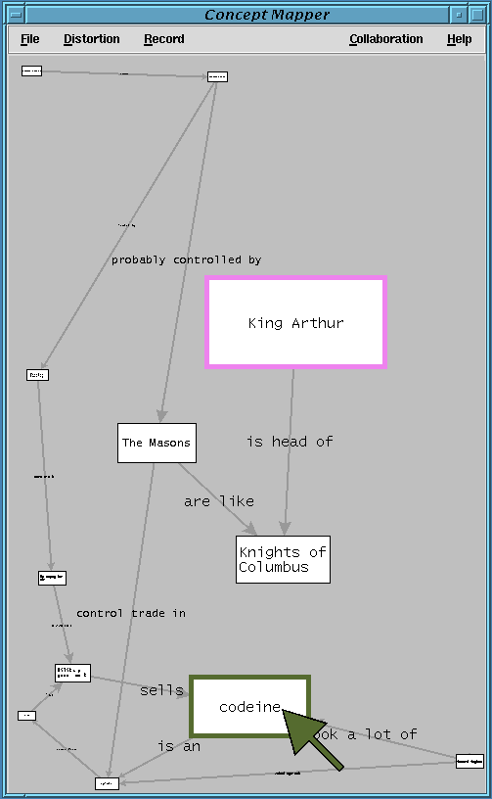
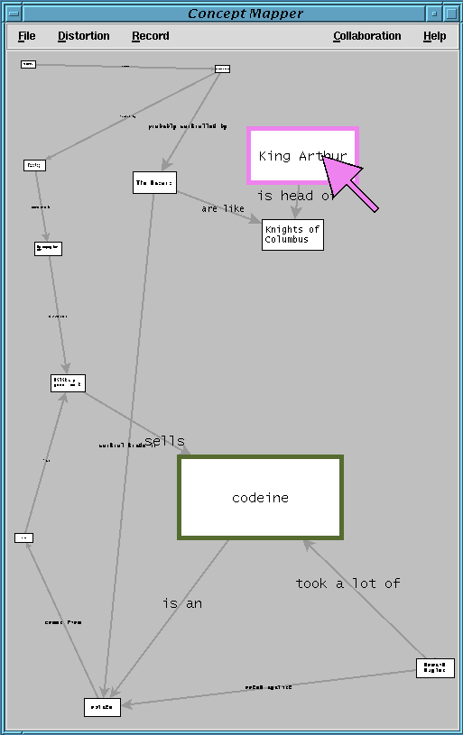

Slide 25
Differing formats
Approach:
  map telepointers to underlying object vs Cartesian space
Issues
  empty and interstitial space
  gestural strokes
  discontinuities
  ambiguous deictic reference

Slide 26
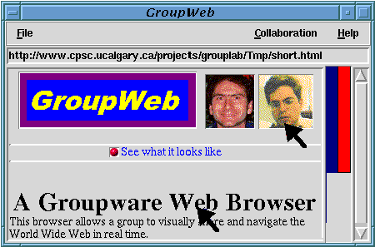
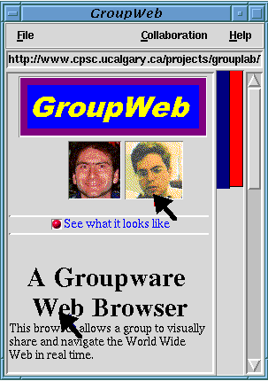
Differing formats

Slide 27
Differing formats
This is some text and here
is some more
This is some text and here is some more

Slide 28
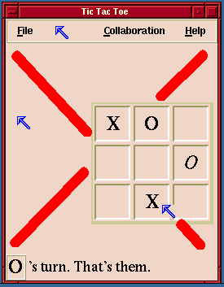
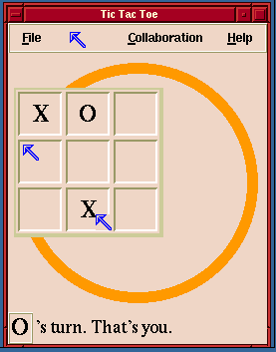
Differing formats
Saul’s View
Carl’s View

Slide 29
Differing representations
Approach
  map cursors to equivalent objects
Issues
  inconsistent coordinate spaces between objects
  no equivalent object may be visible

Slide 30
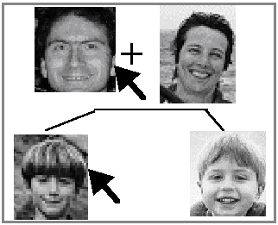
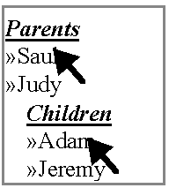
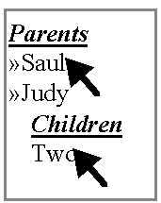
Differing representations
after collapsing
Saul’s View
Carl’s View

Slide 31
Summary
Telepointers:
embody people’s gestures
provide opportunities for
  supplying awareness information
  handling display differences
raise unresolved issues

Slide 32
For more information
http:
//www.cpsc.ucalgary.ca/projects/grouplab
Research funded by:
  Intel Research Council
  National Science and Engineering Research Council

Slide 33
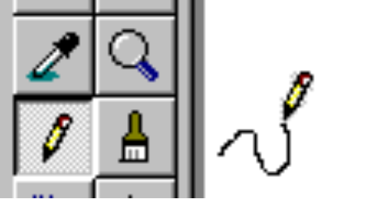
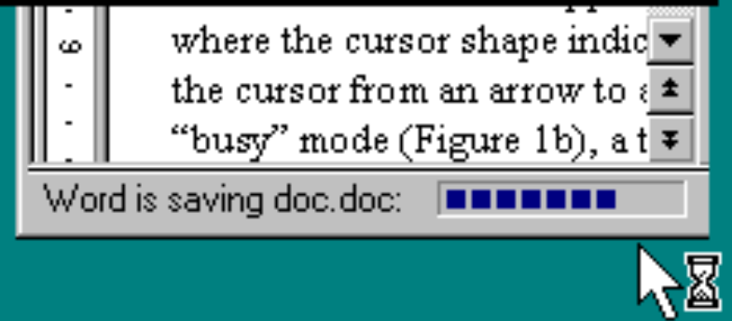
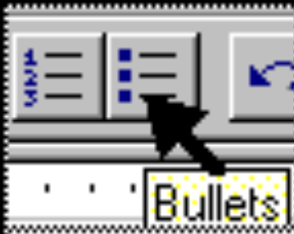
Single User Semantic Cursors
Mode
System state
Help

Slide 34
Display differences
Identical views too restrictive
Saul’s View
Carl’s View

Slide 35
Video Clips
Gestures in group work Tang
Implementing gestures
  through video Ishii
  through telepointers Englebart
  Minneman

Slide 36
Video clips
Identity and mode GroupSketch
Actions GroupKit examples

Slide 37
Video clips
Differing viewports
  example situation
  an awareness widget
differing formats
  by text (GroupWeb)
  by widget (tic tac toe)
  a fisheye space

