Slide 1
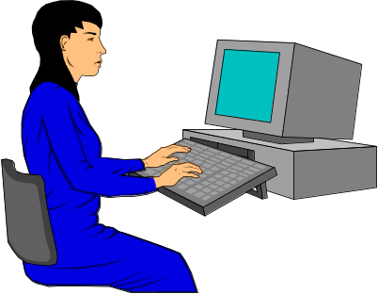
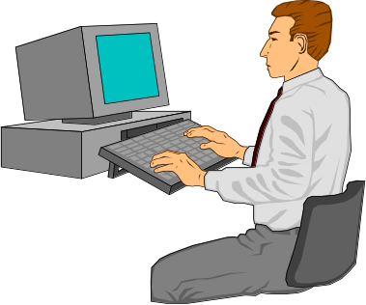
GroupWeb
A WWW Browser as
Real Time Groupware
Note: slide deck does not include the videos shown during its presentation
Saul Greenberg
Mark Roseman
Department of Computer Science
University of Calgary
Notes:
1

Slide 2
Overview
The Message
  Groupware browsers can be excellent collaboration tools
  CSCW research can inform their design
Outline
  motivation
  design principles & GroupWeb

Slide 3


Files: personal information

Slide 4
Web: shared information

Slide 5
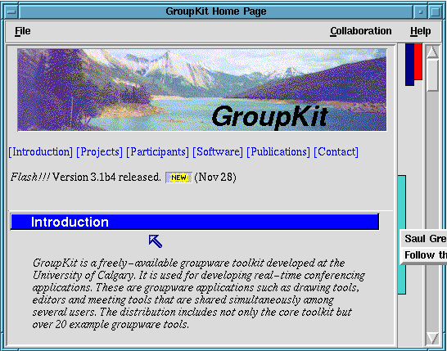

GroupWeb: shared interaction?

Slide 6
Why a groupware browser?
Applications:
  remote presentations
  remote meetings

Slide 7
Why a groupware browser?
Benefits
  Internet: simple connectivity
  easily import distributed information
  well-known interface

Slide 8
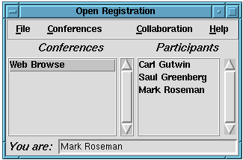
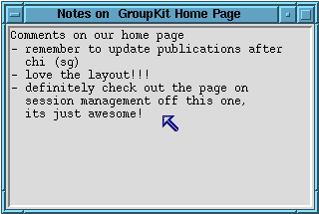
Design Criteria
  gesturing
  annotations
  getting connected
  view control

Slide 9
GroupWeb In Action
Video

Slide 10
Issues
Complexity
HTML Forms
Java
Pragmatics

Slide 11
Summary
Groupware browsers can be excellent tools for people to collaborate over information
Design can be informed by
  existing CSCW research
  GroupWeb prototype
Notes:
32

Slide 12
For more information
http://www.cpsc.ucalgary.ca/
projects/grouplab
  Research funded by:
    Intel Research Council
    National Science and Engineering Research Council

