Slide 1
Awareness through Fisheye Views in Relaxed-WYSIWIS Groupware
Note: Slide deck does not include videos shown during the presentation
Saul Greenberg, Carl Gutwin
Andy Cockburn
University of Calgary and Canterbury

Slide 2
The Message
Fisheye views can afford awareness of others in groupware by showing participants:
    location in the global context
action in the local detail

Slide 3
Outline
Shared workspaces
Workspace awareness
Overview widgets
The fisheye approach

Slide 4
Shared Workspaces
Tabletops, Whiteboards, Control Panels
Design drawings, Documents, Games
Notes:
Tabletops, whiteboards, drawings, documents, control panels, etc.
A shared virtual workspace is any of these provided in a groupware environment

Slide 5
Distributed Groupware

Slide 6
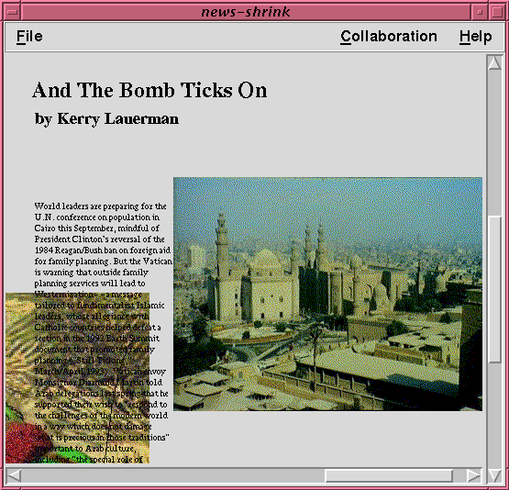
Shared Workspaces

Slide 7
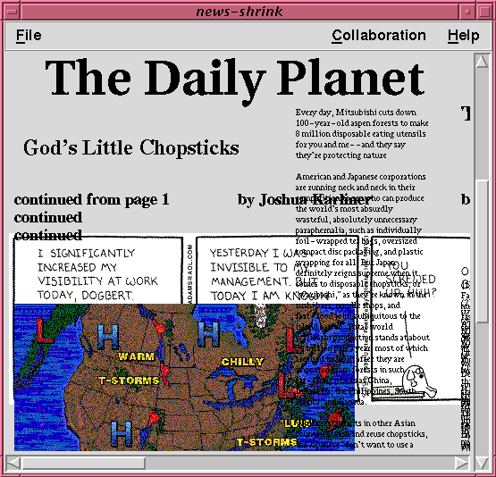
Relaxed WYSIWIS Views

Slide 8
Awareness
“We cannot engage in joint activity
without common ground”
Herbert Clark
Notes:
Awareness for working together vs. awareness for getting together
Awareness in a shared workspace

Slide 9
Our View of Groupware
Allows collaboration to be natural
Awareness
of others
Shared artifacts
Make collaboration possible
Communication

Slide 10
Our View of Groupware
Allows collaboration to be natural
Awareness
of others
Shared artifacts
Make collaboration possible
Communication

Slide 11
Workspace Video

Slide 12
What is Workspace Awareness?
up-to-the-minute knowledge about others’ interaction with a shared workspace
the state of the workspace
my interaction with the workspace
others’ interaction with the workspace
Notes:
1. Three parts
2. Dynamic, ongoing, constantly updated
3. We’re concentrating on one part

Slide 13
What is WA useful for?
Creating opportunities
Coordinating dependent tasks
Monitoring group progress
Providing a shared context

Slide 14
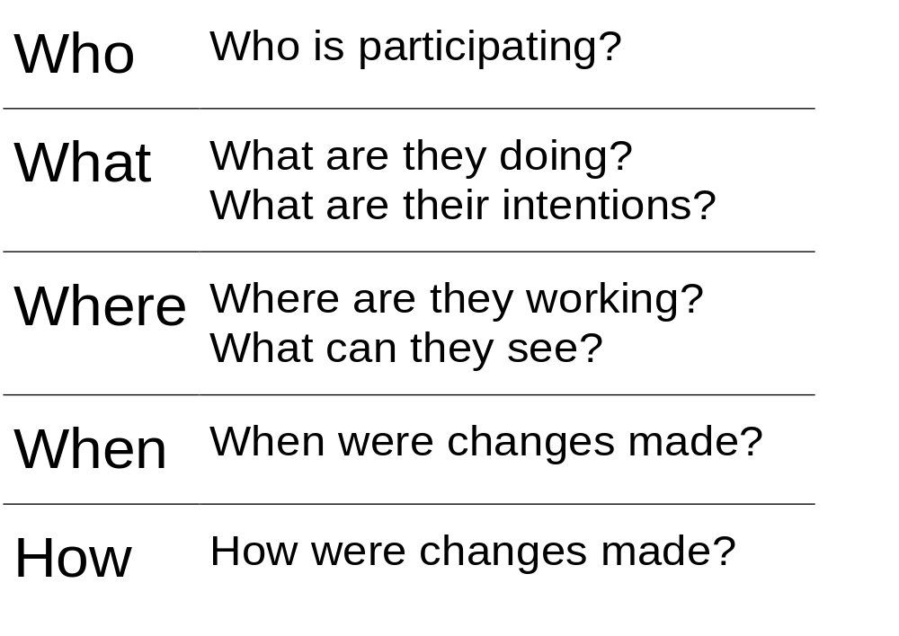
Information

Slide 15
Mechanisms
Peripheral vision
Glances
Verbal activity
Feedthrough

Slide 16
Translation to groupware
Reduced perceptual information
Poorer communication
Computers hide things!
Techniques like relaxed-wysiwis

Slide 17
Display
Interpretation
Weightiness
Distraction
Notes:
We can repair some of the limitations of groupware settings
Components can be added on to groupware interfaces to provide WA information

Slide 18
Awareness Widgets
Support awareness of:
  Presence
  Location
  Activity

Slide 19
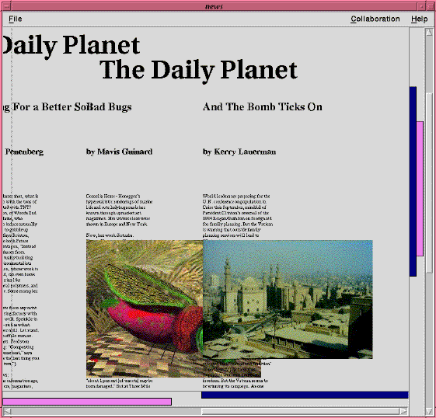
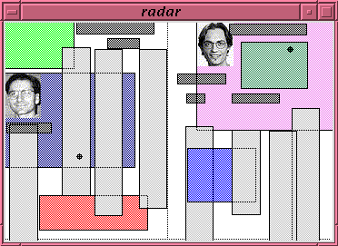
Current Approaches
Notes:
We can repair some of the limitations of groupware settings
Components can be added on to groupware interfaces to provide WA information

Slide 20
Video
Overviews

Slide 21
Problems...
Screen real estate consumed
Separate windows introduces a seam
Overview hides details of actions
Question:
  Can we merge the overview, detail and main view into a single view?

Slide 22
Fisheye Views
Integrate detail and global view
Awareness by:
  location in global context
  details through
  multiple focal points
  telepointers

Slide 23
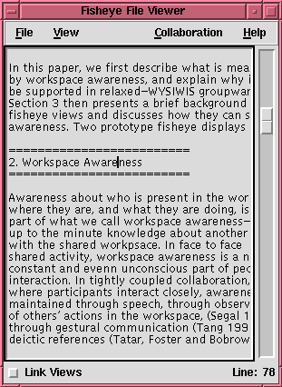

Slide 24
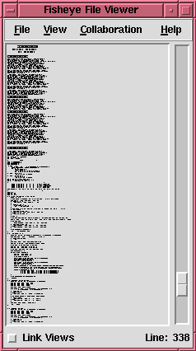

Slide 25
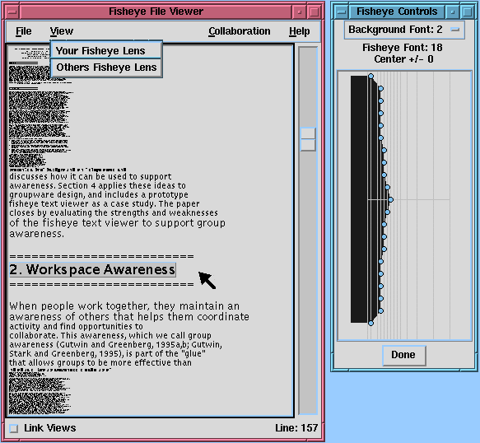
Fisheye
Text single user

Slide 26
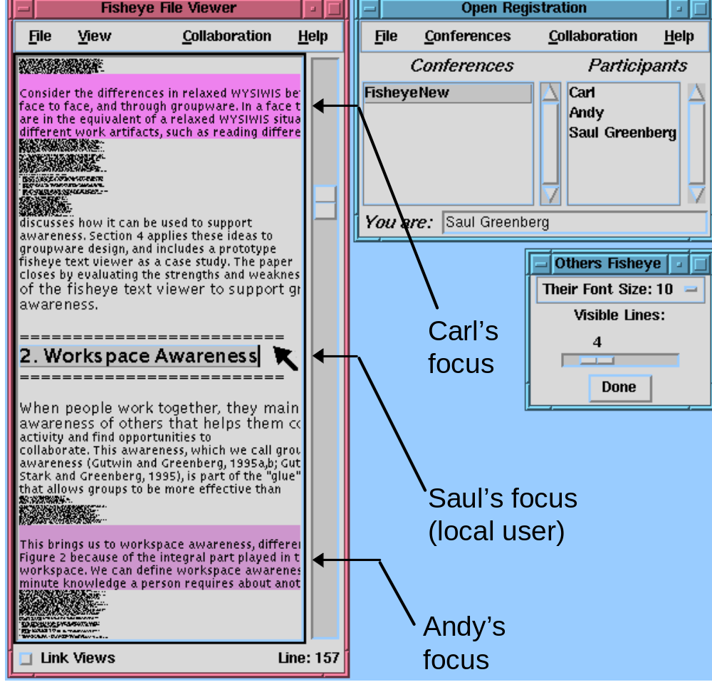
Fisheye
Text
groupware

Slide 27
Video
Fisheye Views

Slide 28
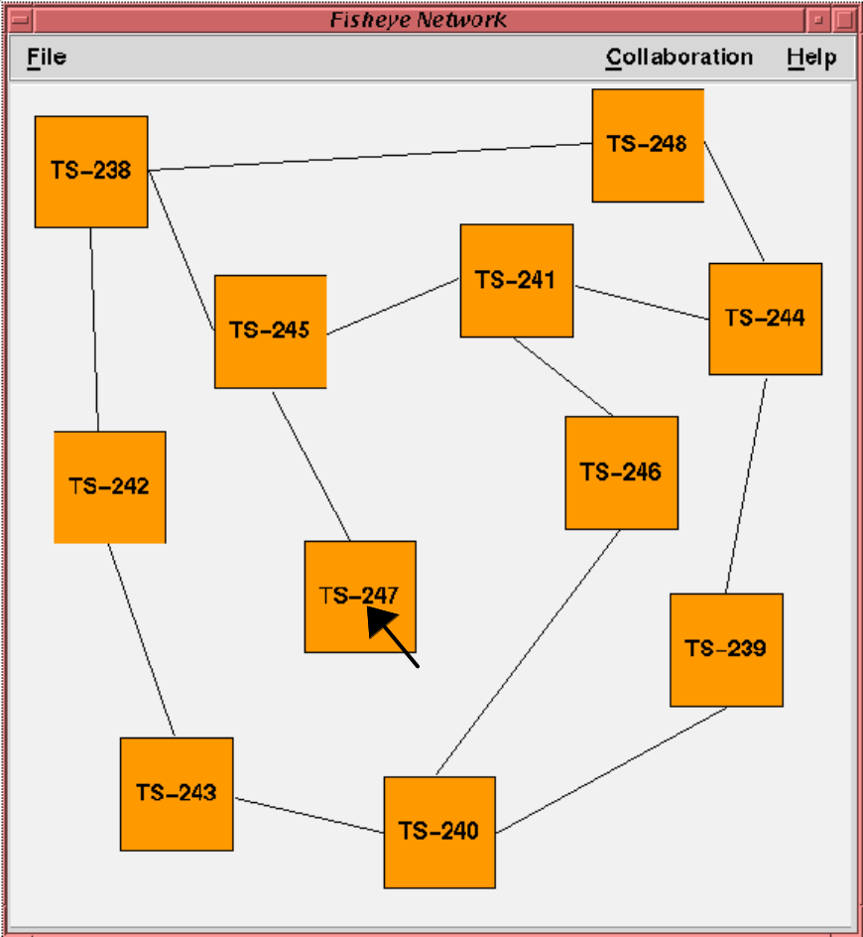
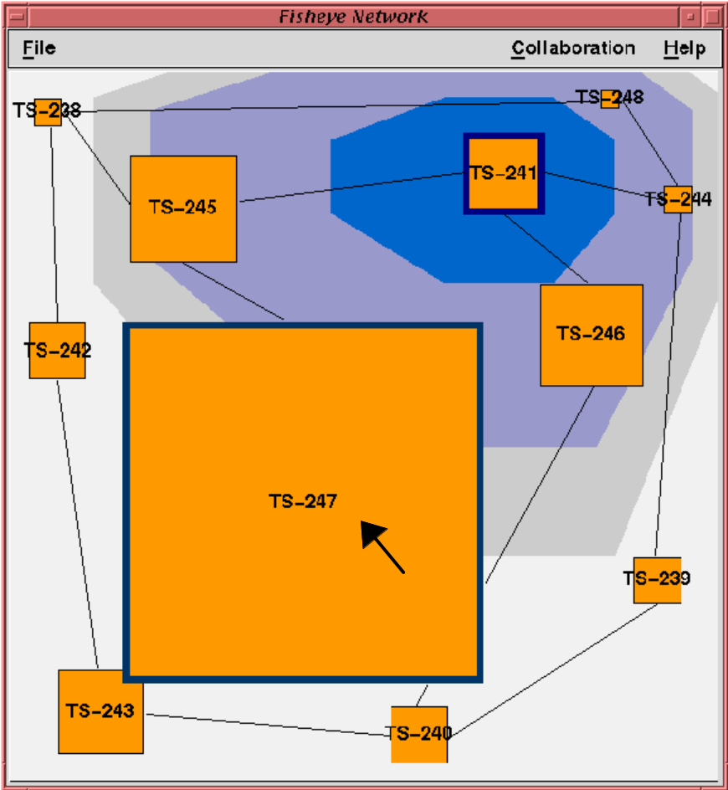
Graphical Fisheye

Slide 29
Do fisheyes work?
Information present
  who is participating
  where they are
  what they are doing
  what changes they are making

Slide 30
Next Steps
Usability studies
  is this a reasonable way to work?

Slide 31
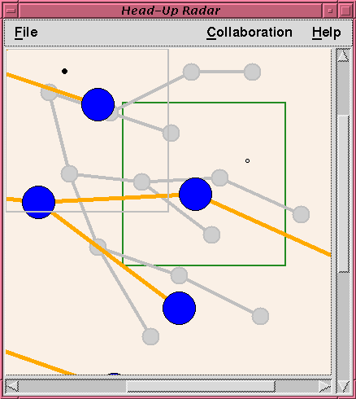
HeadUp
Lens
Main view
in foreground
Overview
in background

Slide 32
The Message (again)
Fisheye views can afford awareness of others in groupware by showing participants:
    location in the global context
action in the local detail

