Slide 1
This presentation collects six talks presented within a special session at the CHI conference
Supporting awareness of others in groupware (session intro)
Peepholes: Low cost awareness of one’s community
Workspace awareness for groupware
Workspace awareness support with radar overviews
A fisheye text editor for relaxed WYIWIS groupware
A usability study of workspace awareness widgets
Note: videos shown during these presentations are not included here

Slide 2
Awareness of Others in Groupware
Who are you, and what are you doing?
Carl Gutwin, Saul Greenberg, Mark Roseman
The University of Calgary

Slide 3
The Message
Groupware will only approach the simplicity and richness of face-to-face collaboration by supporting awareness of others

Slide 4
What’s in this session?
Awareness in group work
Informal awareness through Peepholes
Workspace awareness framework
Awareness widgets
Usability study

Slide 5
Awareness in Group Work

Slide 6
Awareness in Collaboration
Communication
Making Contact
Negotiation
Coupling
Awareness
Anticipation
Assistance
Coordination

Slide 7
Distributed Groupware

Slide 8
Our View of Groupware
Allows collaboration to be natural
Awareness
of others
Shared artifacts
Make collaboration possible
Communication

Slide 9
Our View of Groupware
Allows collaboration to be natural
Awareness
of others
Shared artifacts
Make collaboration possible
Communication

Slide 10
Studying Awareness
What information is important for maintaining awareness?
Does it work?
Can it be translated to a groupware setting?
How should the information be displayed in groupware?

Slide 11
Kinds of Awareness
Informal
Task
Social
Situation / System state
Structural
Workspace

Slide 12




Peepholes
Low cost awareness
of
one’s community

Slide 13
The Message
Groupware success tied to contact facilitation
  informal awareness of each other
  ease of establishing communication
Research
  what is the simplest system that affords informal awareness?

Slide 14
The Problem
Groupware can only work after people make contact with each other
?

Slide 15
Informal awareness
The glue behind casual
interaction
Questions
  who is around?
  are they available now?
  can they be interrupted?
  how can I initiate contact?

Slide 16



Current Approaches
Media Spaces
Periodic Snapshots
  (Portholes)
Active Badges

Slide 17
The Larger Community
Current systems
  high common denominator technology
  restricted communities
  socially intrusive and risky
Overkill for basic awareness needs

Slide 18
Minimalist Awareness
Who is around in my personal community?
Can I reach them now?

Slide 19
Design Requirements
Common denominator technology
Information freely available
Migration path to higher end systems
Provides access to groupware
Tracks one’s custom community

Slide 20
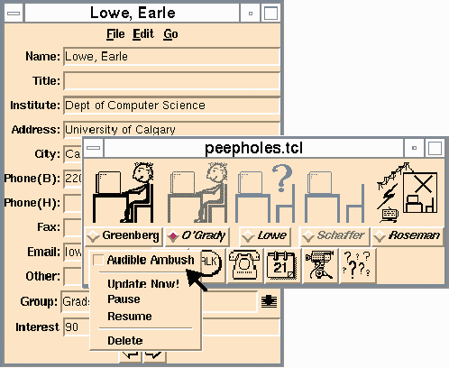
Peepholes
community
database
active icons
groupware
“ambush”

Slide 21
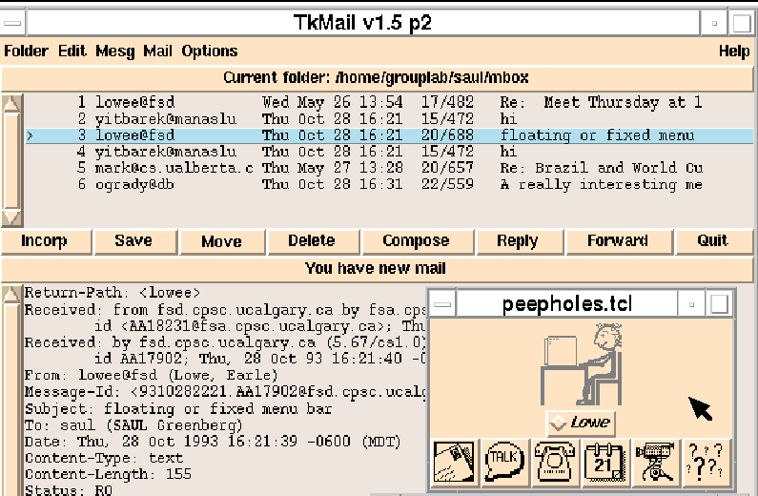
Peepholes and Email

Slide 22
Issues
It works, but…
  information is sometimes unavailable
  information is sometimes unreliable
  unknown groupware capabilities
  privacy concerns

Slide 23
Peepholes Summary
Success of groupware tied to people’s
  informal awareness of each other
  ease of establishing communication
Systems can provide
  low cost activity indicators
  migration to snapshots and full video

Slide 24
Workspace Awareness for Groupware

Slide 25
Shared Workspaces
Tabletops, Whiteboards, Control Panels
Design drawings, Documents, Games

Slide 26
Workspace Video

Slide 27
What is Workspace Awareness?
up-to-the-minute knowledge about others’ interaction with a shared workspace
the state of the workspace
my interaction with the workspace
others’ interaction with the workspace

Slide 28
What is WA useful for?
Coordinating dependent tasks
Monitoring group progress
Monitoring others’ work
Providing a shared context

Slide 29
Studying WA
Information
Evaluation
Translation
Display

Slide 30
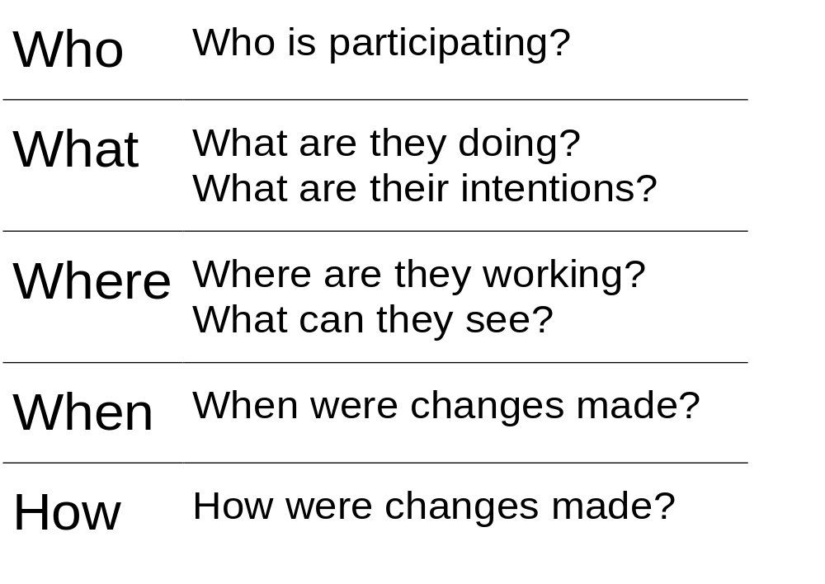
Information

Slide 31
Mechanisms
Peripheral vision
Glances
Verbal activity
Feedthrough

Slide 32
Translation
Reduced perceptual information
Poorer communication
Computers hide things!
Techniques like relaxed-wysiwis

Slide 33
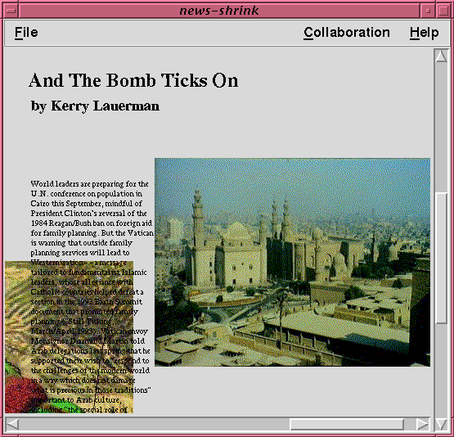
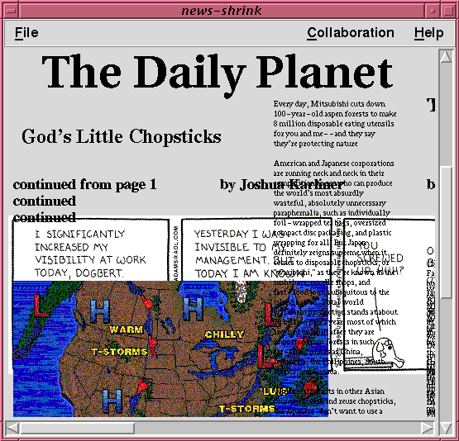
Relaxed WYSIWIS Views

Slide 34
Display
Weightiness
Using existing mechanisms
Distraction

Slide 35
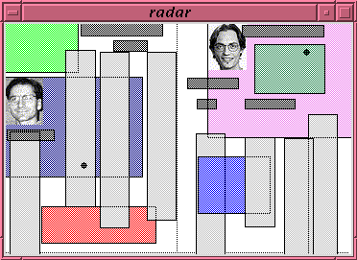
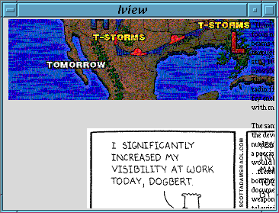
Workspace Awareness Support with Radar Views

Slide 36
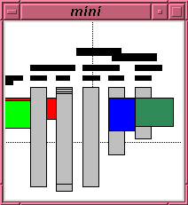
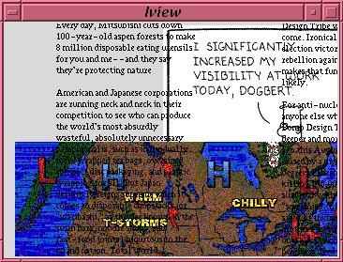
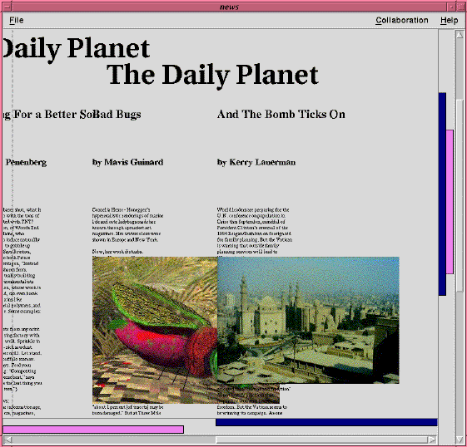
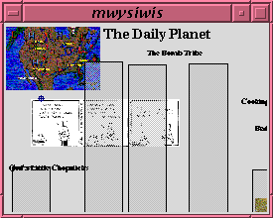
Awareness Widgets

Slide 37
Design Goals
Support awareness of:
  Presence
  Location
  Activity
Follow the affordances of physical workspaces

Slide 38
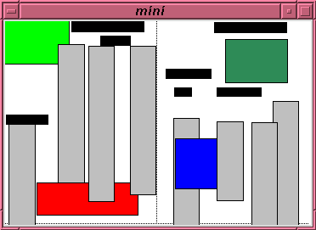
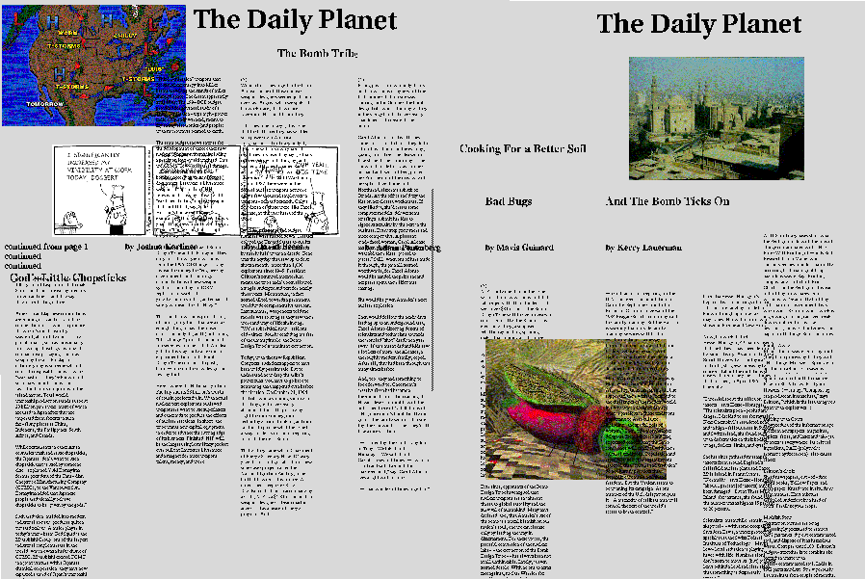
Overviews

Slide 39
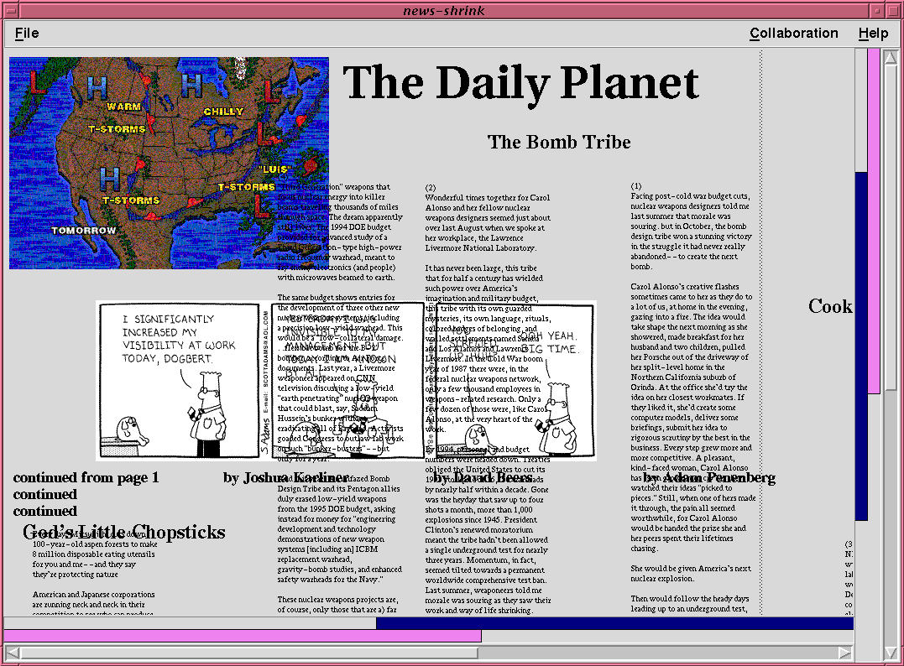
Detail Views

Slide 40
Awareness Widgets Video

Slide 41
Overviews

Slide 42
Detail Views

Slide 43
A talk for
ACM Conference on
Human factors in computing systems
A
Fisheye
Text Editor
for
Relaxed-WYSIWIS
Groupware
Saul Greenberg
University of Calgary
April, 1996

Slide 44
The Message
Fisheye views can provide awareness of both global context and local detail

Slide 45
Different Views

Slide 46
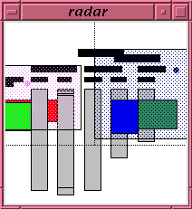
Current solutions

Slide 47
Potential problems
Screen real estate consumed
Awareness window introduces a seam
Overview hides details of actions
Detail view isolated from global context

Slide 48
A Different Approach
Integrate detail view and global view together through a fisheye lens
Awareness by:
  location in global context
  action details through
  multiple focal points
  telepointers

Slide 49
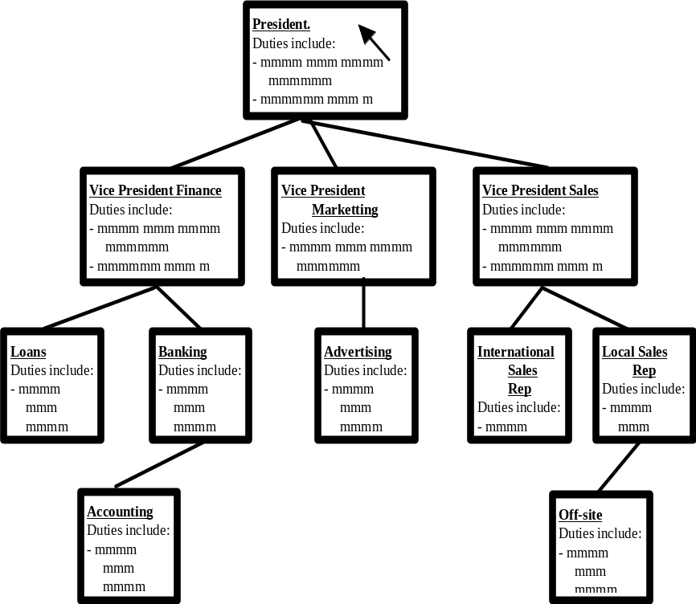
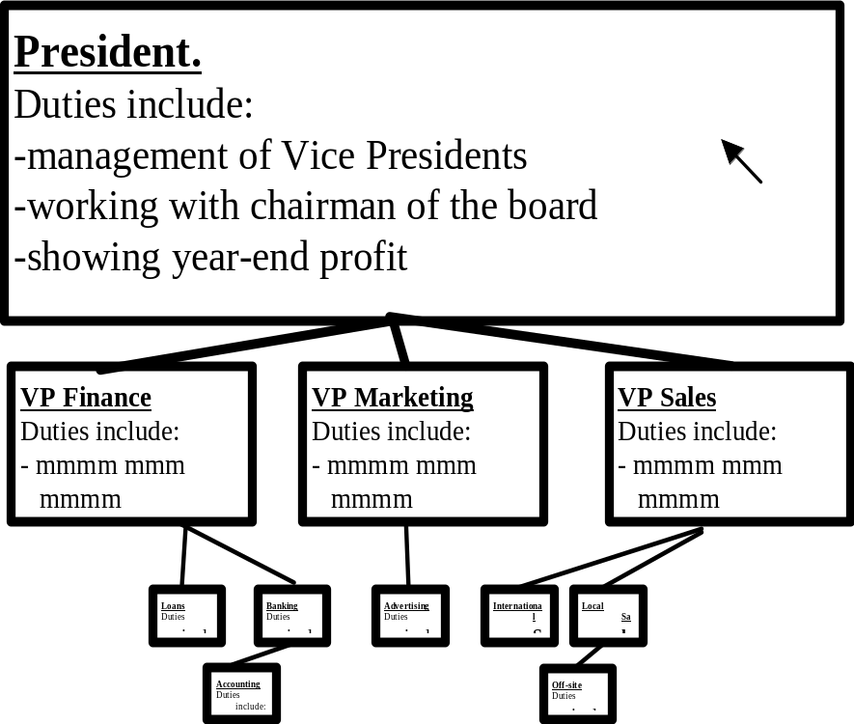
Standard Fisheye views
original
graphical fisheye

Slide 50
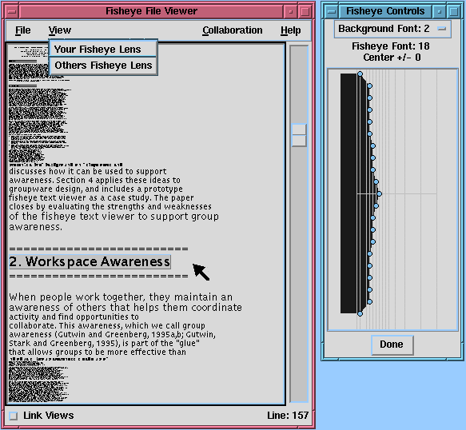
Fisheye
Text single user

Slide 51
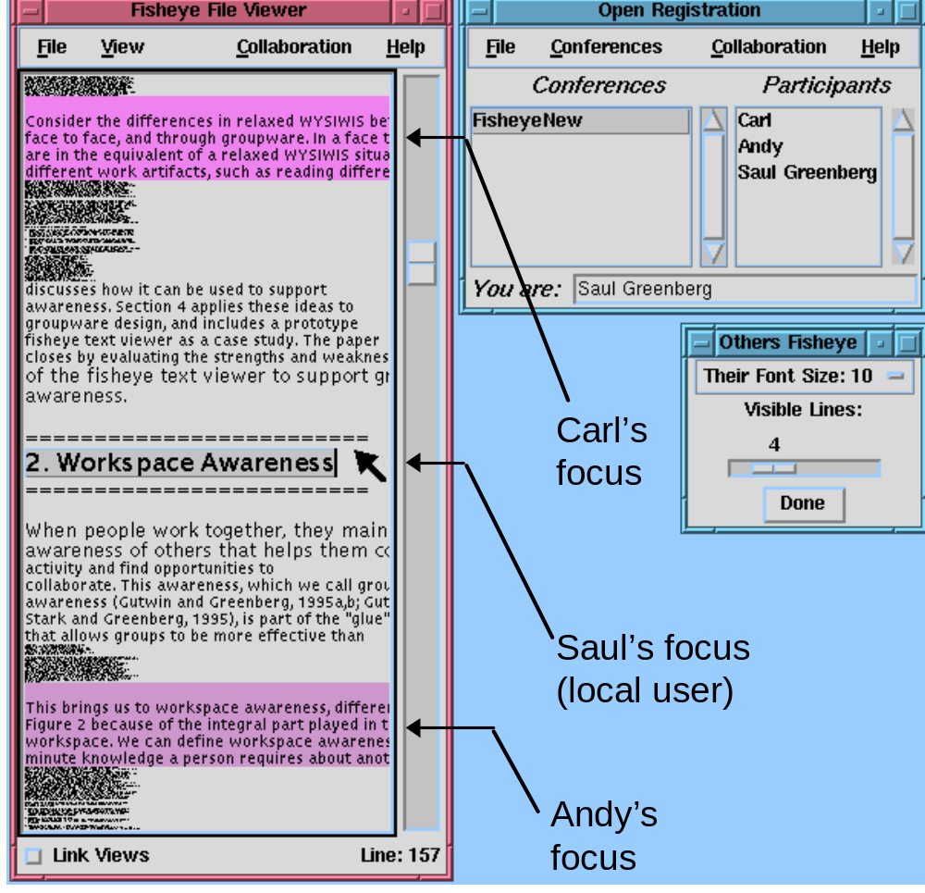
Fisheye
Text
groupware

Slide 52
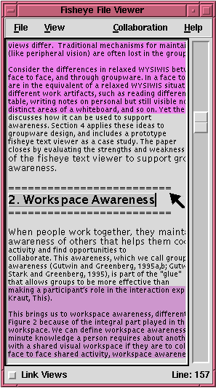
Fisheye
Text
split window

Slide 53
Does it work?
Information present
  who is participating
  where they are
  what they are doing
  what changes they are making
Usability issues
  can they see my details?
  is this a reasonable way to work?

Slide 54
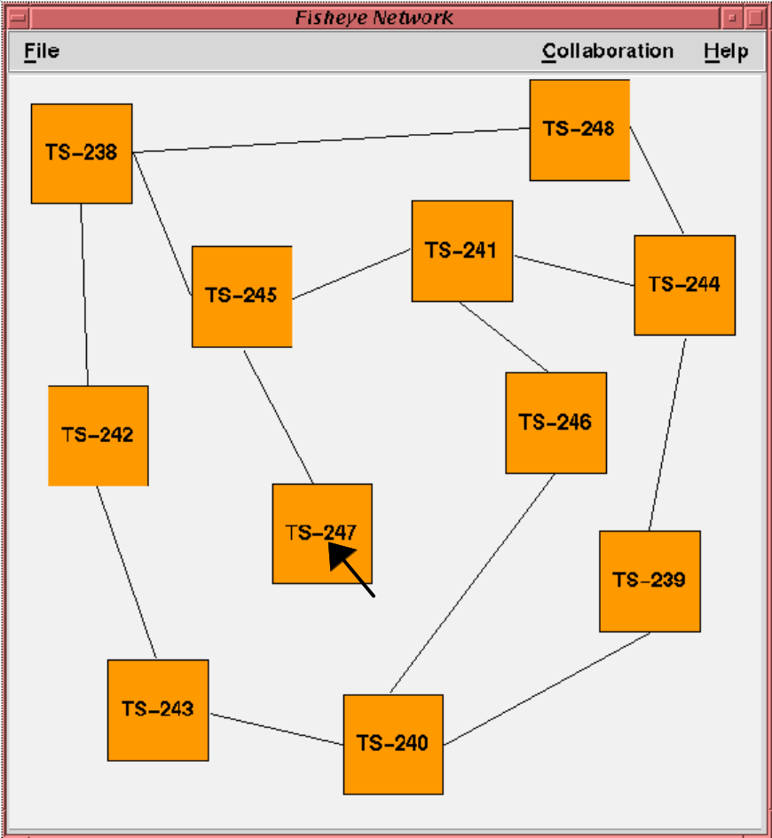
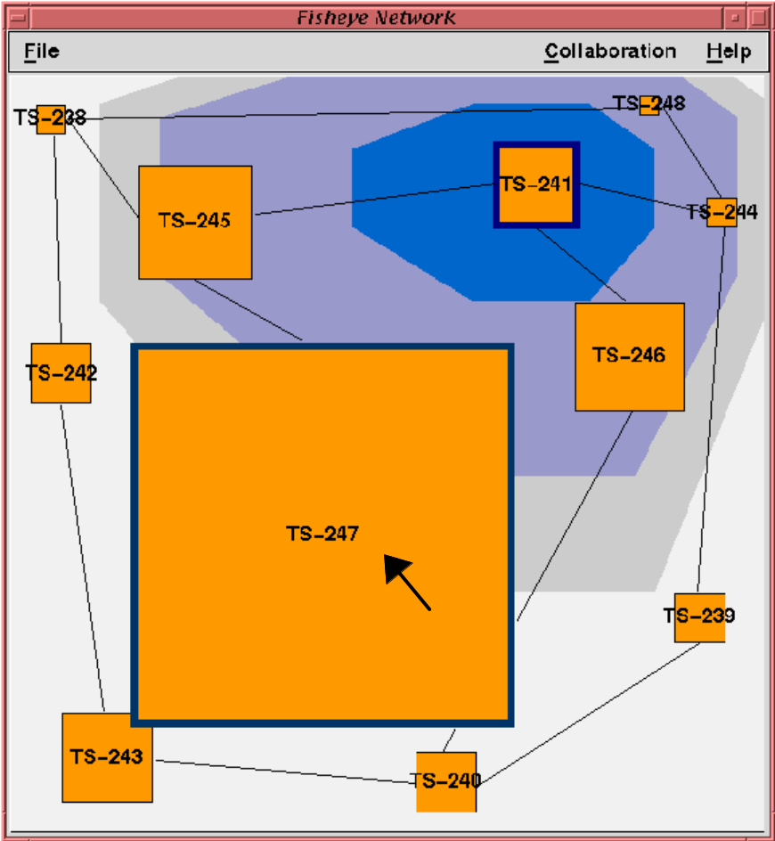
Graphical Fisheye

Slide 55
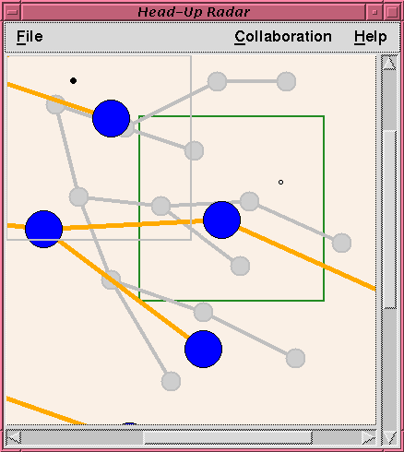
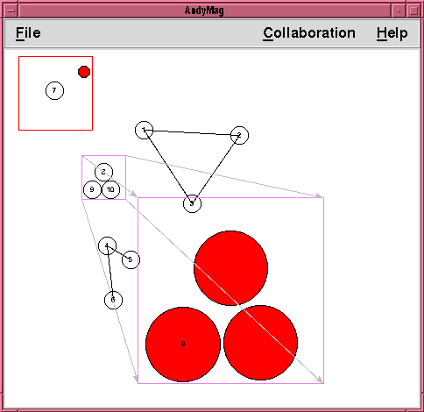
Related Extensions
Head Up Lens
Offset Lens

Slide 56
Summary
Fisheye views can afford awareness
  location in global context
  action details through
  multiple focal points
  telepointers
  customizable
Still requires usage evaluation

Slide 57
A Usability Study of
Workspace Awareness Widgets

Slide 58
Usability Study
Page-layout systems with WA widgets
Setup:
  Distributed pairs of novices
  Two newspaper layout tasks
  Fifteen minutes per task
  Questionnaires and interviews
  Observations and videotape

Slide 59
Conditions

Slide 60
Video of Study Task

Slide 61
Preliminary Findings
General observations
What didn’t work
What did work
Seams and seamlessness
Summary

Slide 62
General Observations
Subjects enjoyed using the system
All pairs completed the tasks
The widgets were used
Gesturing and deixis
Radar and mini views were useful
Multi-user scrollbar and WYSIWID were less so

Slide 63
What Didn’t Work
WYSIWID:
  Not enough context
  Too much detail for the layout task
Multi-user scrollbar:
  No landmarks
  Hard to integrate

Slide 64
What Did Work
Overviews:
  A basis for global WA information
  A way to keep track of the whole space
  Support for individual activity
  A good fit to the spatial task

Slide 65
Seams and Seamlessness
Where to show WA information
  In the main workspace or outside it?
Awareness widgets and conceptual workspaces
  context shift
  perception/action

Slide 66
Usability Summary
People preferred the WA conditions
No major differences between conditions
People are resourceful!
Caveats:
  Group size
  Task type

Slide 67
Overall Conclusions

Slide 68
Summary
Informal
Task
Social
Situation / System state
Structural
Workspace
Several types of awareness affect group work

Slide 69
Summary
Awareness
of others
Shared artifacts
Communication
Awareness is a consideration beyond basic communication and artifact sharing

Slide 70
Summary
Who?
What?
Where?
When?
How?
Designers must consider what elements are important and how to display them

Slide 71
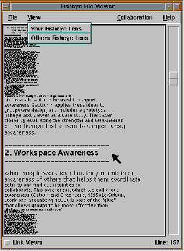
Summary
Awareness can be supported in groupware with special widgets and techniques

Slide 72
Summary
Awareness widgets can improve the usability of groupware applications

Slide 73
For more information...
http://www.cpsc.ucalgary.ca/projects/grouplab
Thanks to:
Intel Corporation Research Council
Natural Sciences and Engineering Research Council of Canada

Slide 74
The Message (again)
Designers must consider and support awareness if groupware is to get beyond the utilitarian state of the art

Slide 75
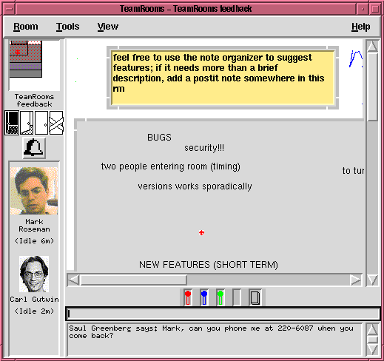
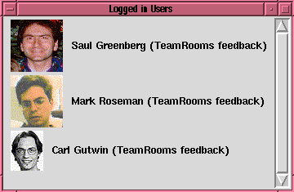

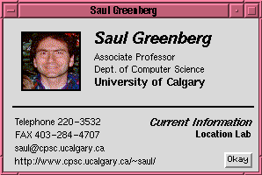
TeamRooms

