Slide 1
Using Distortion-Oriented Displays to Support Workspace Awareness
Note: slide deck does not include videos shown during the presentation
Saul Greenberg, Carl Gutwin
Andy Cockburn
University of Calgary and Canterbury

Slide 2
The Message
Distortion-oriented views can afford awareness of others in groupware by showing participants:
    location in the global context
action in the local detail

Slide 3
Outline
Shared workspaces + awareness
Problems with current widgets
HeadUp and Offset Lens
Fisheye Lens

Slide 4
Shared Workspaces
Tabletops, whiteboards, control panels
Design drawings, documents, games
Notes:
Tabletops, whiteboards, drawings, documents, control panels, etc.
A shared virtual workspace is any of these provided in a groupware environment

Slide 5
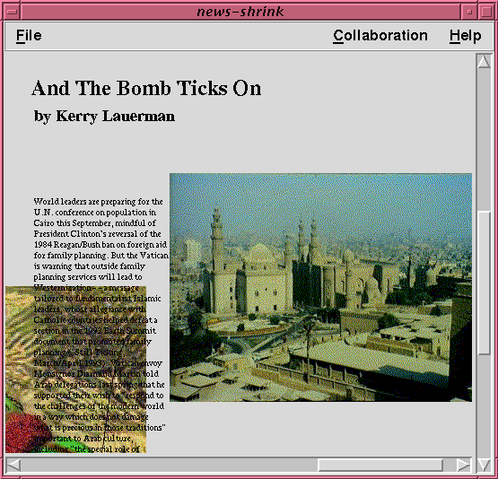
Page layout

Slide 6
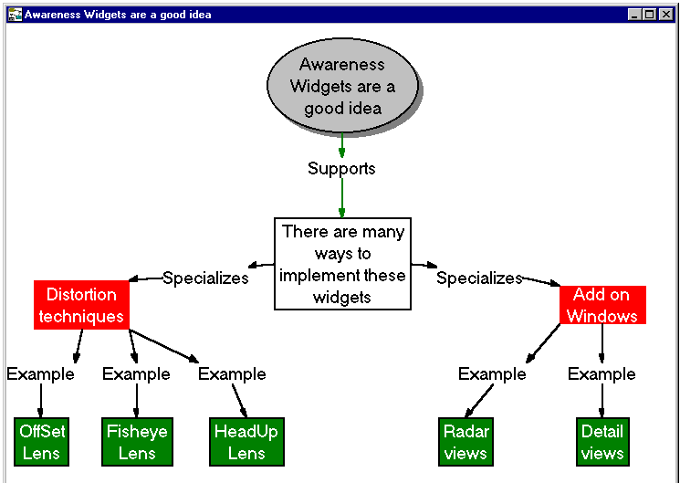
Concept maps

Slide 7
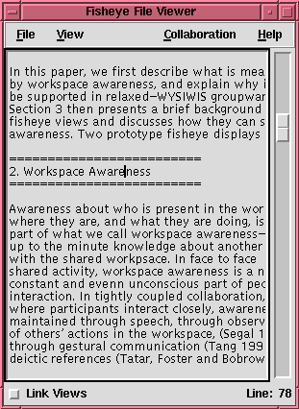
Text Editors

Slide 8
WYSIWIS Views

Slide 9
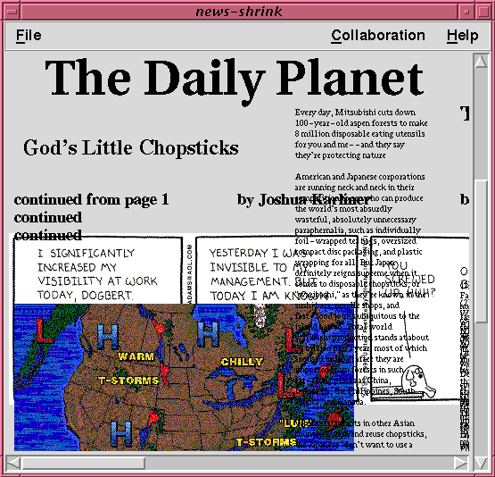
Relaxed WYSIWIS Views

Slide 10
Awareness
“We cannot engage in joint activity
without common ground”
Herbert Clark
Notes:
Awareness for working together vs. awareness for getting together
Awareness in a shared workspace

Slide 11
Awareness Widgets
Presence
Location
Activity
Information
Evaluation
Translation
Display

Slide 12
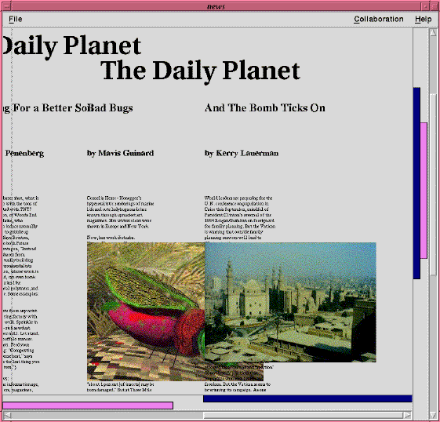
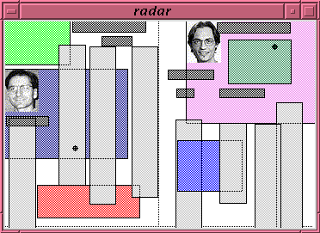
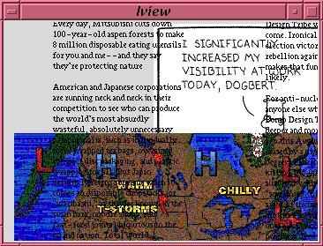
Awareness through add-on windows
Notes:
We can repair some of the limitations of groupware settings
Components can be added on to groupware interfaces to provide WA information

Slide 13
Difficulties:
Screen real estate tradeoff

Slide 14
Difficulties:
Multiple views, multipoint

Slide 15
Difficulties:
Seams in add-on window
“ to be honest, I kind of forgot about the radar”
“ most of the time, I did not notice it”
“ the location of the radar was not very good, [it] forced you to look quite a distance”

Slide 16
Difficulties:
Detailed views out of context
“it shows too little of the other user’s view to figure out where he is.”
“it shows too small an area to gain any real benefit from it.”

Slide 17
Research Question
Can we merge the overview and main view into a single window?
Approach #1
  multiplex overview and main view into a single window via transparent layer

Slide 18
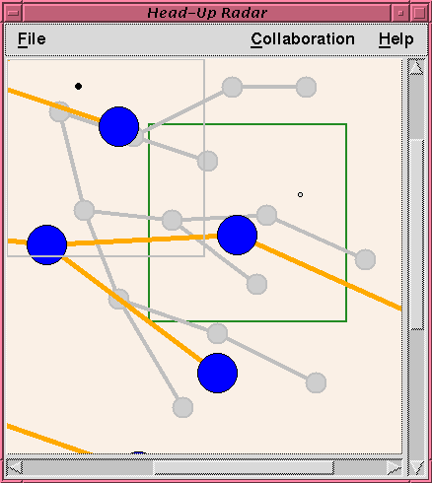
HeadUp
Lens
Main view
in foreground
Overview
in background

Slide 19
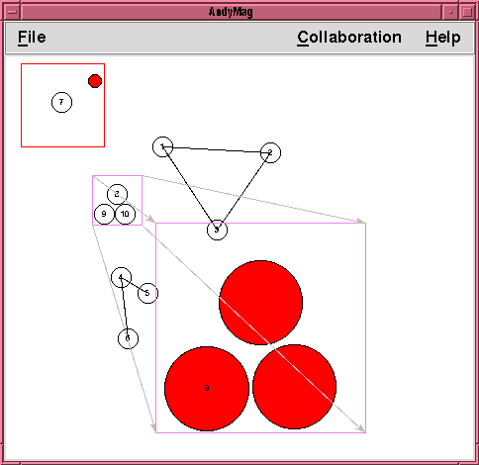
Offset
Lens
Focus
Magnified
view

Slide 20
Video
HeadUp and Offset Lens

Slide 21
Do these lenses work?
Information present
  who is participating
  where they are
  what they are doing
  what changes they are making

Slide 22
Do these lenses work?
no screen real estate tradeoff
overview largest size possible
multiple views collapsed

Slide 23
Further difficulties
Seams in conception and action
Interface issues
  transparency
  control of magnification lenses
  dense views

Slide 24
Research Question
Can we integrate both overview and details into a single view?
Approach #2: Fisheye Views
  location in global context
  details through multiple focal points + telepointers

Slide 25
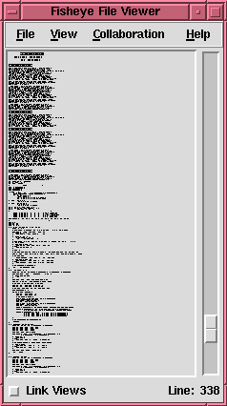

Slide 26
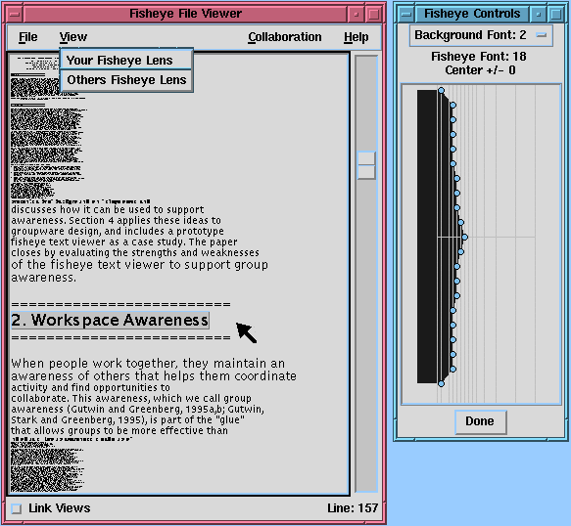
Fisheye
Text single user

Slide 27
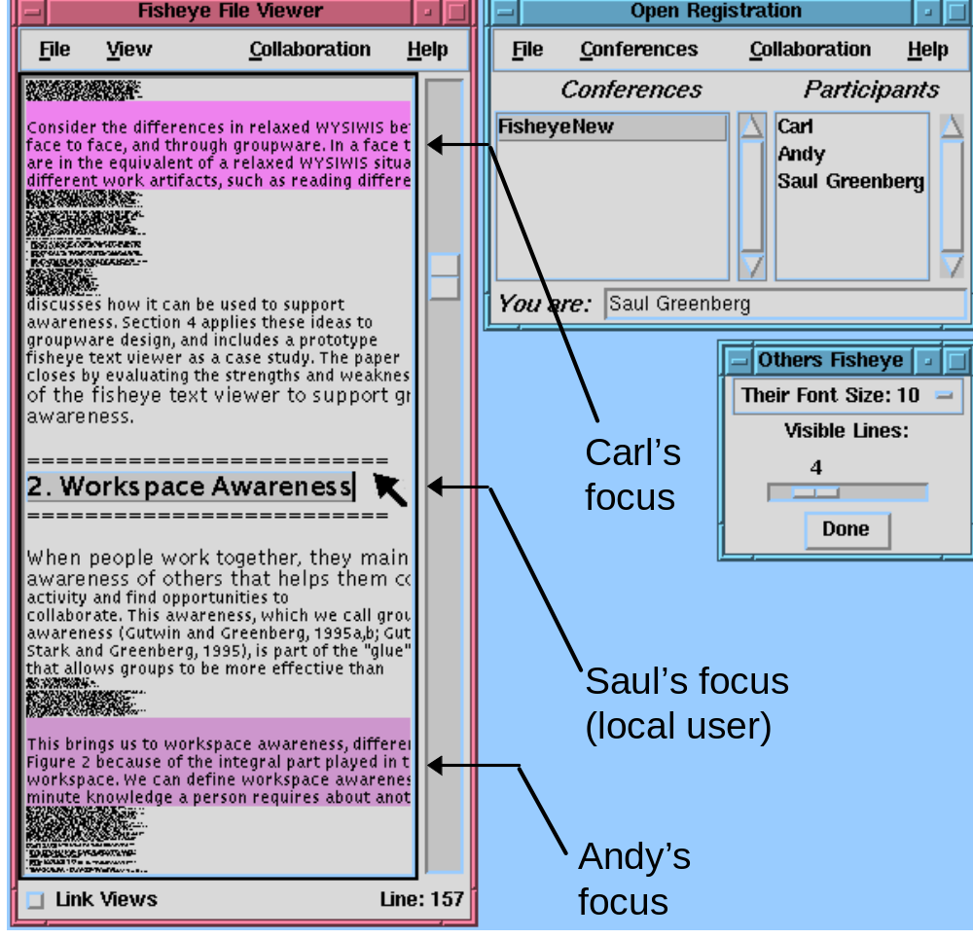
Fisheye
Text
groupware

Slide 28
Video
Fisheye Views

Slide 29
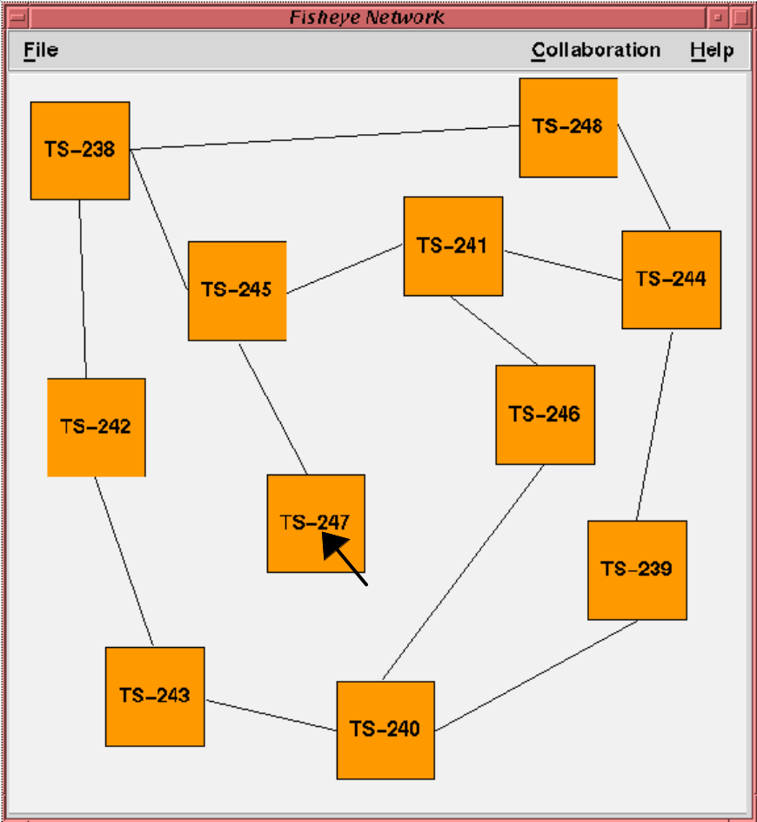
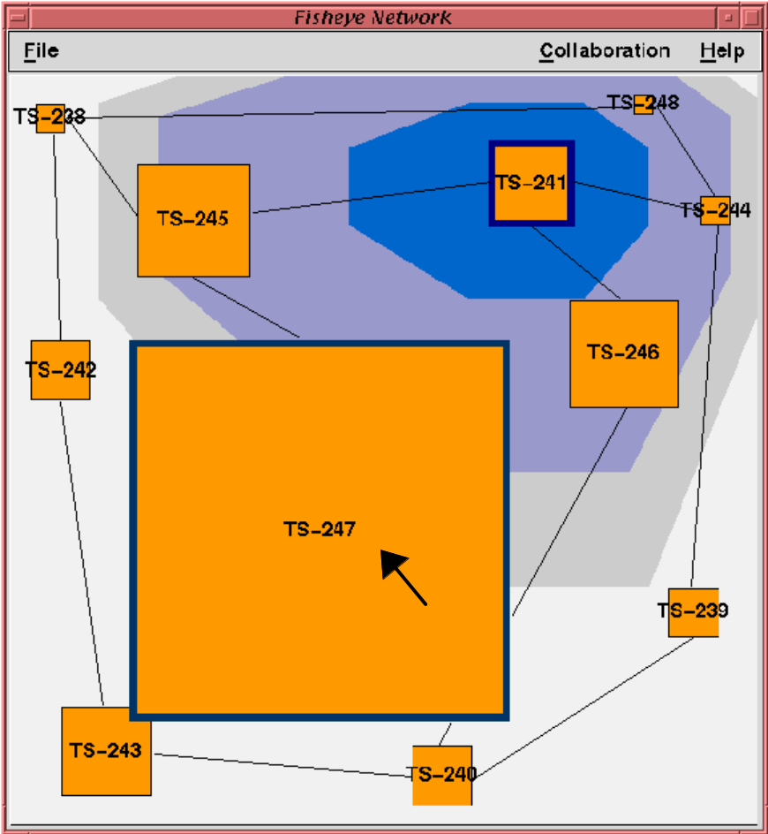
Graphical Fisheye

Slide 30
Do fisheyes work?
Information present
  who is participating
  where they are
  what they are doing
  what changes they are making

Slide 31
Do fisheyes work?
Balances screen real estate tradeoff
Multiple views collapsed into single view
No seam between overview and detail
Actions possible anywhere
Detail always in context

Slide 32
Further difficulties...
But
  unfamiliar representation
  restricted set of tasks
  strange new way of working!

Slide 33
Further Evaluation
Principled analysis
  framework refines design
Usability studies
  is this a reasonable way to work?

Slide 34
Summary
Distortion oriented views:
  minimizes screen real estate tradeoff
  minimizes need for multiple views
  removes conceptual seams in add-on windows
  places detail in context

Slide 35
The Message (again)
Distortion-oriented views can afford awareness of others in groupware by showing participants:
    location in the global context
action in the local detail

Slide 36
For more information...
http://www.cpsc.ucalgary.ca/projects/grouplab
Thanks to:
  Intel Corporation Research Council
  NSERC
  University of Canterbury / Erskine

