Slide 1
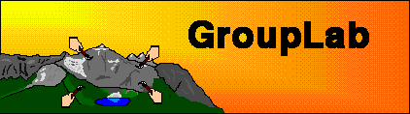
Supporting Workspace Awareness in
Desktop Conferencing
Note: This presentation included live system demonstrations
Carl Gutwin
Saul Greenberg
University of Calgary, Canada

Slide 2
The Message
Awareness of other people’s work in a shared space is essential for effective group interaction
Groupware systems must include specific mechanisms to support this practice
Notes:
as in face to face situations, where we are selectively aware of what is going on around us

Slide 3
Outline
Desktop conferencing
Workspace awareness
Prototypes
Notes:
Desktop conferencing to set the scene and as a reminder
Workspace awareness, to define what we are investigating and to offer a preliminary framework for discussing its concepts
Prototypes, or bottom up inventions of various widgets that support awareness through software

Slide 4
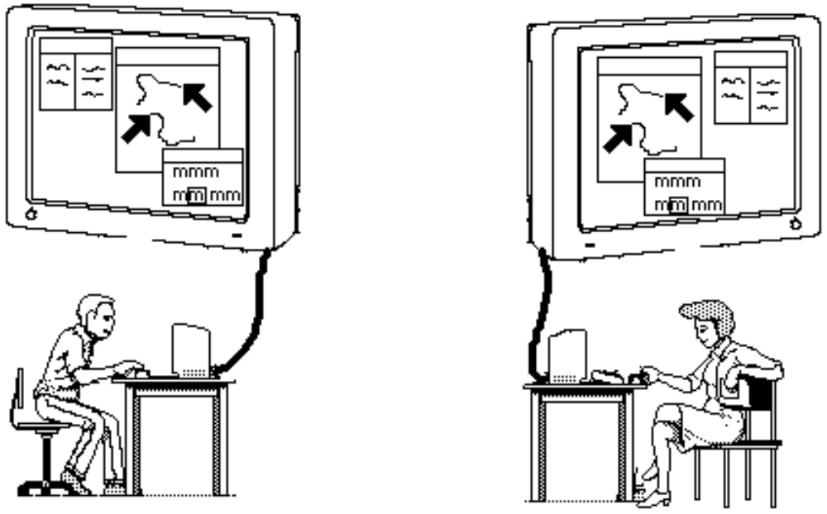
Desktop Conferencing
George’s
Office
Mary’s
Office
Notes:
Desktop conferencing
-Two or more people communicating and working together through their computers
-different locations
-expect audio, perhaps video as well
-sharing work as well as artifacts

Slide 5
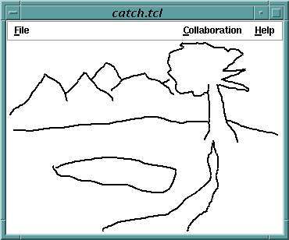
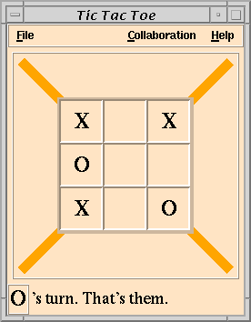
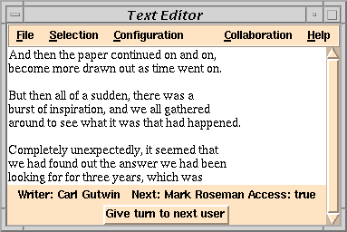
Notes:
shared text editors
multi-user games
electronic whiteboards

Slide 6
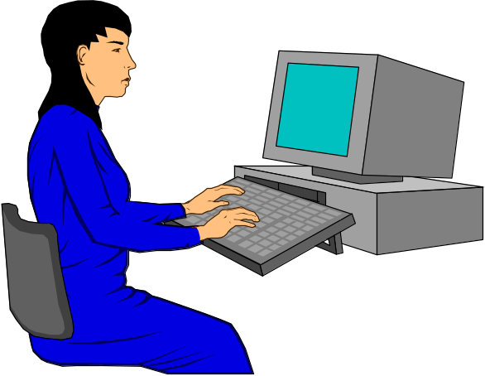
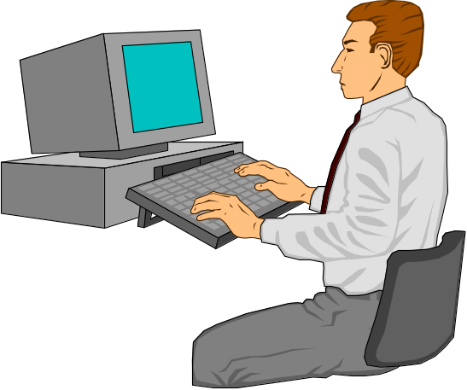
What you see is what I see
Strict
Notes:
strict WYSIWIS follows from face to face metaphor of working closely together over a shared artefact
implies people seeing fine-grained changes of the artefact, and ability to gesture to objects with telepointers
because people know they are looking at exactly the same thing, it helps them talk around the artefact

Slide 7
Relaxed WYSIWIS
Org Chart
Organization Chart
President
Vice President (Finance)
-accounting
-banking
Vice President (Product)
-technical support
>>help desk
-R & D
By space
By representation
Notes:
Harness power of computers to let people look at the same thing in different ways
different parts of same document
different representation of items in the document
relaxes collaboration from tight real-time interaction to “mixed focus”, where people go off and do their own thing for short intervals
new challenges
for people to maintain awareness of what others are doing in workspace,
greater risk of communication breakdowns
in particular, one of the challenges is how groupware can maintain people’s awareness of what others are doing, especially when they are not looking at the same thing.

Slide 8
Awareness
Group awareness
Workspace awareness
Research process
Notes:
One of the problems with awareness is that although its something we all intuitively know about and use, its quite hard to tease out its essential features.
What we’ve done is create a framework for categorizing people’s awareness requirements in group settings.
First, I’ll talk about types of awareness in general, which we call group awareness.
I’ll then focus onto one particular type of awareness, called workspace awareness, and describe how we are conducting research into it.

Slide 9
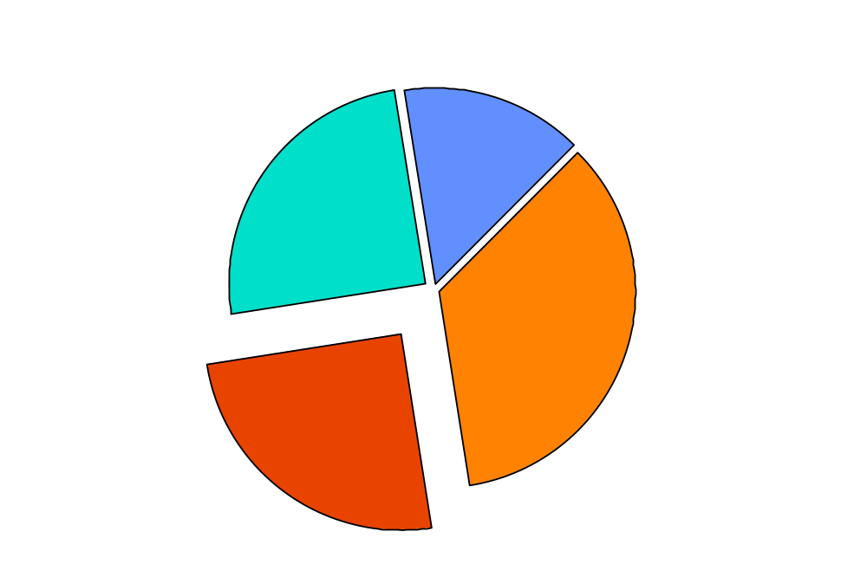
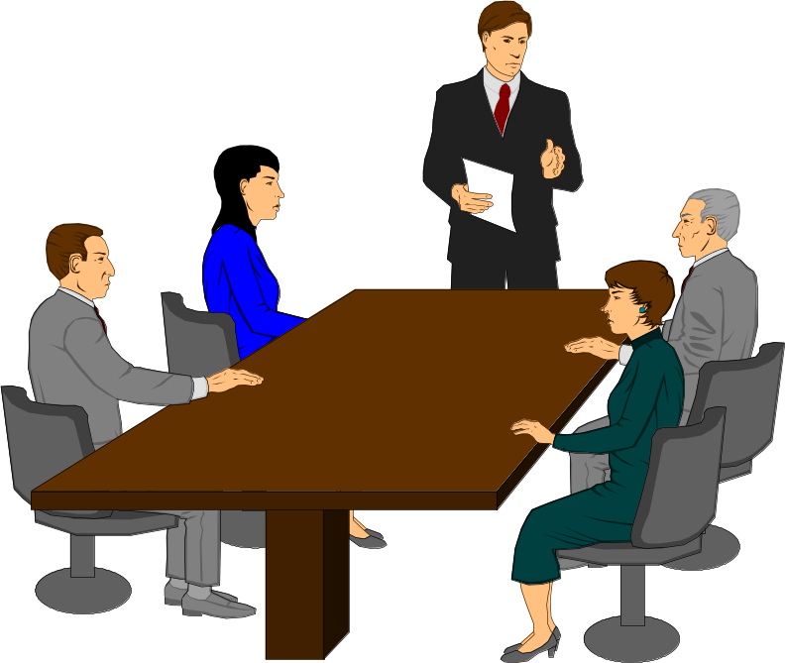
Group Awareness
Notes:
in a face-to-face group activity, people maintain knowledge about the other people and the work they are doing:
This awareness knowledge, which we call group awareness, comprises:
1 Physical: basic physical things like who’s there, where are they sitting,
2 Task: what task are they involved in and how it fits within their larger work activities
3 Social: social aspects of working with other people -
your relationships to other members of the group,
and protocols of interaction like deciding whether you can interrupt someone.
4 Workspace awareness: documents to table, jot, whiteboards, pass around, point at things,
these four are the glue that allows fluid collaborative work...
taken for granted because the information comes for free in a face to face situation

Slide 10
Group Awareness
Notes:
In dC, need for awareness doesn’t go away
Participant Information (Social)
Who is around/using the workspace
Can we get some information about them (social status?)
Participant Activity
Are people reachable?
How active are they?
How available are they to communication

Slide 11
Workspace Awareness
The up-to-the-minute knowledge about another person’s interaction with the shared workspace.
Notes:
Group awareness makes groups more effective by reducing the overhead of working together and by creating opportunities for collaboration.
I should very briefly describe what desktop conferencing is, but ga can be introduced as something that happens in f2f situations.

Slide 12
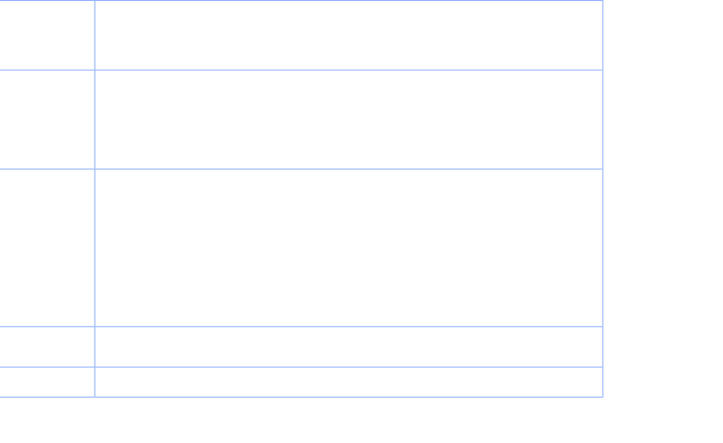
Workspace Awareness Framework

Slide 13
Research Process
Identify elements of workspace awareness
Decide what information to transmit
Invent widgets for presenting information
Evaluate effectiveness

Slide 14
Awareness Prototypes
Participant widgets
Telepointers
Radar Views
Magnification and Distortion Views

Slide 15
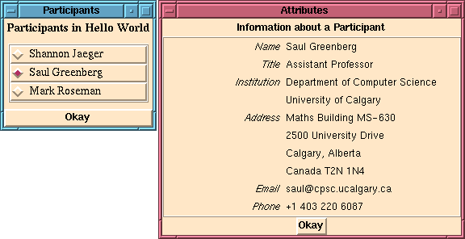
Participant Information
Notes:
Participant Information (Social)
Who is around/using the workspace
Can we get some information about them (social status?

Slide 16
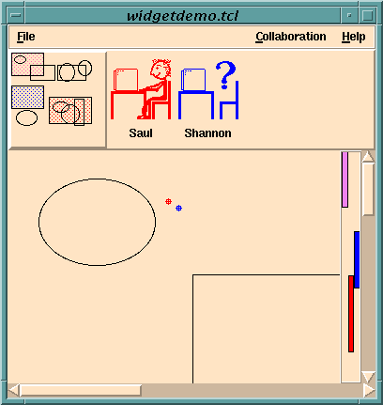
Participant Activity
Notes:
Participant Activity
Are people reachable?
How active are they?
How available are they to communication

Slide 17
Telepointers
File
File
Open
Close
Save
Save as
Close
literal
cursors
relaxed
location
cursors
semantic
cursors
Notes:
Telepointers---multiple cursors, one for each participant
gives a sense of who is around
how active they are
what they are doing
what they intend to do
allowing people to point and gesture around the workspace
three types
literal (conventional
relaxed locations (for relaxed WYSIWIS)
semantic (transmitting meaning as well as location)

Slide 18
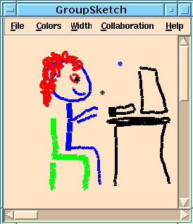
Literal telepointers
Notes:
Literal
X/Y coordinates, may be window, or world (if relaxed WYSIWIS)
relaxed---only see it if view overlaps

Slide 19
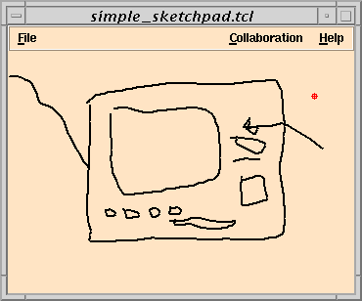
Notes:
Overlays
one iimplementation technique

Slide 20
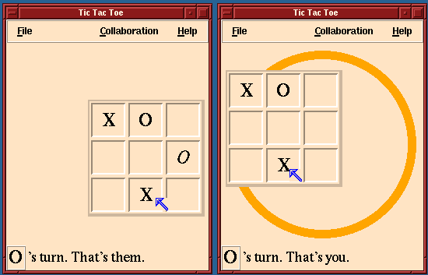
Relaxed location cursors
Notes:
Relaxed location
When representations differ, difft things can be in difft locations
eg widgets in different parts of screen; cursors are relative to widget, not to screen

Slide 21
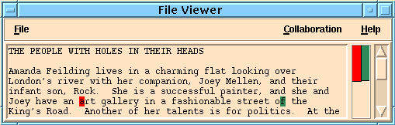
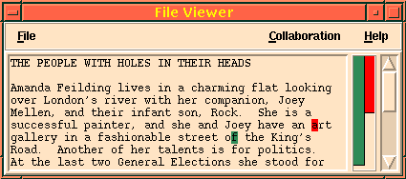
Relaxed Location Cursors
Notes:
Relaxe location (Text)
example

Slide 22
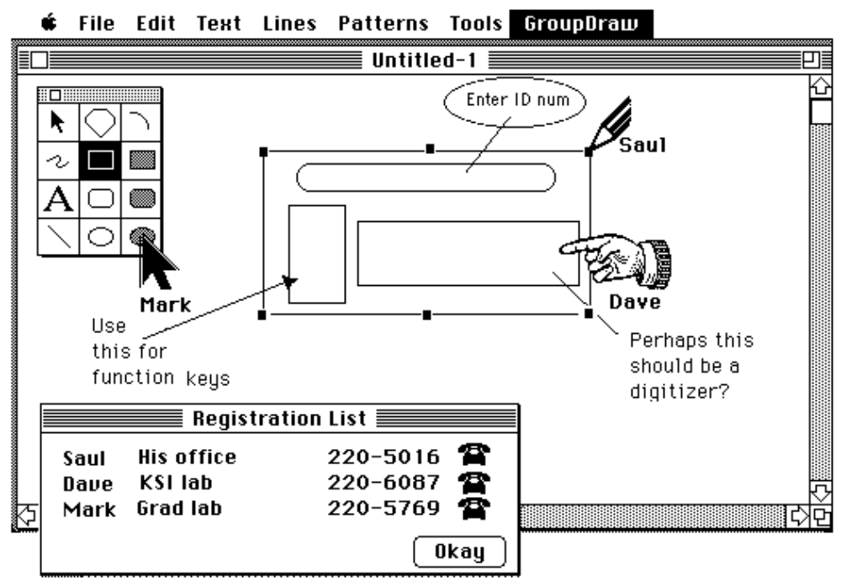
Semantic Cursors
Notes:
Semantic cursors (GroupDraw)
transmit info other than location
eg. mode of others, identity

Slide 23
Semantic Cursors
File Edit
File Edit
Open
Close
Save
Save as
Close
Notes:
Semantic cursors (Menu)
completely difft representation; moves away from pure location
eg, show remote selection of item, rather than menu pulldown
economy of action, not as obtrusive

Slide 24
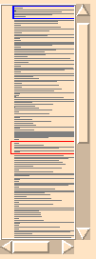
Radar Views
overviews in separate windows
Radar + WISIWYD
View
Multi-User
Scrollbar
Gestalt
View
Notes:
Radar Views
for spatially relaxed WYSIWIS
provide location and awareness of what others are doing
by displaying an overview in a separate window,
plus and indication of where they are
will show four types

Slide 25
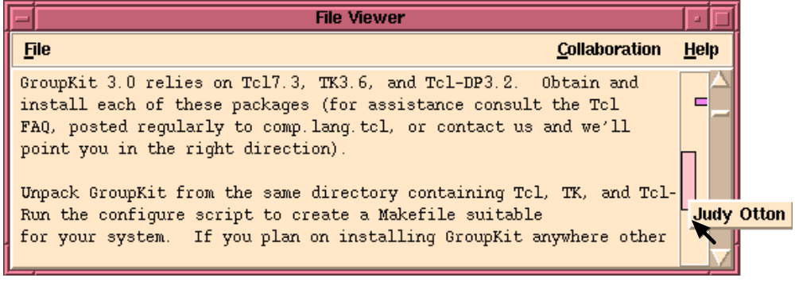
Multi-User Scrollbars
Notes:
In different-view situations, people need to know where each other are working in the virtual workspace.
Multi user scroll bar:
shows relative position in document (roughly where)
shows overlap between views
shows who is around, what they are doing

Slide 26
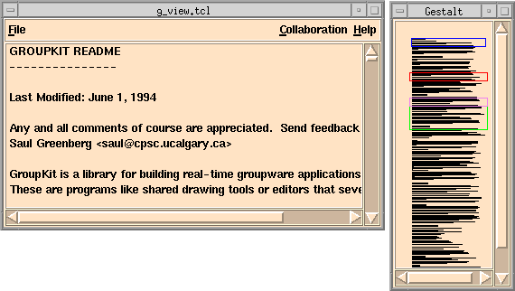
Gestalt View

Slide 27
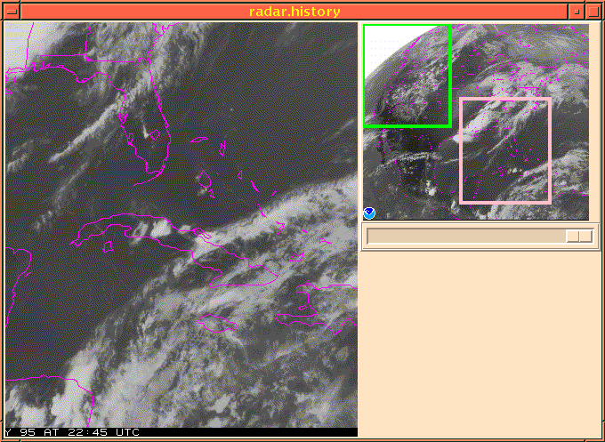
Radar View
Notes:
Radar View
Gestalt View (text)
similar, but scrollbar region now a miniature of text document
additional cues about the where
viewports are movable
- graphical gestalt view
- miniature shows whole document with viewports overlaid as rectangles
- in the slide, the large view is represented as the pink rectangle in the miniature

Slide 28
Historical Radar

Slide 29
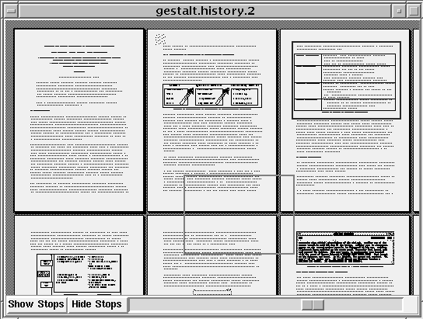
Historical Radar

Slide 30
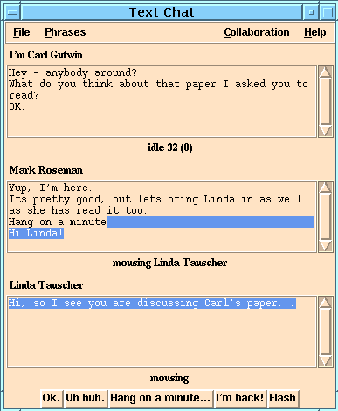
Aging by attention

Slide 31
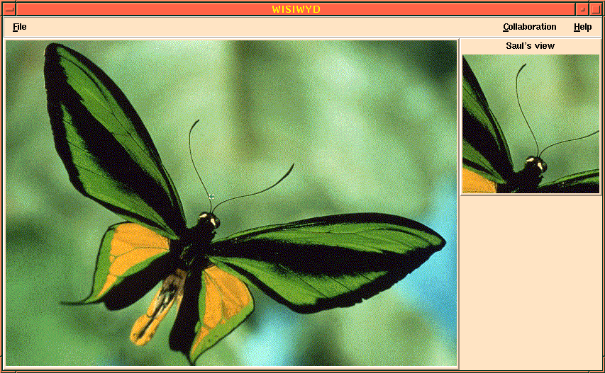
What you see is what I do
Notes:
WYSIWID
- sometimes a miniature isn’t enough information about what a person is doing
- however, it’s impossible to show a full-size duplicate of everyone’s view
- we’ve designed a widget that shows a limited area around another person’s mouse cursor at full size
- since actions are often connected to the mouse cursor, this will often give a good idea of what is happening, in a small area
- in the slide,...

Slide 32
Distortion & Magnification
fisheye lens
moving lens
biplanar view
Notes:
Distortion and Magnification
Coffee table idea: What if we can provide both an overview and detail within a single viewport?
Demonstrate via 3 approaches: fisheye views,...

Slide 33
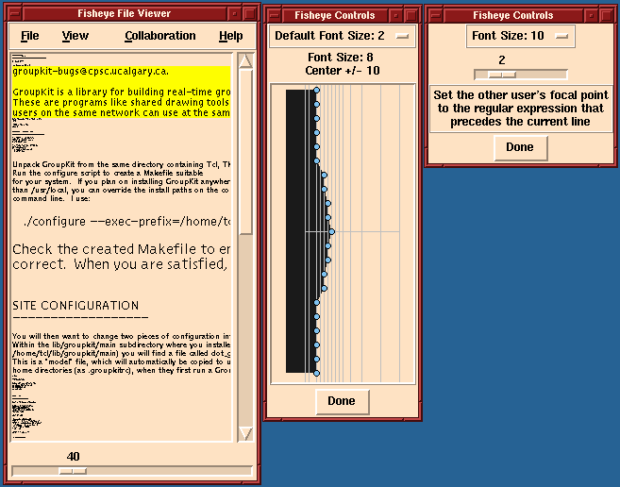
Fisheye Lens
other’s
focus
my
focus
Notes:
Fisheye views
global overview of many lines of text (but not all)
areas of interest are magnified
shows where all members of the group are working, in the context
who, where, what... easy to align views

Slide 34
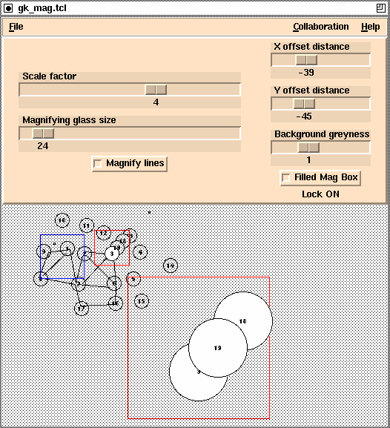
Moving
Lens
Notes:
Moving Lens
Magnification lens over miniature; offset away from focus
shows telepointers in both views
can work in both detail and overviews
viewports of others visible as well as actions they are doing
but can be confusing...

Slide 35
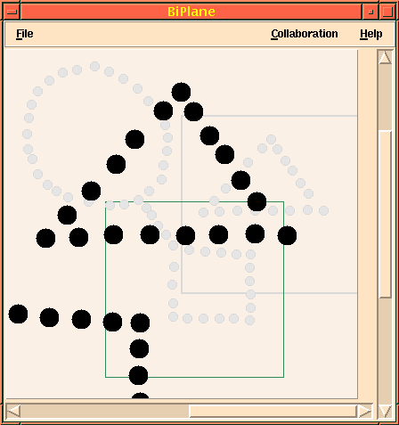
Biplanar
View
Notes:
Biplanar View
- provides two levels to the view of a graphical document
- a fixed view of the entire document within each viewport as a ghosted-out background
- and a limited full-size view in the foreground
- the boxes show where you are in the document, and also where other people are

Slide 36
Summary and the Message
Awareness of other people’s work in a shared space is essential for effective group interaction
Groupware systems must include specific mechanisms to support this practice

