Slide 1

Support for
Workspace Awareness in Educational Groupware
Note: This presentation included live system demonstrations
Carl Gutwin, Gwen Stark, Saul Greenberg
University of Calgary and Calgary Board of Education

Slide 2
Outline
Awareness in collaborative learning
Workspace awareness and groupware
Prototypes
Next steps

Slide 3
The message
Awareness of other learners in a shared space is crucial for effective group activity
Educational groupware must provide support for this practice

Slide 4
Awareness in collaborative learning
Involvement
Curriculum Designer
Teacher
Evaluator
Student
Student Awareness
Social
Task
Concept
Workspace
Workspace Awareness
Who is involved?
Where are they?
What are they doing?
What have they done?

Slide 5
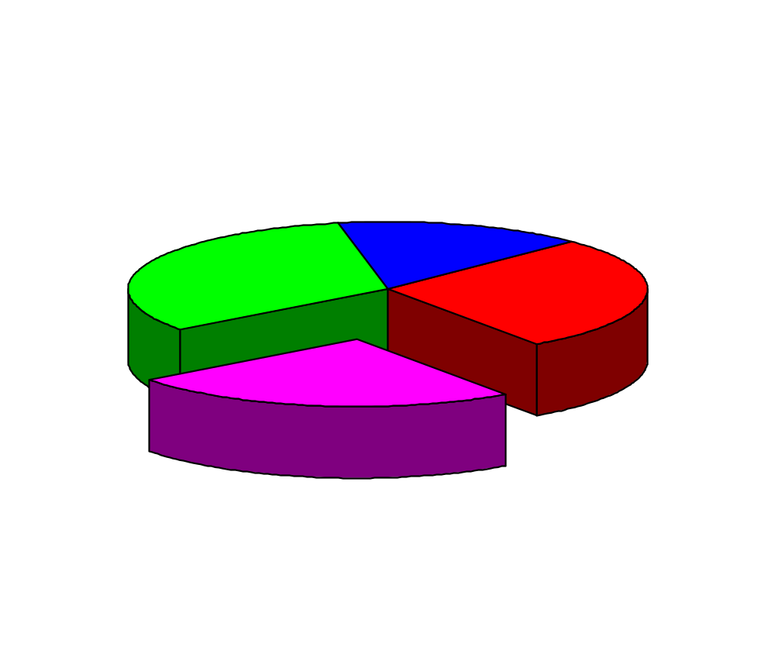
Kinds of student awareness
Workspace
Concept
Task
Social
What should I expect from others?
How will I interact with the group?
What role will I take?

Slide 6
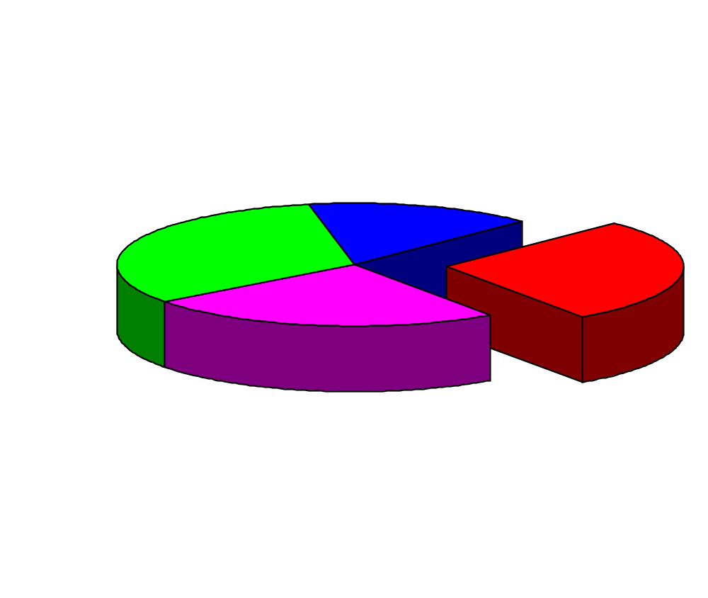
Kinds of student awareness
Workspace
Concept
Task
Social
What do we know about the task?
What steps must we take to complete it?
How will it be evaluated?
What tools are needed?

Slide 7
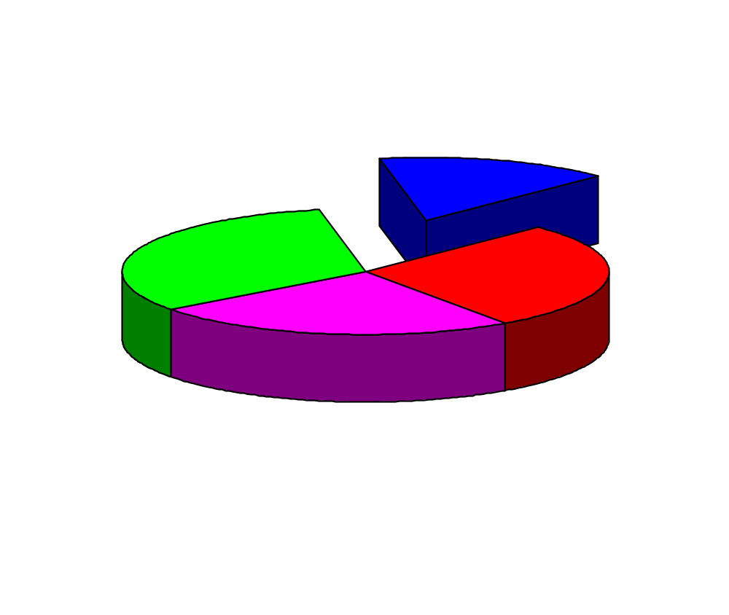
Kinds of student awareness
Concept
Workspace
Task
Social
How does the activity fit into what I already know about the concept?
What else do I need to find out about?
Do I need to revise my current ideas?

Slide 8
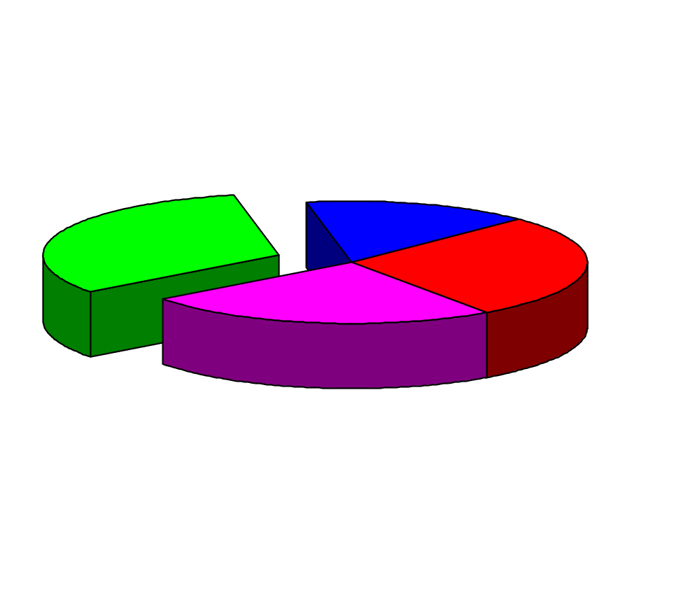
Kinds of student awareness
Workspace
Concept
Task
Social
What are the others doing?
Where are they?
What have they already done?
What will they do next?

Slide 9
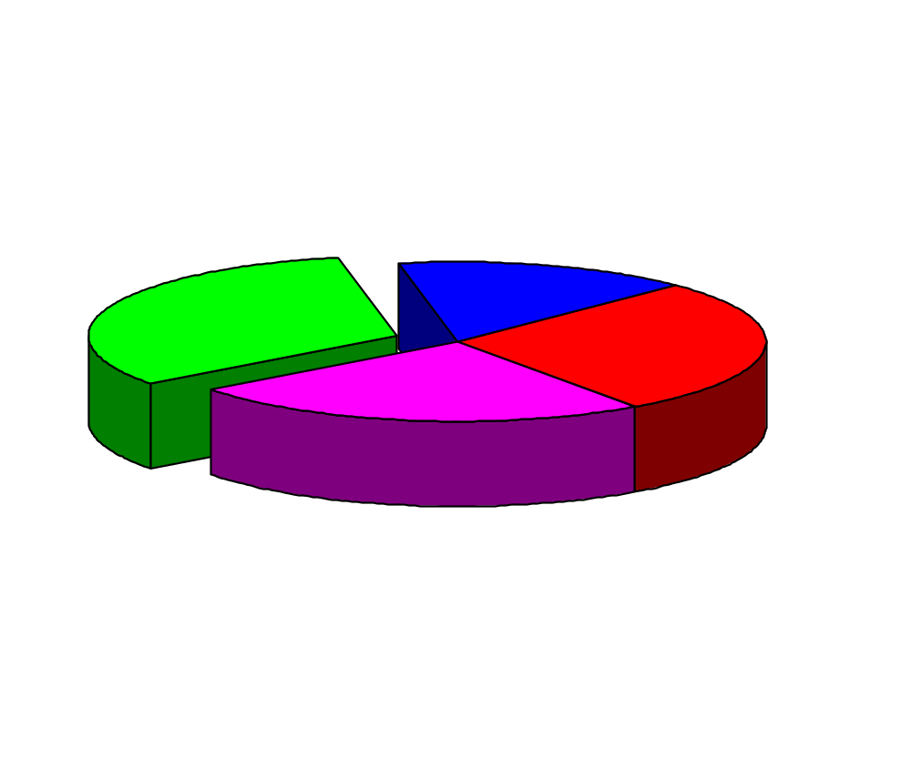
Kinds of student awareness
Concept
Workspace
Task
Social

Slide 10
Educational groupware
A setting for learner-learner interaction
Provides a shared workspace
Focus: synchronous and distributed

Slide 11

What you see is what I see?
Strict WYSIWIS
Org Chart
Org Chart

Slide 12
What you see is what I see?
Relaxed by location
Org Chart

Slide 13
What you see is what I see?
Relaxed by representation
Org Chart
Organization Chart
President
Vice Pres. (Finance)
-accounting
-banking
Vice Pres. (Product)
-technical support
>>help desk
-R & D

Slide 14
What you see is what I see?
Can be relaxed by location or representation
Organization Chart
President
Vice Pres. (Finance)
-accounting
-banking
Vice Pres. (Product)
-technical support
>>help desk
-R & D
Org Chart

Slide 15
Workspace awareness
Up-to-the-minute knowledge about another learner’s interaction with the shared workspace.

Slide 16
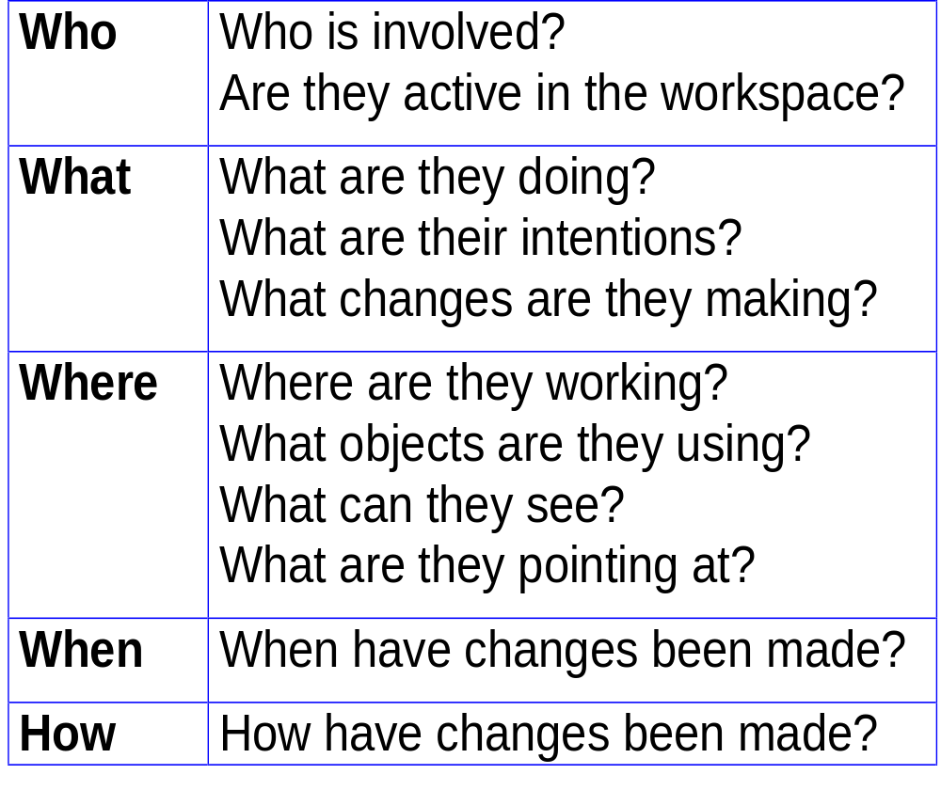
Workspace awareness framework

Slide 17
Prototypes
Cursors and Scrollbars
Radar Views
Local Activity

Slide 18
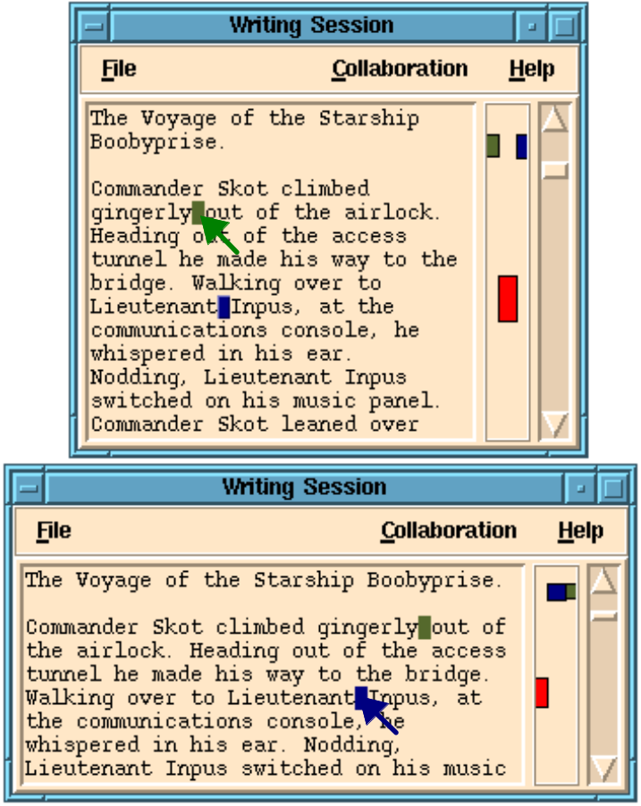
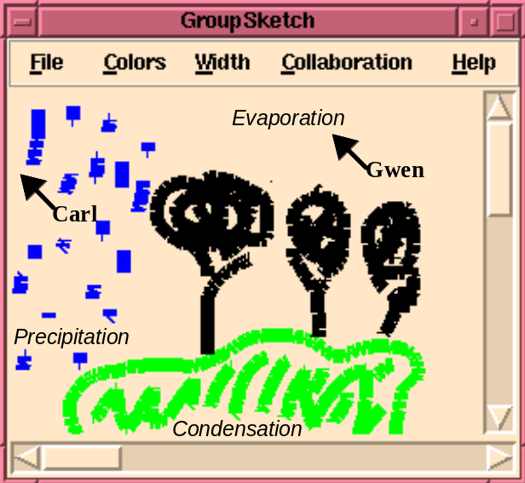
Cursors and Scrollbars

Slide 19
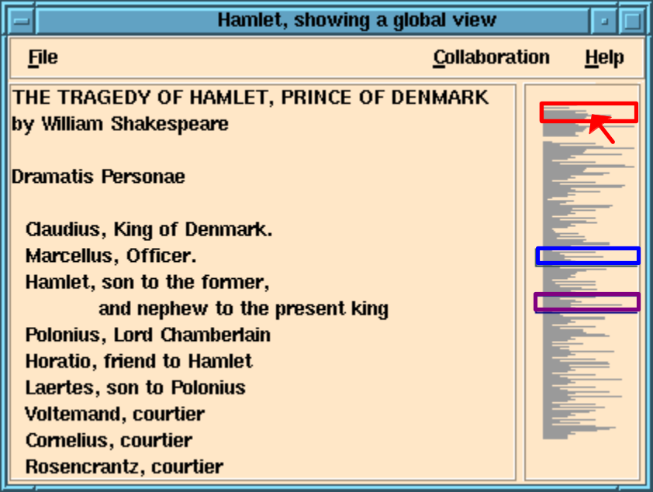
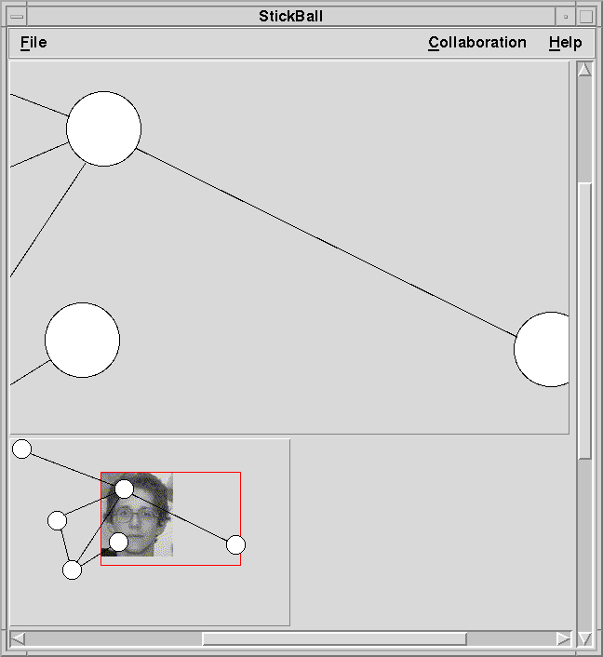
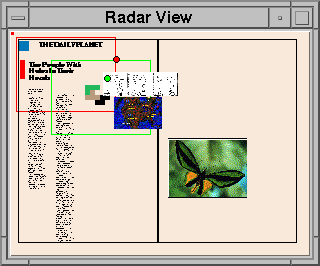
Radar Views

Slide 20
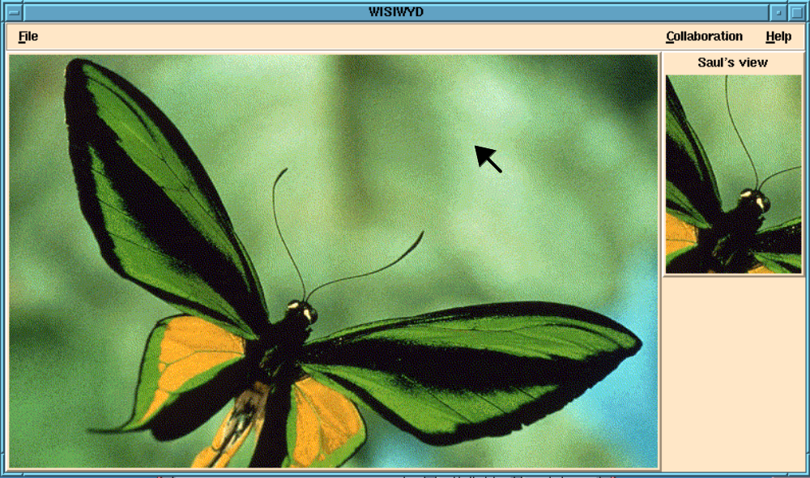
Local Activity

Slide 21
Conclusions
Educational groupware must provide support for workspace awareness
Current status
  Theory and prototypes
Future work
  Verification and systems
For more information:
http://www.cpsc.ucalgary.ca/projects/grouplab/home.html

