Slide 1

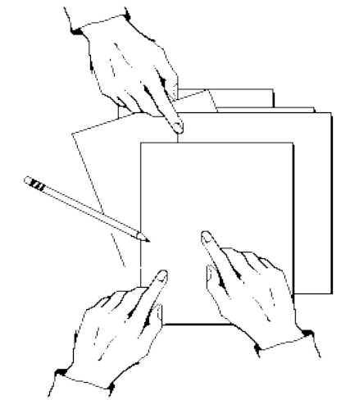
Real Time Groupware
as a
Distributed System
Saul Greenberg
David Marwood
University of Calgary

Slide 2
Overview
The Message:
  Concurrency control in groupware must be treated differently than in traditional distributed systems, as the system includes people as well as computers
Outline
  The problem
  Groupware with no concurrency control
  Effects of Locking
  Effects of Serialization

Slide 3
Focus: Real Time Groupware
People are sharing a computational workspace
  voice/video communication
  focus attention on shared visual workspace or document (WYSIWIS)
  aware of fine grained actions
  simultaneous interactions

Slide 4
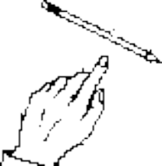
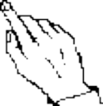
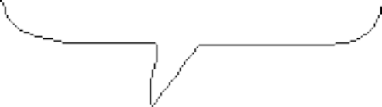
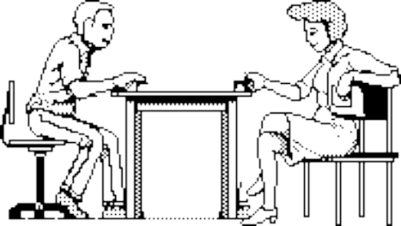
Artifact Sharing in The Physical World
Mmmm mmm mmmm mm mmm mmmmm m mmm.
Mm mmmm mm. Mmmmm mmm.

Slide 5
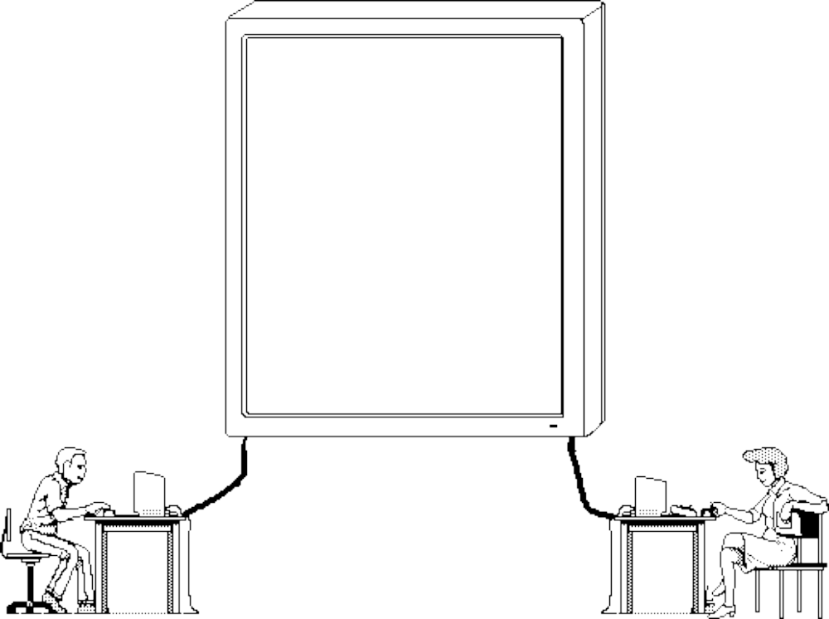




Artifact Sharing in Groupware: Conceptual Model
Mmmm mmm mmmm mm mmm mmmmm m mmm.
Mm mmmm mm. Mmmmm mmm.

Slide 6
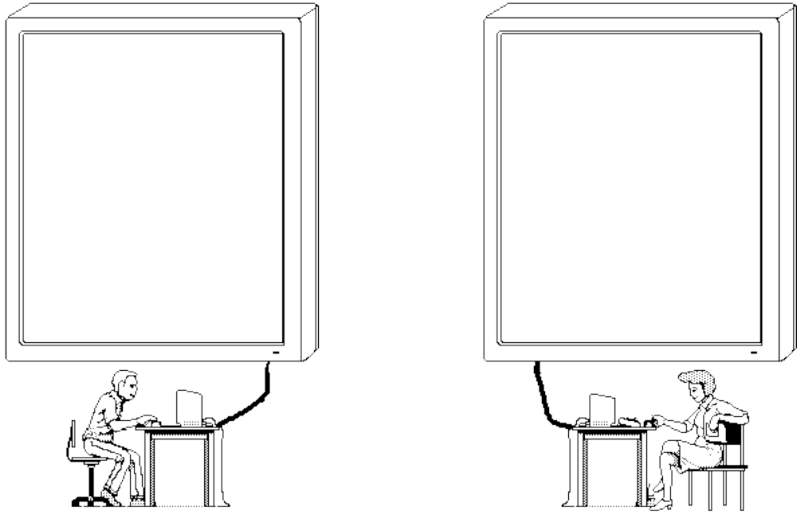
Artifact Sharing in Distributed Groupware
Mmmm mmm mmmm mm mmm mmmmm m mmm.
Mm mmmm mm. Mmmmm mmm.
Mmmm mmm mmmm mm mmm mmmmm m mmm.
Mm mmmm mm. Mmmmm mmm.

Slide 7
Conflict...
Mmmm mmm mmmm mm mmm mmmmm m mmm.
Mm mmmm mm. Mmmmm mmm.
Mmmm mmm mmmm mm mmm mmmmm m mmm.
Mm mmmm mm. Mmmmm mmm.
move pie
delete pie

Slide 8
The Synchronization Problem
Site 1
Site 2
Event A
A
Event B
Event A
B
Event B
time
Problem when
  events are not commutative
    global order must be maintained

Slide 9
The Atomic Sequence Problem
Site 1
Site 2
Events A₁₋₃
A₁
A₂
A₃
Event A₁₋₂
Event A₄
B
Event A₃
Event A₄
time
  several local events (A₁ A₂ A₃) part of a transaction that is vulnerable to corruption by other events
    atomic nature of groups of events must be maintained

Slide 10
No Concurrency Control
Objects are allowed to get out of synchronization
Issues:
  commutativity
  effects of inconsistencies
  social mediation
  expected amount of conflicts

Slide 11

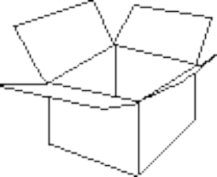

No Concurrency Control
Commutative actions
bitmap drawing
object drawing
text editing
Dave
Saul
saul
This is the first paragraph.
And this is the second one.
dave
saul
dave
commutative:
sketching
creating
different objects
inserting text
in different locations
non-
commutative:
sketching+erasing
move+delete
operations on same
text

Slide 12
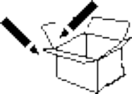
No Concurrency Control
Inconsistencies may not matter
Saul's view
Dave's view
draw
erase
time

Slide 13


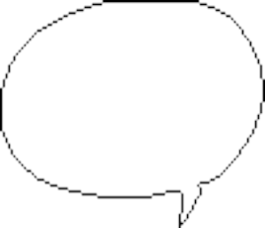


No Concurrency Control
People mediate their own actions when sharing work
  social protocol
  speech
  awareness
Conflicts can happen, but rare
  accidental interference
  side effects of actions
  intentional changing of control
saul
  ...and I’ll
  move the
  jigsaw
  I’ll move
  the line...
judy

Slide 14
No Concurrency Control
The message here...
  concurrency conflicts rare because people mediate themselves
  when conflicts happen they may not matter much
  people may be able to repair negative effects of conflicts
The role of the interface
  support people’s natural ability to mediate themselves and repair damage
    feedback on system state
    affordances of shared objects
    display intentions of people

Slide 15
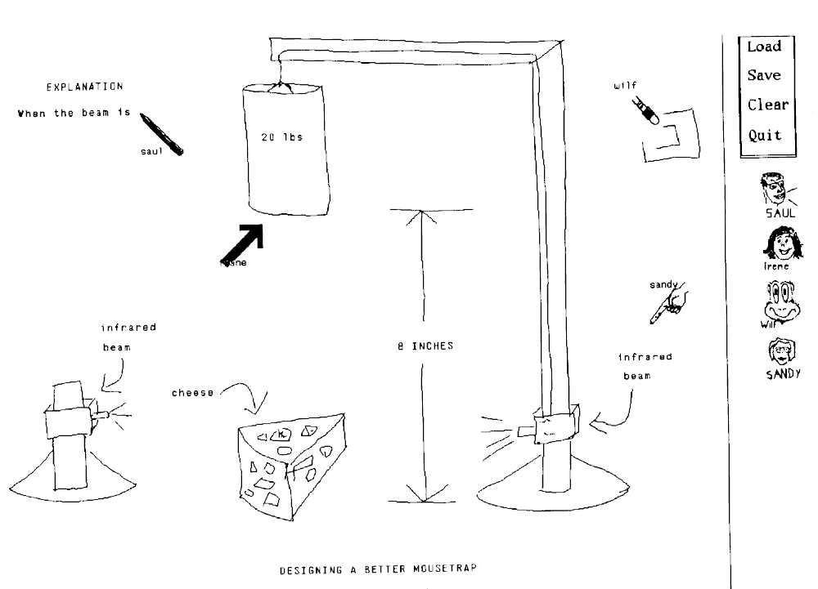
Groupware examples
GroupSketch
  multiple cursors always on display
  fine grained actions transmitted

Slide 16
Groupware Examples
The bouncing ball
Dave’s view
Saul’s view
saul
dave
saul
saul
dave
dave
saul
saul
dave
dave
time

Slide 17
Groupware examples
CoLab
  busy indicators
    selected screen objects are grayed out
    to tell others to leave it alone
Tivoli
  immutable objects
    concurrency conflicts creates copy of object
    people repair drawing if needed
dave
dave
saul
dave
saul
dave

Slide 18
Locking
Gains privileged access to some object for a length of time
  Used to guarantee integrity of a sequence of actions
Issues
  Grain size
  Conservative locking and wait latency
  Optimistic locking and undo effects
free
lock request
approved
locked
lock request
denied
release
free

Slide 19
Locking
Grain size of locks affect the interface feel
  how little or how much of the object(s) on display are managed by a single lock
Document
Object
Within Object
dave
saul
saul
dave
saul
dave
Saul’s turn
Document
Paragraph
Selection
This is the first paragraph.
And this is the second one.
saul
This is the first paragraph.
And this is the second one.
saul
This is the first paragraph.
And this is the second one.
dave
dave
Saul’s turn

Slide 20

Locking
Conservative (non-optimistic) locks
  requestor must wait until lock is granted before using object
  simple to implement
  noticeable the interaction
initiates action
waits
does action
dave
dave
dave

Slide 21
Locking
Optimistic locks with undos
  requestor gives itself a tentative approval for a lock
    object used immediately
    if lock approved, continues as normal
    if denied, must return object to original state
  premises:
    lock requests normally succeed
    proceeding without waiting worth the occasional

Slide 22
dave
lock
granted
lock
requested
tentative
approval
?
dave
lock
denied
dave
dave
1st lock
denied
dave
dave
2nd lock
requested

Slide 23
Locking
Optimistic locking
dave
lock
granted
lock
requested
tentative
approval
?
dave
lock
denied
dave
dave
1st lock
denied
dave
dave
2nd lock
requested

Slide 24
Locking
The message here...
  grain size of lock affects the feel of the interface
  waiting for locks is not desirable
    especially since lock requests normally succeed
  building a sensible interface for optimistic locking is hard
    but proceeding without waiting worth the occasional
    The role of the interface
  grain size should be user-centered
  interface responsiveness must take priority
  feedback to participants of state of locked objects
  sensible feedback of undo operations

Slide 25
Groupware Examples
Coarse grain locks
  shared view systems with turntaking
  version control systems
Variable sized locks in text editors
  MACE
    user specifies upper and lower bounds of a text region
  SASSE
    conservative locks around text selection
  DISTEDIT
    system decides what locks are needed based on request
Fine grain locks
  GroupDraw
    locks at the object handle level

Slide 26
Serialization
Events are always executed in the same order across the entire system
How?
  Total order of events maintained
    global clock
  Effects of out of order events detected and repaired
    redone or transformed to the correct order
Issues
  Strange interaction behavior

Slide 27
Serialization
Serialization can lead to strange interaction behaviors
  the bouncing ball revisited...
Dave’s view
Saul’s view
saul
dave
saul
saul
dave
dave
saul
saul
dave
dave
time

Slide 28
  Text editing...
saul
This is the first paragraph.
And this is the second one.
dave
Saul types “Hello”
Dave types “There”
saul
HTelhelroeThis is the first paragraph.
And this is the second one.
dave

Slide 29
Serialization
Conservative (non-optimistic) serialization
  each action scheduled and must wait its turn
  interaction suffers if wait is long
Event A
Event B ready
A
wait
Event A
Event B
B
Event B

Slide 30
Serialization
Optimistic serialization
  events executed
  undone/redone or transformed if they are out of order
Site 1
Site 2
Event A
A
Event B
B
Event A
Event B
Undo B,A
Execute A, B

Slide 31
Serialization
Optimistic serialization
  results may conflict with user expectations
saul
dave
1
This is a line in a
paragraph.
saul
dave
saul
dave
2
This is a line in a
3
This is a goline in a
paragraph.
paragraph.
dave
saul
dave
saul
5
This is a good line
4
in a paragraph.
saul
dave
6
od

Slide 32
Serialization
The message here
  can guarantees consistency
  serialized results may conflict with participant’s expectations
  waiting for serialization is not desirable
    especially since many events will need serialization
  building a sensible undo remains difficult
The role of the interface
  what needs to be serialized and what doesn’t
    some actions are commutative
  responsiveness must take priority
  sensible feedback of undo operations
  conceptual model of serialization process

Slide 33
Groupware Examples
Most explore different serialization, undo, and transformation schemes
  Grove:
    transformation of out of order operations
  Bobrow:
    Dependency detection informs group of order conflicts
  GroupDesign:
    selective serialization with undo/redo
  DistEdit & Gina:
    group undo and concurrency undo

Slide 34
The Paper also includes:
Greater detail
Concurrency control in GroupKit
Replicated and centralized architectures
Pointers to particular groupware systems and algorithms

Slide 35
Summary
Concurrency control in groupware must be treated differently than in traditional distributed systems, as the system includes people as well as computers
  Implementors:
    how people can naturally avoid concurrency conflicts
    effects of concurrency algorithms on the interface
  Interface designers:
    when concurrency control is required
    increase feedback to let people mediate themselves
    mitigate unavoidable problems due to concurrency control

