Slide 1
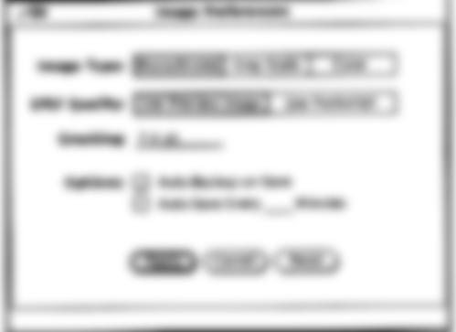
Graphical Screen Design
Part 2: Analyzing designs and other visual design concepts
Lecture /slide deck produced by Saul Greenberg, University of Calgary, Canada
Notice: some material in this deck is used from other sources without permission. Credit to the original source is given if it is known,

Slide 2
Overview
CRAP recap
Grids
Other visual design concepts
consistency relationships
organization legibility and readability
navigational cues appropriate imagery
familiar idioms

Slide 3
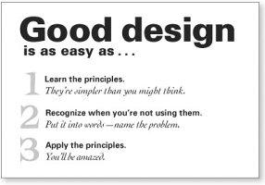
CRAP Recap
Contrast
make different things different
brings out dominant elements
mutes lesser elements
creates dynamism
Repetition
repeat design throughout the interface
consistency
creates unity
Alignment
visually connects elements
creates a visual flow
Proximity
groups related elements
separates unrelated ones
1
2
3
4
5
1
2
3
1
4
3
4
2
1
2
3
Robin Williams Non-Designers Design Book, Peachpit Press

Slide 4
Repetition & Consistency
internal consistency
elements follow same conventions and rules
set of application-specific grids enforce this
external consistency
follow platform and interface style conventions
use platform and widget-specific grids
deviate only when it provides a clear benefit to user
Help
Warning
Tip of the day: Monday, Mar 12
!
mmmm mmm
mmm
?
mmmm mmm
mmm mmm
mmmm mmm
mmm
Okay
Okay
Dismiss

Slide 5
Proximity vs. External Structure
alignment
white (negative) space to separate
minimize explicit structure
Mmmm:
Mmmm:
Mmmm:
Mmmm:
Mmmm:
Mmmm:
Mmmm:
Mmmm:
Mmmm:
Mmmm:
Mmmm:
Mmmm:
Mmmm:
Mmmm:
Mmmm:

Slide 6
Proximity vs. External Structure
Boxes do not create a strong structure
boxes do not create a strong structure
contrast and alignment emphasises organization
Reproduced from: Designing Visual Interfaces, Mullet & Sano, Prentice Hall

Slide 7
Navigational Cues
provide initial focus
direct attention as appropriate to important 2ndary, or peripheral items as appropriate
order should follow a user’s conceptual model of sequences
Reproduced from: Designing Visual Interfaces, Mullet & Sano, Prentice Hall

Slide 8
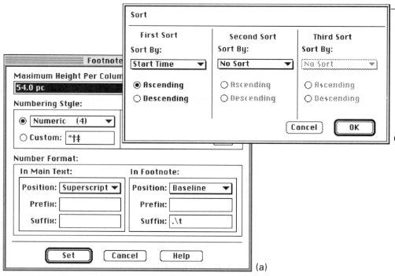
Analyzing Poor Designs
Using structure as a crutch
Reproduced from: Designing Visual Interfaces, Mullet & Sano, Prentice Hall

Slide 9
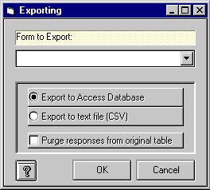
Analyzing Poor Designs
Overuse of 3-d effects
unnecessarily structure
unnecessary visual clutter
WebForms

Slide 10
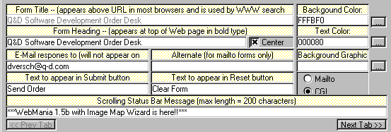
Analyzing Poor Designs
Where do your eyes go?
Images: Webfroms

Slide 11
Analyzing Poor Designs
contrast
cannot distinguish colored labels from editable fields
repetition
buttons do not look like buttons
alignment
no flow
explicit structure replaces proximity
lines and blocks compete with alignment
Image: Webfroms

Slide 12
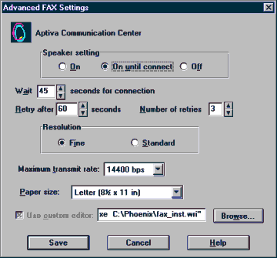
Analyzing Poor Designs
No regard for order and organization
IBM's Aptiva Communication Center
Image: Webfroms

Slide 13
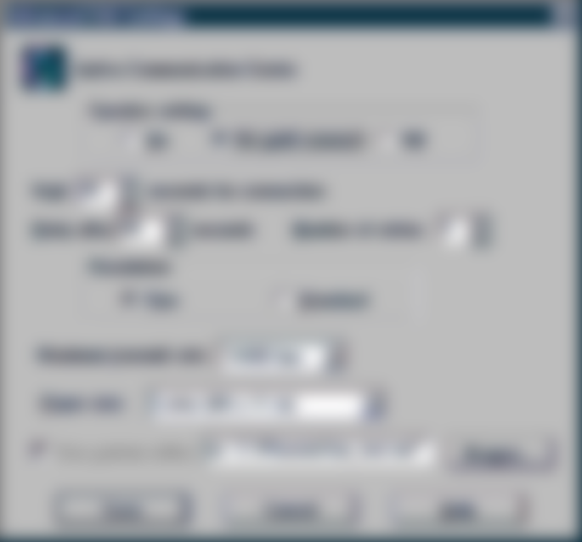
Analyzing Poor Designs
No regard for order and organization
IBM's Aptiva Communication Center
Image: Webfroms

Slide 14
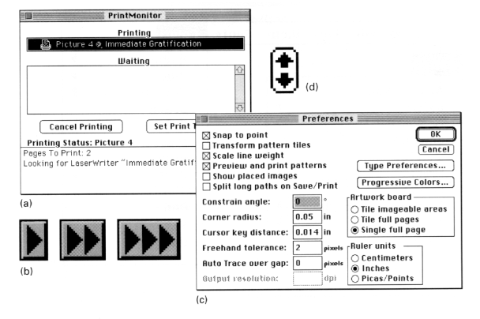
Analyzing Poor Designs
Spatial tension
Image: Designing Visual Interfaces, Mullet & Sano, Prentice Hall

Slide 15
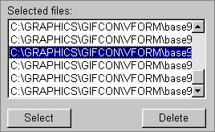
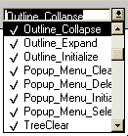
Analyzing Poor Designs
How do you chose when you cannot discriminate screen elements from each other?
GIF Construction Set
Microsoft Access 2.0

Slide 16
How do you chose when you cannot discriminate screen elements from each other?
GIF Construction Set
Microsoft Access 2.0

Slide 17
Repairing Designs
Minimal contrast, weak proximity
ambiguous structure
interleaved items
Image : Designing Visual Interfaces, Mullet & Sano, Prentice Hall

Slide 18
Repairing Designs
Strong proximity (left/right split)
unambiguous
hierarchy clear
Images: Designing Visual Interfaces, Mullet & Sano, Prentice Hall

Slide 19
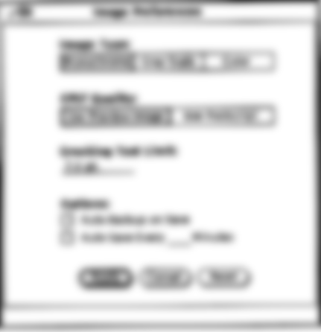
Image : Designing Visual Interfaces, Mullet & Sano, Prentice Hall

Slide 20
Image : Designing Visual Interfaces, Mullet & Sano, Prentice Hall

Slide 21
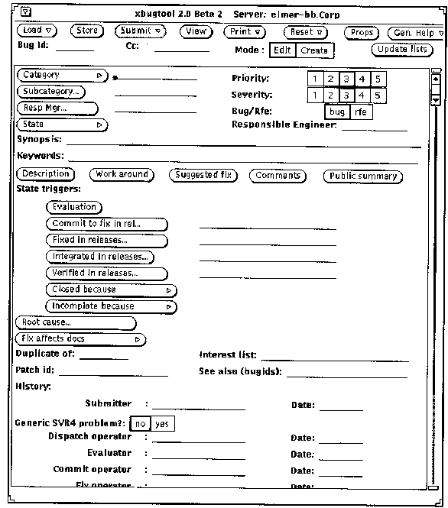
Repairing Designs
Haphazard layout
Images: Designing Visual Interfaces, Mullet & Sano, Prentice Hall

Slide 22
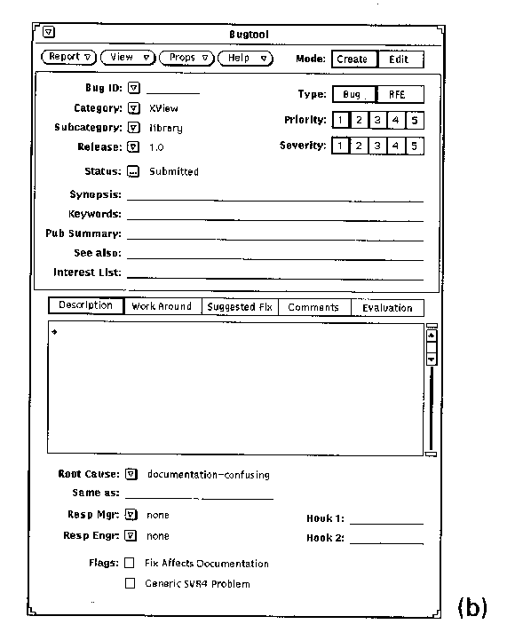
Repairing Designs
Repaired…
Images: Designing Visual Interfaces, Mullet & Sano, Prentice Hall

Slide 23
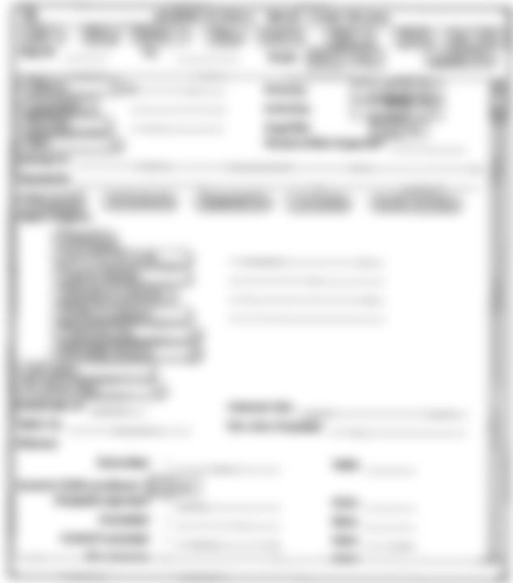
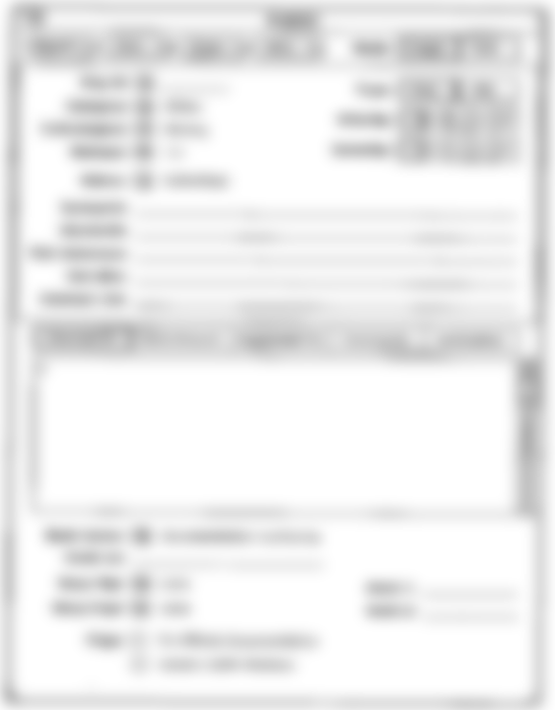

Slide 24
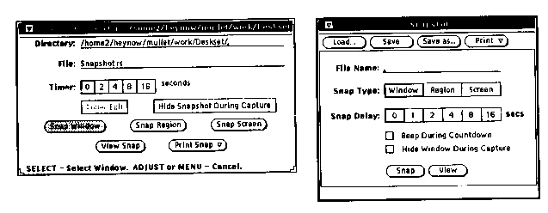
Repairing Designs
Alignment and factoring
Images: Designing Visual Interfaces, Mullet & Sano, Prentice Hall

Slide 25
Repairing Design
Economy of visual elements
leverage factoring
minimize number of controls
include only those that are necessary
eliminate, or relegate others to secondary windows
minimize clutter
so information is not hidden
xxx: ____
MMMM
xxx: ____
xxx: ____
xxx: ____
xxx: ____
xxx: ____
xxx: ____
xxx: ____
xxx: ____
NNNN
xxx: ____
xxx: ____
xxx: ____
NNNN
MMMM
xxx: ____
xxx: ____
xxx: ____

Slide 26
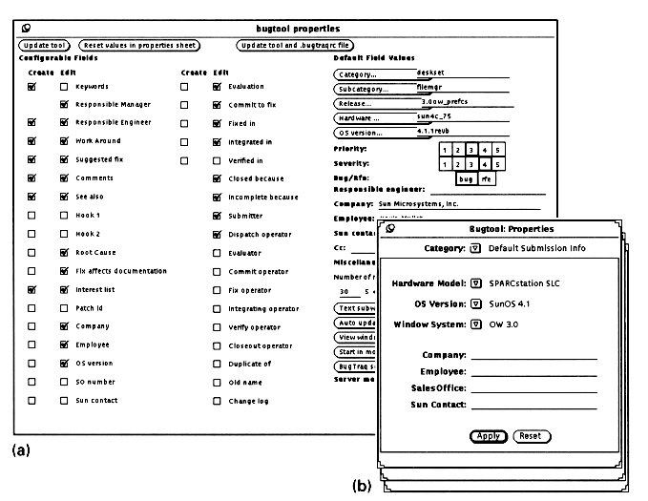
Repairing Design
Excessive display density solved by factoring
Images: Designing Visual Interfaces, Mullet & Sano, Prentice Hall

Slide 27
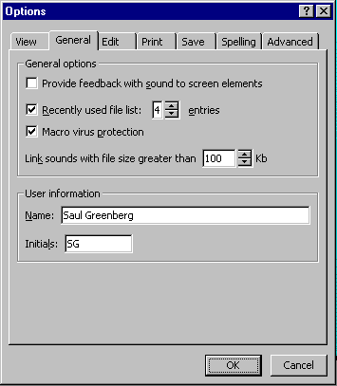
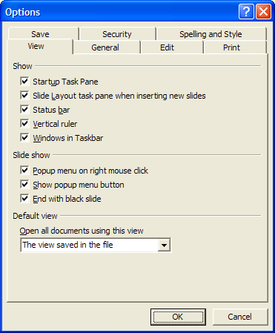
Repairing Design
Excessive display density solved by tabs
but can be overdone

Slide 28
Legibility and readability
Characters, symbols, graphical elements should be easily noticable and distinguishable
Text set in Helvetica
TEXT SET IN CAPITOLS
Text set in Braggadocio
Text set in Times Roman
Text set in Courier

Slide 29
Legibility and readability
Proper use of typography
1-2 typefaces (3 max)
normal, italics, bold
1-3 sizes max
Large
Medium
Small
Large
Medium
Small
Readable
Unreadable
Design components to be
inviting and attractive
Design components to be
inviting and attractive
Design components to be
inviting and attractive
Design components to be
inviting and attractive

Slide 30
Legibility and readability
typesetting
point size
word and line spacing
line length
Indentation
color
Readable
Unreadable: Design components
to be easy to interpret and
understand. Design components to
be inviting and attractive
Design components to be
inviting and attractive
Design components to be
inviting and attractive

Slide 31
Popkin Software’s System Architect

Slide 32
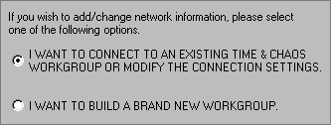
Time & Chaos
These choices must be really important, or are they?

Slide 33
Greyed-out example text hard to read. Why not make it black?
Regional preferences in Windows 95

Slide 34
Text orientation difficult to read
Microsoft Word

Slide 35
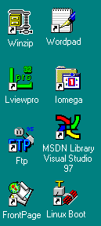
Imagery
Signs, icons, symbols
right choice within spectrum from concrete to abstract
Icon design very hard
except for most familiar, always label them
Image position and type should be related
image “family”
Consistent and relevant image use
identifies situations, offerings...
Partial icon family

Slide 36
Choosing levels of abstraction
Images: Designing Visual Interfaces, Mullet & Sano, Prentice Hall

Slide 37
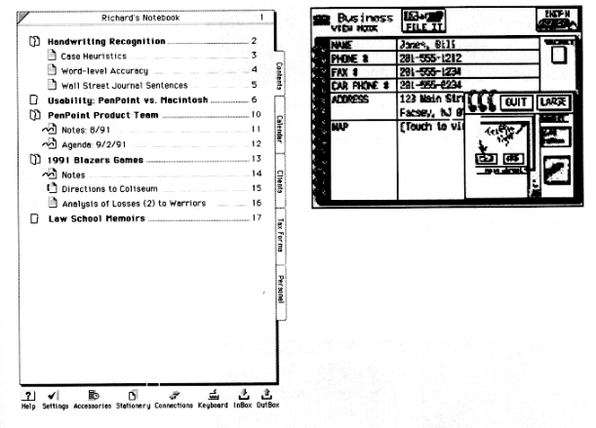
Refined vs excessive literal metaphors
Images: Designing Visual Interfaces, Mullet & Sano, Prentice Hall

Slide 38
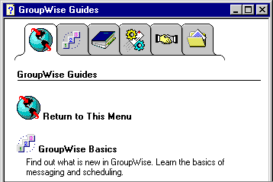
Novell GroupWise 5.1
What do these images mean?
no tooltips included
one of the tabs is a glossary explaining these images! which one?

Slide 39
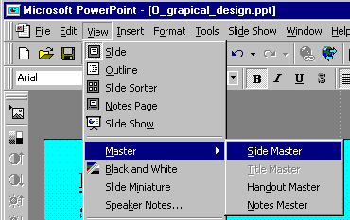
Idioms
Familiar ways of using GUI components
appropriate for casual to expert users
builds upon computer literacy
must be applied carefully in walk up and use systems
Window manipulation
Files
Standard typographic controls
Toolbars and tooltips
What you see is what you get displays
Pulldown menus
Cascading menu
Dialog box item
Microsoft Powerpoint

Slide 40
How to choose between widgets
What components must be in the display?
necessary visual affordances
frequent actions
direct manipulation for core activities
buttons/forms/toolbar/special tools for frequent/immediate actions
menus/property window for less frequent actions
secondary windows for rare actions
How are components related?
organize related items as “chunks”
What are familiar and expected idioms?
cross application look and feel

Slide 41
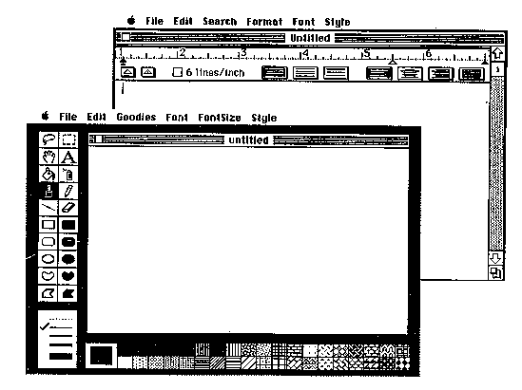
Displaying core functionality
Images: Designing Visual Interfaces, Mullet & Sano, Prentice Hall

Slide 42
Widgets and complexity
how can window navigation be reduced?
avoid long paths
avoid deep hierarchies

Slide 43
Grids
Horizontal and vertical lines to locate window components
aligns related components
Organization
contrast for dominant elements
element groupings by proximity
organizational structure
alignment
Consistency
location
format
element repetition
organization
Format of variable contents
Standard icon set
Message text in Arial 14, left adjusted
Widget to widget spacing
No
Ok
window to widget spacing
Fixed components

Slide 44
Standard icon set
Message text in Arial 14, left adjusted
?
Do you really want to delete the file “myfile.doc” from the folder “junk”?
No
Ok
No
Ok
!
Cannot move the file “myfile.doc” to the folder “junk” because the disc is full.
Apply
The file was destroyed
Cancel
Ok

Slide 45
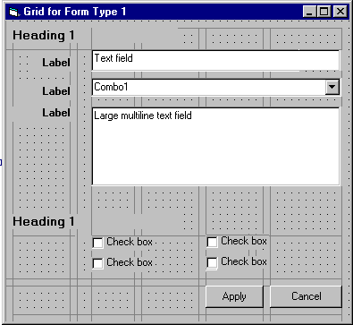
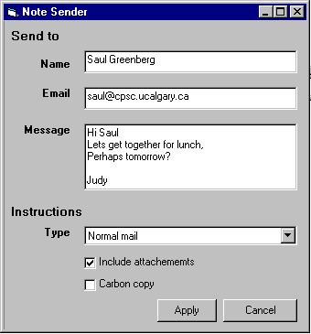
Two-level Hierarchy
indentation
contrast
Logic of organizational flow
Alignment connects visual elements in a sequence
Grouping by white space

Slide 46
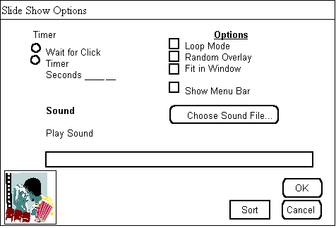
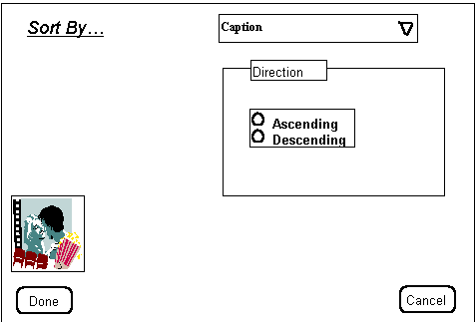
Exercise
Graphical redesign
Create a grid emphasizing:
visual consistency
relationships between screen elements
navigational cues
economy
legibility and readability
imagery

Slide 47
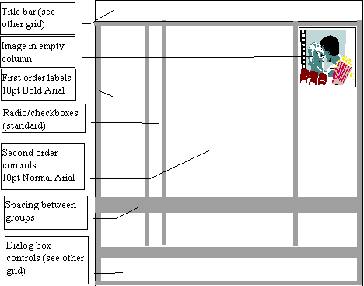
Constructing a grid
Maintain consistency with GUI style
locate standard components - title bar, window controls, …
Decide navigational layout + white space + legibility + typography
annotated grid shows location of generic components
these generic components may have their own grids.

Slide 48
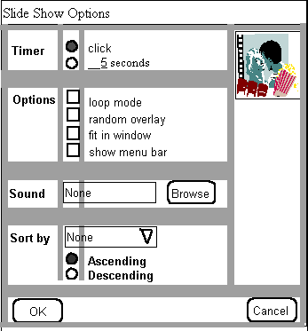
Using the grid
Determine relationships, navigational structure
map navigational structure onto the grid
Economize
collapse two windows into one
trim sound dialog

Slide 49
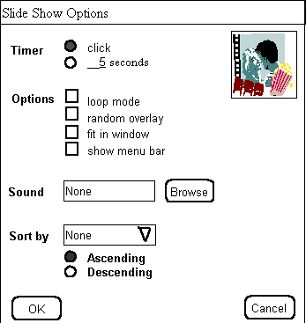
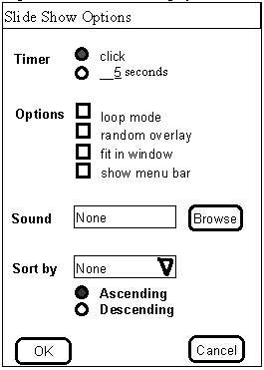
Using the grid
Evaluate by displaying actual examples
Economize further
decide which we prefer
vs

Slide 50
You now know
CRAP
Grids are an essential tool for graphical design
Other visual concepts include
visual consistency
repetition
visual organization
contrast, alignment and navigational cues
visual relationships
proximity and white space
familiar idioms
legibility and readability
typography
appropriate imagery

Slide 51
Interface Design and Usability Engineering
Articulate:
who users are
their key tasks
Brainstorm designs
Refined designs
Completed designs
Goals:
Task centered system design
Participatory design
User-centered design
Psychology of everyday things
User involvement
Representation & metaphors
Participatory interaction
Task scenario walk- through
Graphical screen design
Interface guidelines
Style guides
Evaluate tasks
Usability testing
Heuristic evaluation
Field testing
Methods:
low fidelity prototyping methods
high fidelity prototyping methods
Products:
User and task descriptions
Throw-away paper prototypes
Testable prototypes
Alpha/beta systems or complete specification

Slide 52
Primary Sources
This slide deck is partly based on concepts as taught by:
Designing Visual Interfaces, Mullet & Sano, Prentice Hall
Robin Williams Non-Designers Design Book, Peachpit Press

Slide 53
Permissions
You are free:
to Share — to copy, distribute and transmit the work
to Remix — to adapt the work
Under the following conditions:
Attribution — You must attribute the work in the manner specified by the author (but not in any way that suggests that they endorse you or your use of the work) by citing:
“Lecture materials by Saul Greenberg, University of Calgary, AB, Canada. http://saul.cpsc.ucalgary.ca/saul/pmwiki.php/HCIResources/HCILectures”
Noncommercial — You may not use this work for commercial purposes, except to assist one’s own teaching and training within commercial organizations.
Share Alike — If you alter, transform, or build upon this work, you may distribute the resulting work only under the same or similar license to this one.
With the understanding that:
Not all material have transferable rights — materials from other sources which are included here are cited
Waiver — Any of the above conditions can be waived if you get permission from the copyright holder.
Public Domain — Where the work or any of its elements is in the public domain under applicable law, that status is in no way affected by the license.
Other Rights — In no way are any of the following rights affected by the license:
Your fair dealing or fair use rights, or other applicable copyright exceptions and limitations;
The author's moral rights;
Rights other persons may have either in the work itself or in how the work is used, such as publicity or privacy rights.
Notice — For any reuse or distribution, you must make clear to others the license terms of this work. The best way to do this is with a link to this web page.

