Slide 1
Controlled Experiments
Part 1: Introduction
Lecture /slide deck produced by Saul Greenberg, University of Calgary, Canada
Notice: some material in this deck is used from other sources without permission. Credit to the original source is given if it is known,

Slide 2
Outline
Terminology
What is experimental design?
What is an experimental hypothesis?
How do I plan an experiment?
Why are statistics used?
What are the important statistical methods?

Slide 3
Quantitative evaluation of systems
Quantitative:
  precise measurement, numerical values
  bounds on how correct our statements are
Methods
  user performance data collection
  controlled experiments

Slide 4

Collecting user performance data
Data collected on system use (often lots of data)
Exploratory:
  hope something interesting shows up (e.g., patterns)
  but can be difficult to analyze
Targeted
  look for specific information, but may miss something
    frequency of request for on-line assistance
      what did people ask for help with?
    frequency of use of different parts of the system
      why are parts of system unused?
    number of errors and where they occurred
      why does an error occur repeatedly?
    time it takes to complete some operation
      what tasks take longer than expected?

Slide 5
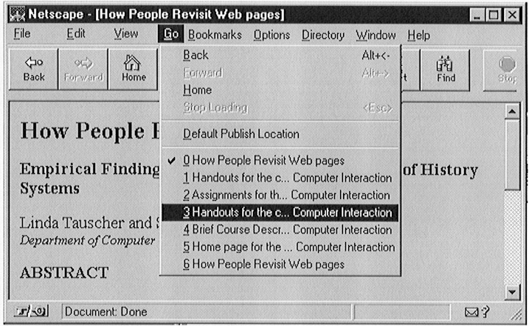
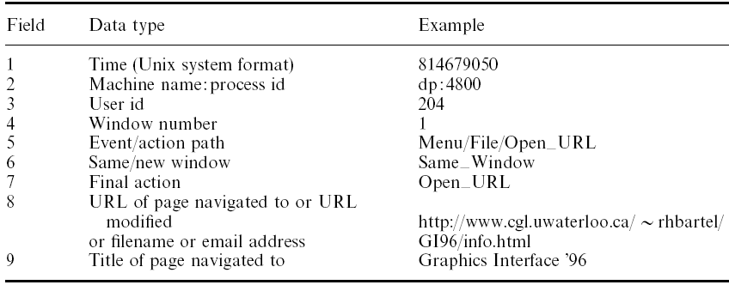
Logging example
How people navigate with web browsers
From: Tauscher, L. and Greenberg, S. (1997) How People Revisit Web Pages: Empirical Findings and Implications for the Design of History Systems. International Journal of Human Computer Studies - IJHCS, 47(1):97-138.

Slide 6
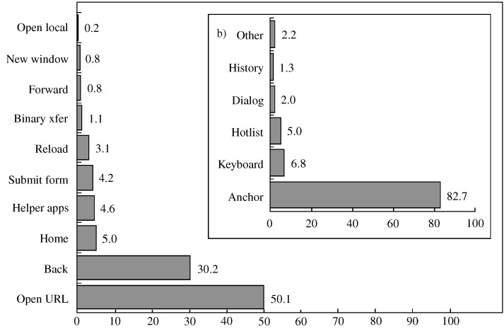
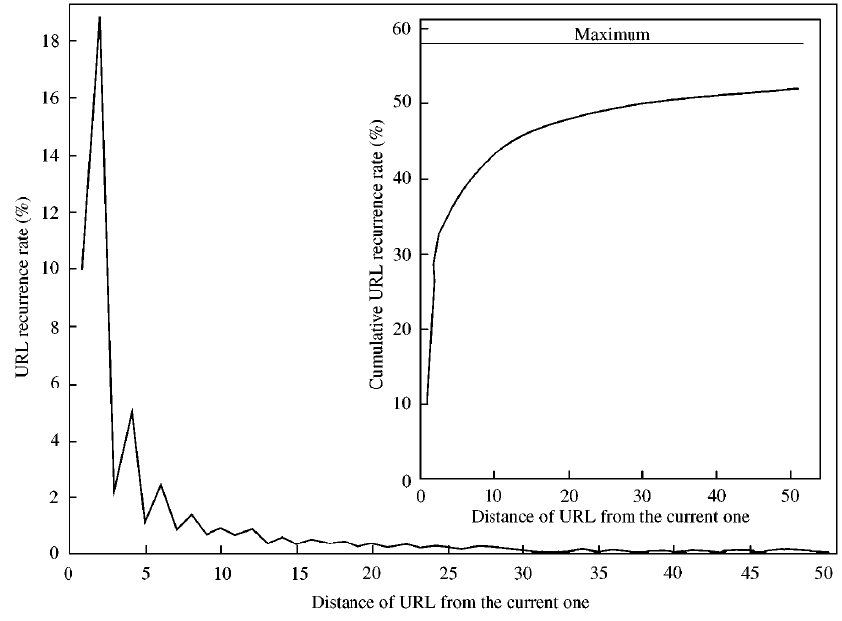
Logging example
How people navigate with web browsers
From: Tauscher, L. and Greenberg, S. (1997) How People Revisit Web Pages: Empirical Findings and Implications for the Design of History Systems. International Journal of Human Computer Studies - IJHCS, 47(1):97-138.

Slide 7
Controlled experiments
Traditional scientific method
Reductionist
  clear convincing result on specific issues
In HCI:
  insights into cognitive process,
  human performance limitations, ...
  allows system comparison,
  fine-tuning of details ...

Slide 8
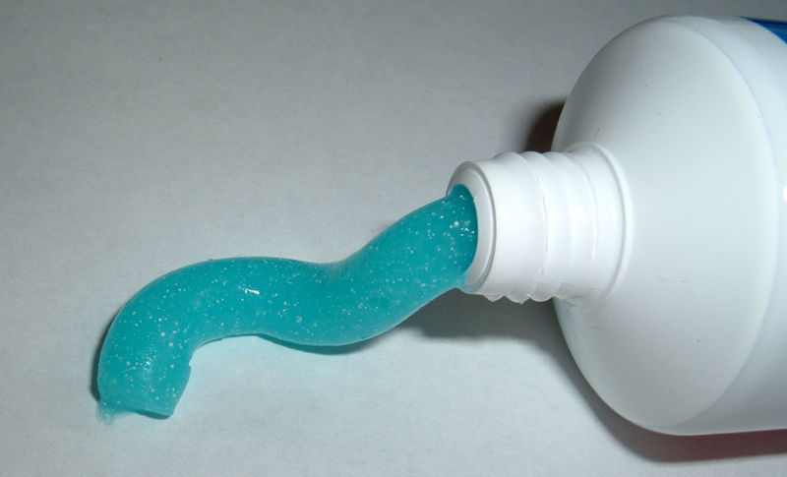

example
Which toothpaste is best?
Images from http://www.futurederm.com/wp-content/uploads/2008/06/060308-toothpaste.jpg and http://4.bp.blogspot.com/_i2tTNonulCM/R7t3T7qDxTI/AAAAAAAAAB0/JrUU1wJMeFo/s400/ist2_2301636_tooth_paste[1].jpg

Slide 9
example
Which menu should we use?
File Edit View Insert
File
New
New
Edit
Open
Open
View
Close
Close
Insert
Save
Save

Slide 10
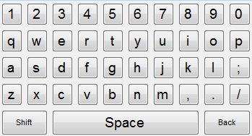
example
Choosing on-screen keyboards
Keyboard size
  what is the best trades off with screen real estate?

Slide 11
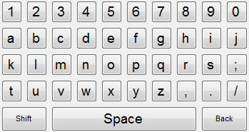
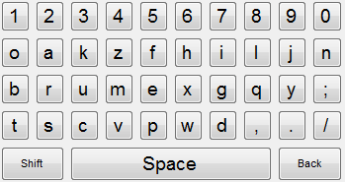
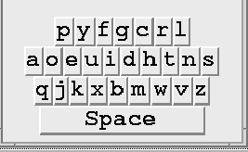
example
Choosing on-screen keyboards
Keyboard layout
  ease of learning by non-typists vs. expertise
  touch typing ≠hunt and peck
Qwerty Alphabetic Random
Dvorak

Slide 12

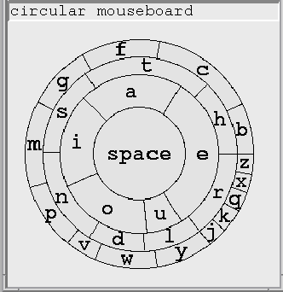
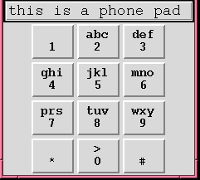
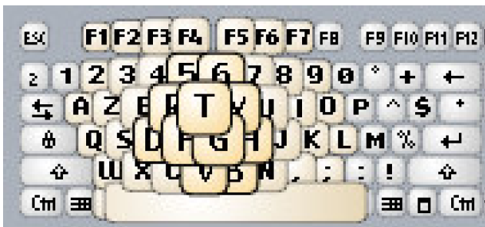
example
Choosing on-screen keyboards
Unconventional keyboard layouts
  are they ‘better’?
Raynal, Vinot & Truillet: UIST’07

Slide 13
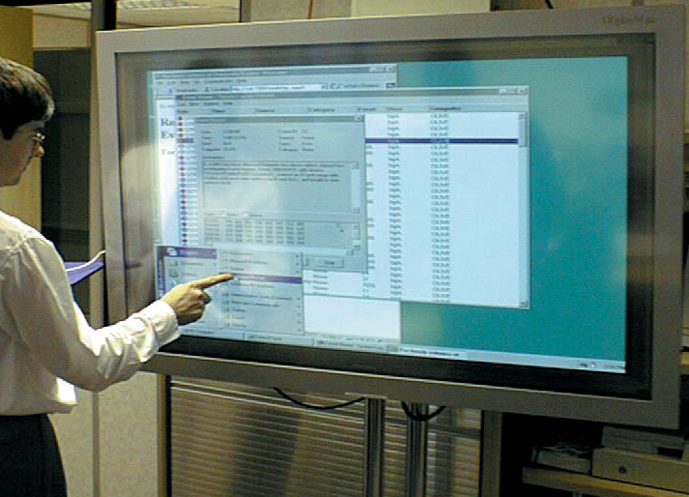

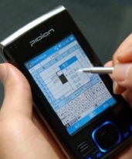

example
Choosing on-screen keyboards
Affects of input device?

Slide 14
example
Choosing on-screen keyboards
Issues
  can’t just ask people (preference ≠performance)
  observations alone won’t work
    effects may be too small to see but important
    variability of people will mask differences (if any)
  need to understand differences between users
    strong vs. moderate vs. weak typists
  …

Slide 15
A) Lucid and testable hypothesis
State a lucid, testable hypothesis
  this is a precise problem statement
Example 1:
  There is no difference in the number of cavities in children and teenagers using crest and no-teeth toothpaste when brushing daily over a one month period

Slide 16
A) Lucid and testable hypothesis
Example 2:
  There is no difference in user performance (time and error rate) when selecting a single item from a pop-up or a pull down menu of length 3, 6, 9 or 12 items, regardless of the subject’s previous expertise in using a mouse or using the different menu types
File Edit View Insert
File
New
New
Edit
Open
Open
View
Close
Close
Insert
Save
Save

Slide 17
A) Lucid and testable hypothesis
Example 3:
  There is no difference in user performance (time and error rate) and preference (5 point likert scale) when typing on two sizes of an alphabetic, qwerty and random on-screen keyboard using a touch-based large screen, a mouse-based monitor, or a stylus-based PDA.

Slide 18
Independent variables
b) Hypothesis includes the independent variables that are to be altered
  the things you manipulate independent of a subject’s behaviour
  determines a modification to the conditions the subjects undergo
  may arise from subjects being classified into different groups

Slide 19
Independent variables
in toothpaste experiment
There is no difference in the number of cavities in children and teenagers using glow-right and no-teeth toothpaste when brushing daily over a one month period
    toothpaste type: uses Crest or No-teeth toothpaste
    age: <= 11 years or > 11 years

Slide 20
Independent variables
in menu experiment
There is no difference in user performance (time and error rate) when selecting a single item from a pop-up or a pull down menu of length 3, 6, 9 or 12 items, regardless of the subject’s previous expertise in using a mouse or using the different menu types
    menu type: pop-up or pull-down
    menu length: 3, 6, 9, 12
    subject type (expert or novice)

Slide 21
Independent variables
in keyboard experiment
There is no difference in user performance (time and error rate) and preference (5 point likert scale) when typing on two sizes of an alphabetic, qwerty and random on-screen keyboard using a touch-based large screen, a mouse-based monitor, or a stylus-based PDA.
    keyboard type: alphabetic, qwerty, random
    size: small, large
    input/display: touch/large, mouse/monitor, stylus/PDA

Slide 22
Dependant variables
c) Hypothesis includes the dependent
variables that will be measured
    variables dependent on the subject’s behaviour / reaction to the independent variable
    the specific things you set out to quantitatively measure / observe

Slide 23
Dependant variables
in toothpaste experiment
There is no difference in the number of cavities in children and teenagers using glow-right and no-teeth toothpaste when brushing daily over a one month period in toothpaste experiment
    number of cavities
other things we could have measured
    frequency of brushing
    preference

Slide 24
Dependant variables
in menu experiment
There is no difference in user performance (time and error rate) when selecting a single item from a pop-up or a pull down menu of length 3, 6, 9 or 12 items, regardless of the subject’s previous expertise in using a mouse or using the different menu types
    time to select an item
    selection errors made

Slide 25
Dependant variables
in keyboard experiment
There is no difference in user performance (time and error rate) and preference (5 point likert scale) when typing on two sizes of an alphabetic, qwerty and random on-screen keyboard using a touch-based large screen, a mouse-based monitor, or a stylus-based PDA.
    other things we could have measured
    time to learn to use it to proficiency

Slide 26
Subject Selection
d) Judiciously select and assign subjects to groups
ways of controlling subject variability
    reasonable amount of subjects
    random assignment
    make different user groups an independent variable
    screen for anomalies in subject group
      superstars versus poor performers
Novice
Expert

Slide 27
Controlling bias
e) Control for bias
    unbiased instructions
    unbiased experimental protocols
      prepare scripts ahead of time
    unbiased subject selection
Now you get to do the
pop-up menus. I think
you will really like them...
I designed them myself!

Slide 28
Statistical analysis
f) Apply statistical methods to data analysis
  confidence limits:
    the confidence that your conclusion is correct
    “the hypothesis that computer experience makes no difference is rejected at the .05 level”
    means:
      a 95% chance that your statement is correct
      a 5% chance you are wrong

Slide 29
Interpretation
g) Interpret your results
  what you believe the results really mean
  their implications to your research
  their implications to practitioners
  how generalizable they are
  limitations and critique

Slide 30
Planning flowchart for experiments
Stage 1
Stage 2
Stage 3
Stage 4
Stage 5
Problem
Planning
Conduct
Analysis
Interpret-
definition
research
ation
feedback
research
define
preliminary
data
interpretation
idea
variables
testing
reductions
literature
generalization
review
controls
data
statistics
collection
reporting
statement of
apparatus
hypothesis
problem
testing
procedures
hypothesis
select
development
subjects
experimental
design
feedback
Image reproduced from an early ACM CHI tutorial, but I cannot recall which one

Slide 31
You know now
Controlled experiments strive for
  lucid and testable hypothesis
  quantitative measurement
  measure of confidence in results obtained (statistics)
  replicability of experiment
  control of variables and conditions
  removal of experimenter bias
Experimental design requires
careful planning

Slide 32



Permissions
You are free:
  to Share — to copy, distribute and transmit the work
  to Remix — to adapt the work
Under the following conditions:
Attribution — You must attribute the work in the manner specified by the author (but not in any way that suggests that they endorse you or your use of the work) by citing:
  “Lecture materials by Saul Greenberg, University of Calgary, AB, Canada. http://saul.cpsc.ucalgary.ca/saul/pmwiki.php/HCIResources/HCILectures”
Noncommercial — You may not use this work for commercial purposes, except to assist one’s own teaching and training within commercial organizations.
Share Alike — If you alter, transform, or build upon this work, you may distribute the resulting work only under the same or similar license to this one.
With the understanding that:
Not all material have transferable rights — materials from other sources which are included here are cited
Waiver — Any of the above conditions can be waived if you get permission from the copyright holder.
Public Domain — Where the work or any of its elements is in the public domain under applicable law, that status is in no way affected by the license.
Other Rights — In no way are any of the following rights affected by the license:
  Your fair dealing or fair use rights, or other applicable copyright exceptions and limitations;
  The author's moral rights;
  Rights other persons may have either in the work itself or in how the work is used, such as publicity or privacy rights.
Notice — For any reuse or distribution, you must make clear to others the license terms of this work. The best way to do this is with a link to this web page.

