Slide 1
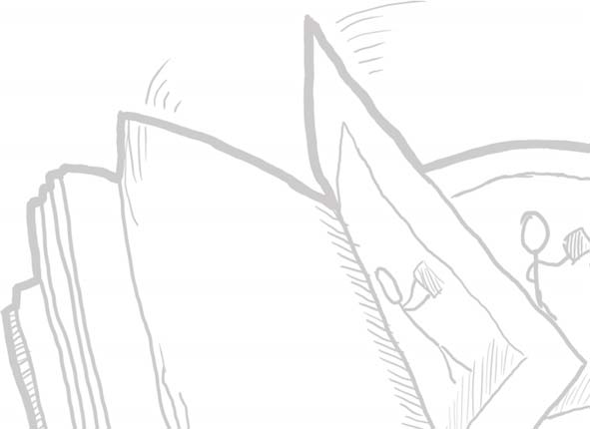
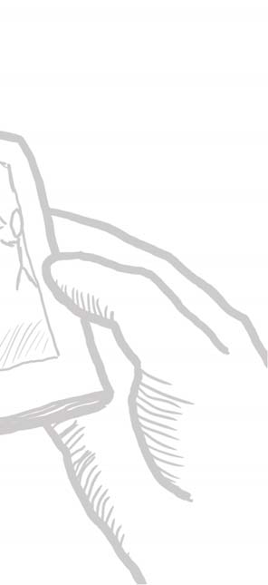
The Animated Sequence
Chapter 5.1 in Sketching User Experiences: The Workbook

Slide 2
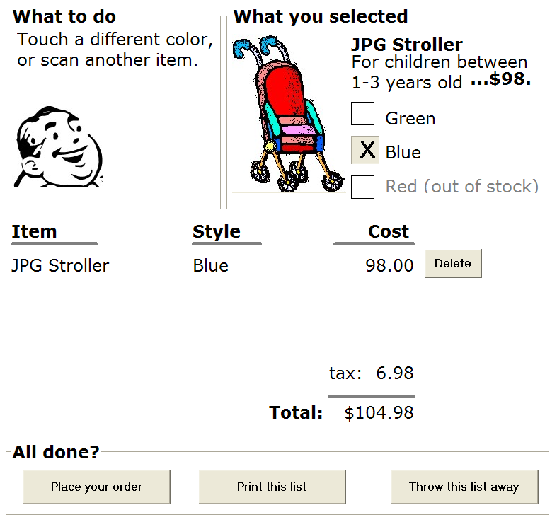
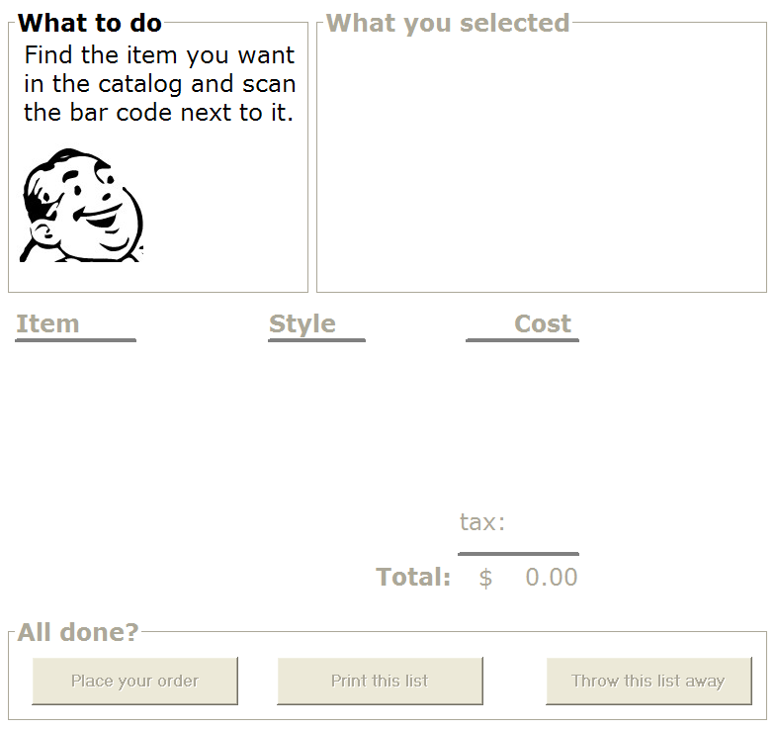
Animated Sequence
Present your storyboards as a series of successive frames that can be played back

Slide 3
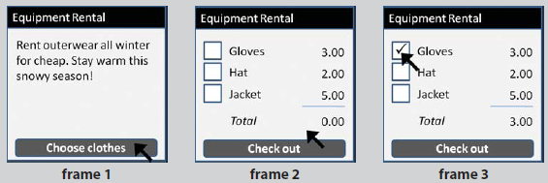
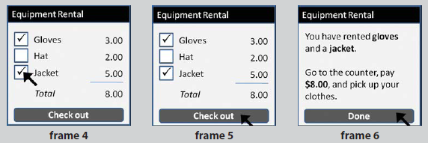
A Simple Example

Slide 4
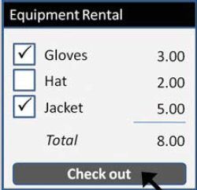
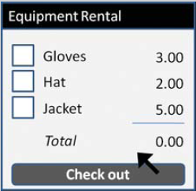
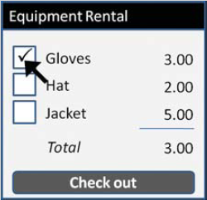
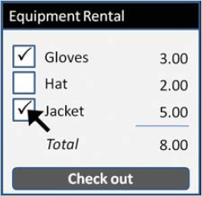
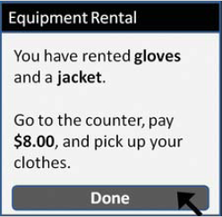
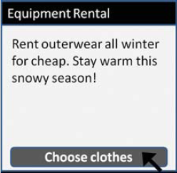

Slide 5
did you notice any issues?

Slide 7
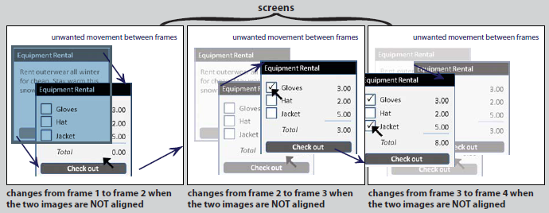
Registration Problem
Issue when frame elements do not align…

Slide 8
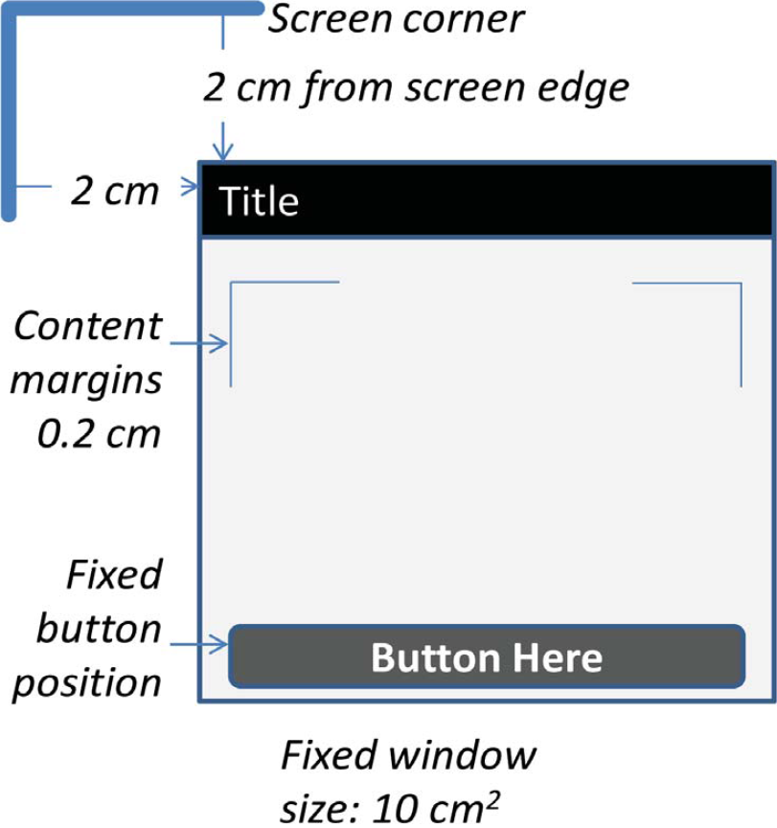
Registering Images
General approach: use templates
static elements
fixed position
fixed size
relative to
each other
screen

Slide 9
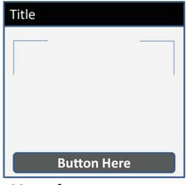
Registering Images
1. Master template
lowest common denominator elements
master

Slide 10
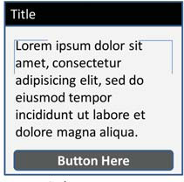
Registering Images
2. Copy and modify specialized templates
text window
master

Slide 11
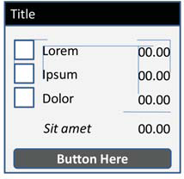
Registering Images
2. Copy and modify specialized templates
item selection window
text window
master

Slide 12
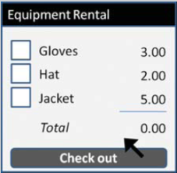
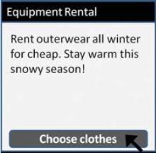
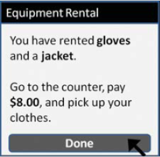
Registering Images
3. Create final frames from templates
master

Slide 13
Building the Animated Sequence
4. Order it in sequence
as a slide show

Slide 14
Building the Animated Sequence
4. Order it in sequence
a flip book
a movie
overlays…

Slide 15
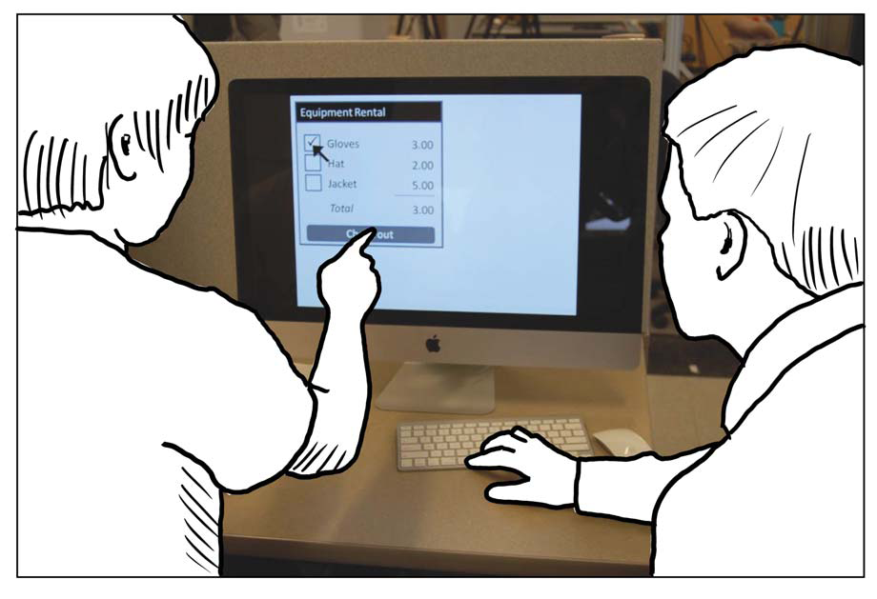
Building the Animated Sequence
5. Play it
manual (space bar)
tell the story as you go between slides
automatic
timer

Slide 16
Another Problem
Cursor jumps around
solved in next chapter

Slide 17
You now know
Animating a storyboard
a slide show of each frame
unaligned elements are problem
templates help you register static elements

Slide 18
Permissions
You are free:
to Share — to copy, distribute and transmit the work
to Remix — to adapt the work
Under the following conditions:
Attribution — You must attribute the work in the manner specified by the author (but not in any way that suggests that they endorse you or your use of the work) by citing:
“from presentations accompanying the book ‘Sketching User Experiences, the Workbook’, by S. Greenberg, S. Carpendale, N. Marquardt and B. Buxton”
Noncommercial — You may not use this work for commercial purposes, except to assist one’s own teaching and training within commercial organizations.
Share Alike — If you alter, transform, or build upon this work, you may distribute the resulting work only under the same or similar license to this one.
With the understanding that:
Not all material have transferable rights — materials from other sources which are included here are cited
Waiver — Any of the above conditions can be waived if you get permission from the copyright holder.
Public Domain — Where the work or any of its elements is in the public domain under applicable law, that status is in no way affected by the license.
Other Rights — In no way are any of the following rights affected by the license:
Your fair dealing or fair use rights, or other applicable copyright exceptions and limitations;
The author's moral rights;
Rights other persons may have either in the work itself or in how the work is used, such as publicity or privacy rights.
Notice — For any reuse or distribution, you must make clear to others the license terms of this work. The best way to do this is with a link to this web page.

