Slide 1
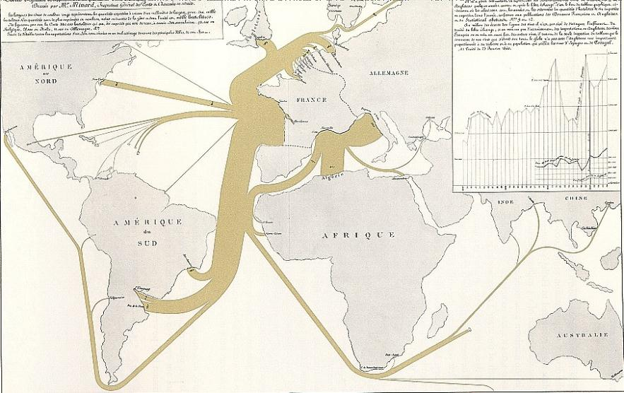
Representations
Part 1: Visualizing Interaction
Lecture /slide deck produced by Saul Greenberg, University of Calgary, Canada
E. Tufte “Visual Display of Quantitative Information” p 25,
Notice: some material in this deck is used from other sources without permission. Credit to the original source is given if it is known,

Slide 2
The messages
Good representations
  captures essential elements of the event / world & mutes the irrelevant
  appropriate for the person, their task, and their interpretation
Information visualization
  Tufte’s principles
  overview first, zoom and filter, then details on demand
  many techniques now available

Slide 3
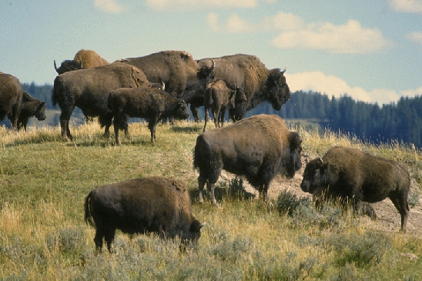

Good representations
# Buffalo
captures essential elements of the event / world
deliberately leaves out / mutes the irrelevant
appropriate for the person and their interpretation
appropriate for the task, enhancing judgment ability
How many buffalo?
# Buffalo
# Adults
# calfs
8
4

Slide 4



Representation
Representations
  formal system or mapping by which information can be specified (D. Marr)
  a sign system in that it stands for something other than its self.
  Representations of 34
    fingers:
    decimal: 34
    binary: 100010
    roman: XXXIV
    mayan: base 5 within base 20

Slide 5
Representation
Presentation
  how the representation is placed or organized on the screen
    34, 34, 34,
34

Slide 6
Representations
Solving a problem simply means representing it so as to make the solution transparent
  --Simon, 1981
Good representations
  allow people to find relevant information
    information may be present but hard to find
  allow people to compute desired conclusions
    computations may be difficult or “for free” depending on representations

Slide 7
Which is the best flight?
depart arrive
AC 117 Vancouver - Calgary 7:00 9:00
Cdn 321 Vancouver - Calgary 9:00 12:00
Cdn 355 Calgary - Montreal 13:30 19:30
AC 123 Calgary - Toronto 12:30 16:30
AC 123 Toronto - Montreal 16:45 17:30
*time zone: +1 van-cal, +2 cal-tor, mtl
Exact times
length
stop-overs
switching planes
speed of plane…
Vancouver
7
9
11
13
15
17
AC 117
Cdn 321
Calgary
8
10
12
14
16
18
AC 123
Cdn 355
Toronto
Montreal
10
12
14
16
18
20
Adapted from Edward Tufte

Slide 8
When do I take my drugs?
10 - 30% error rate in taking pills, same for pillbox organizers
Inderal - 1 tablet 3 times a day
Lanoxin - 1 tablet every a.m.
Carafate - 1 tablet before meals and at bedtime
Zantac - 1 tablet every 12 hours (twice a day)
Quinag - 1 tablet 4 times a day
Couma - 1 tablet a day
Breakfast Lunch Dinner Bedtime
Lanoxin O
Inderal O O O O
Quinag O O O O
Carafate O O O O
Zantac O O
Couma O
Breakfast Lunch Dinner Bedtime
Lanoxin
Inderal Inderal Inderal Inderal
Quinag Quinag Quinag Quinag
Carafate Carafate Carafate Carafate
Zantac Zantac
Couma
Adapted from Donald Norman

Slide 9
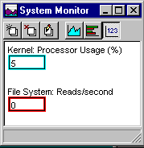
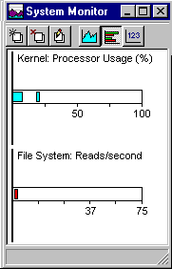
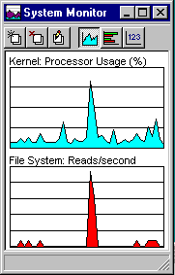
Which representation is best?
depends heavily on task
What is precise
value?
How does the performance
now compare to its peak?
How does performance
change over time?
Windows 95 System Monitor

Slide 10
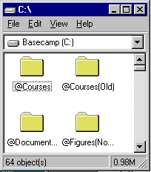
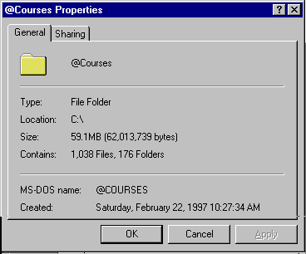
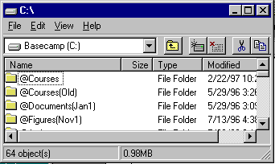
Which folder has the most documents?
right menu
+ properties
Windows 95 File Viewer

Slide 11
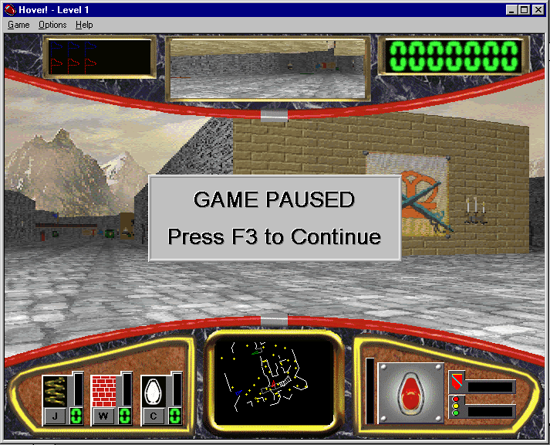
Where am I?
Detailed navigation
plus precision
General navigation
plus orientation
Windows NT Hover Game

Slide 12
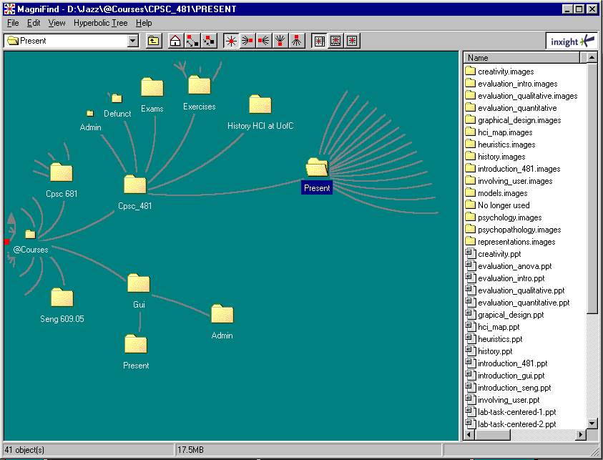
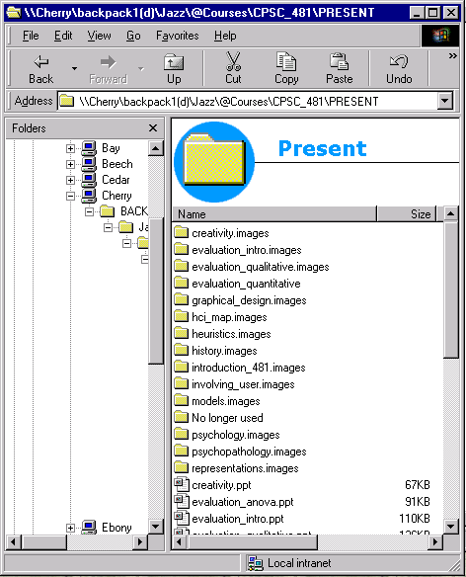
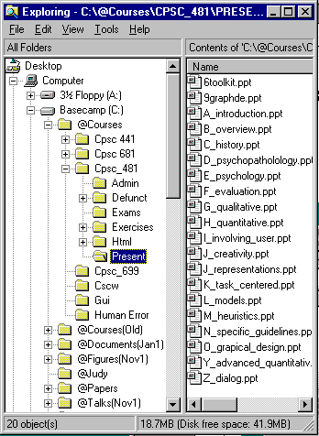
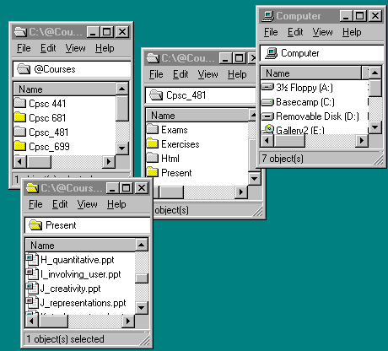
Where am I?
Inxight Magnifind

Slide 13
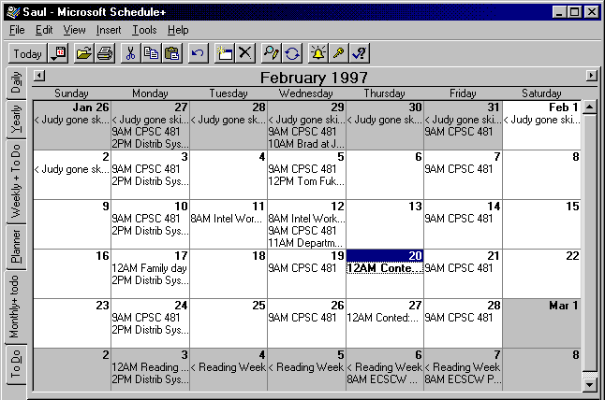
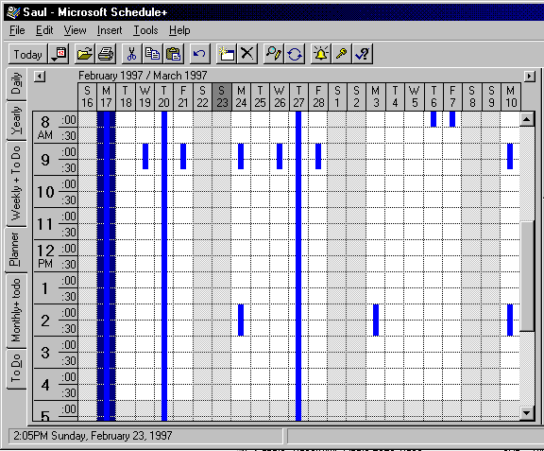
What do I have to do?
Microsoft Schedule+

Slide 14
Information Visualization
Graphics should reveal the data
  show the data
  not get in the way of the message
  avoid distortion
  present many numbers in a small space
  make large data sets coherent
  encourage comparison between data
  supply both a broad overview and fine detail
  serve a clear purpose
E. Tufte
Visual Display of Quantitative Information
many examples on the following slides are taken from Tufte’s books

Slide 15
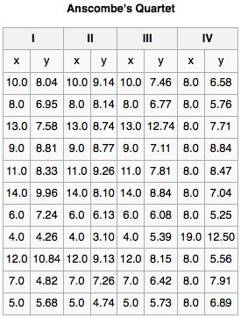
Anscombe’s Quartet
N: 11.0
mean X’s : 9.0
mean Y’s : 7.5
standard error of slope estimate: 0.1
sum of squares: 110.0
regression sum of squares: 27.5
residual sum of squares of Y: 13.8
correlation coefficient: 0.8
r squared: 0.7
regression line: Y=3+0.5X
E. Tufte “Visual Display of Quantitative Information” p 25,

Slide 16
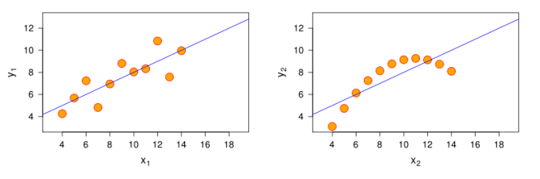
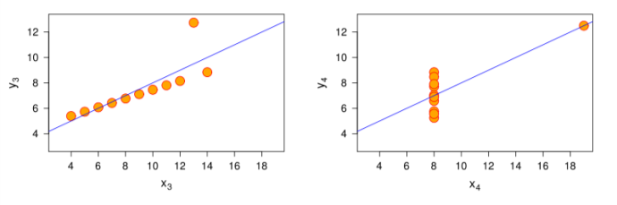
Anscombe’s Quartet
N: 11.0
mean X’s : 9.0
mean Y’s : 7.5
standard error of slope estimate: 0.1
sum of squares: 110.0
regression sum of squares: 27.5
residual sum of squares of Y: 13.8
correlation coefficient: 0.8
r squared: 0.7
regression line: Y=3+0.5X
Graphics Reveal the Data
E. Tufte “Visual Display of Quantitative Information” p 25,

Slide 17
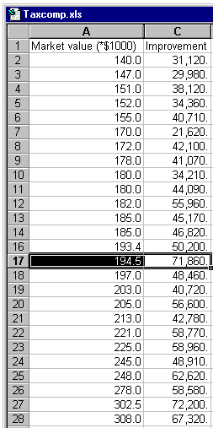
Do I deserve a tax break?

Slide 18

1864 Exports of French Wine
E. Tufte “Visual Display of Quantitative Information” p 25,

Slide 19
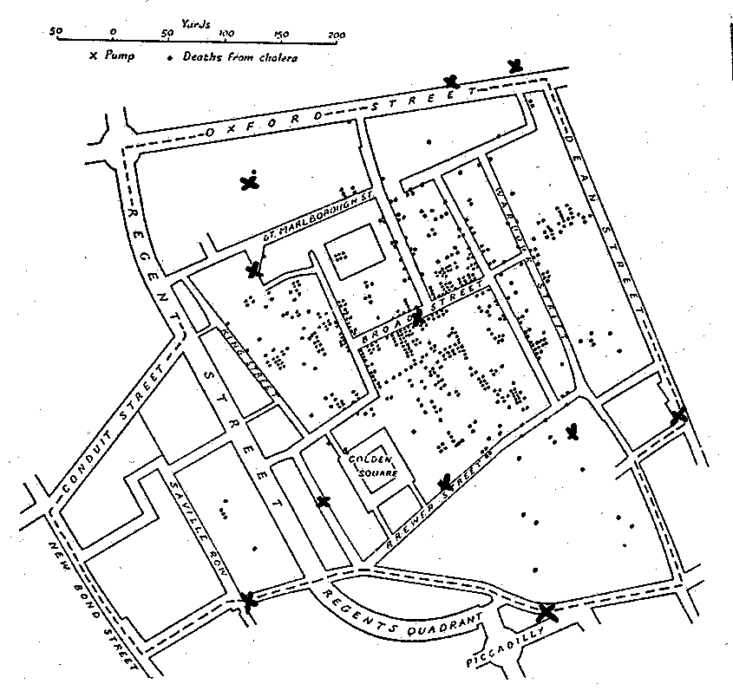
Deaths by Cholera
Dr John Snow
1854
E. Tufte “Visual Display of Quantitative Information”

Slide 20
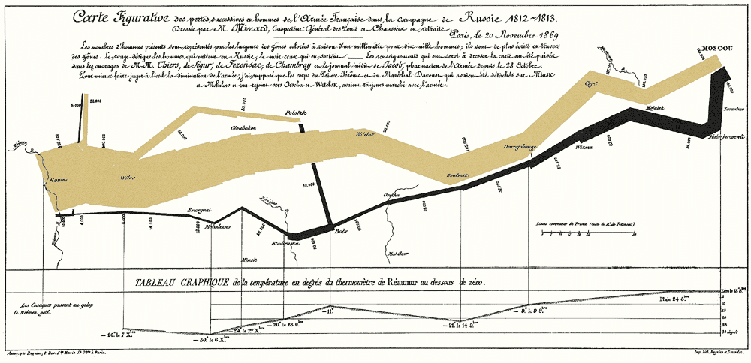
Napolean's march to Moscow Charles Minard
E. Tufte “Visual Display of Quantitative Information”

Slide 21
Chart Junk: A common error
Information display is not just pretty graphics
  graphical re-design by amateurs on computers gives us
    “fontitis,” “chart-junk,” etc.

Slide 22
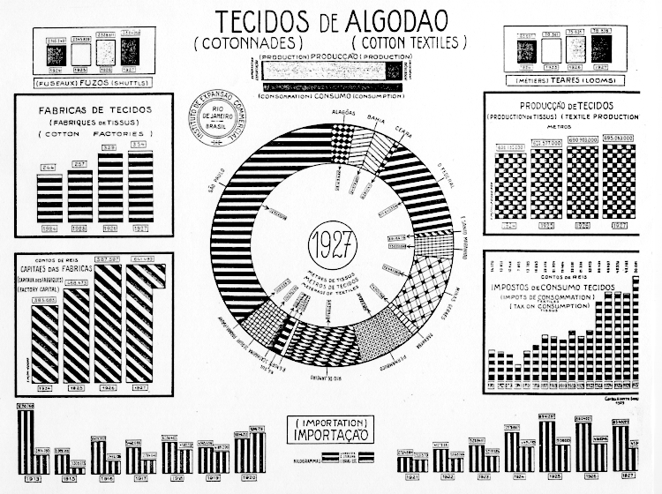
Chart Junk: Cotton production in Brazil, 1927
E. Tufte Visual Display of Quantitative Information

Slide 23
Chart Junk: Removing deception and simplification
70
Maintenance cost / year
65
60
55
50
45
40
35
30
25
20
15
10
5
0
Ford
GM
Pontiac
Toyota

Slide 24
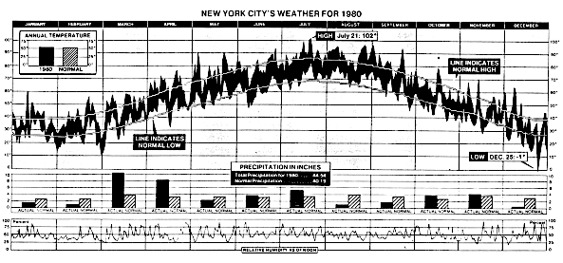
Data density
New York Weather History for 1980
  181 numbers/sq inch
E. Tufte “Visual Display of Quantitative Information”

Slide 25
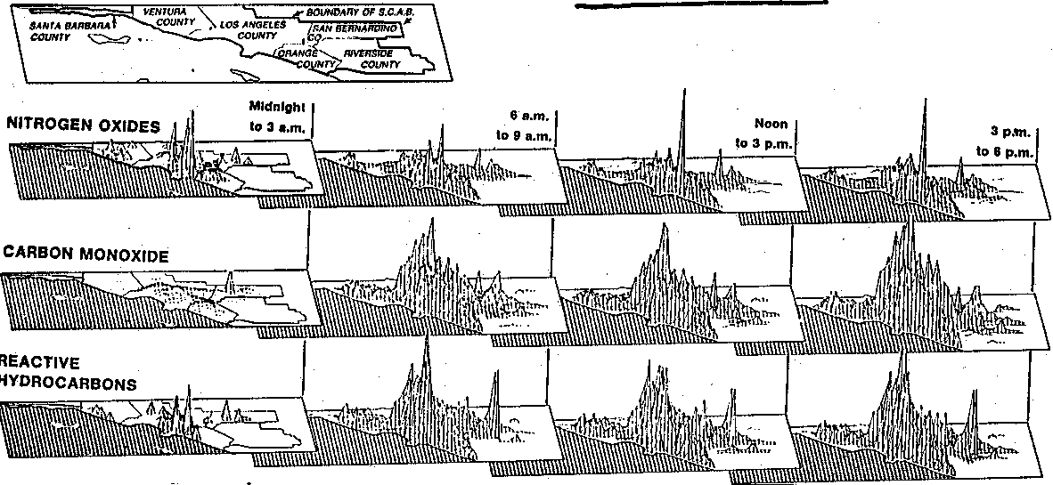
Small multiples
Learn once
  invite comparisons
E. Tufte Visual Display of Quantitative Information

Slide 26
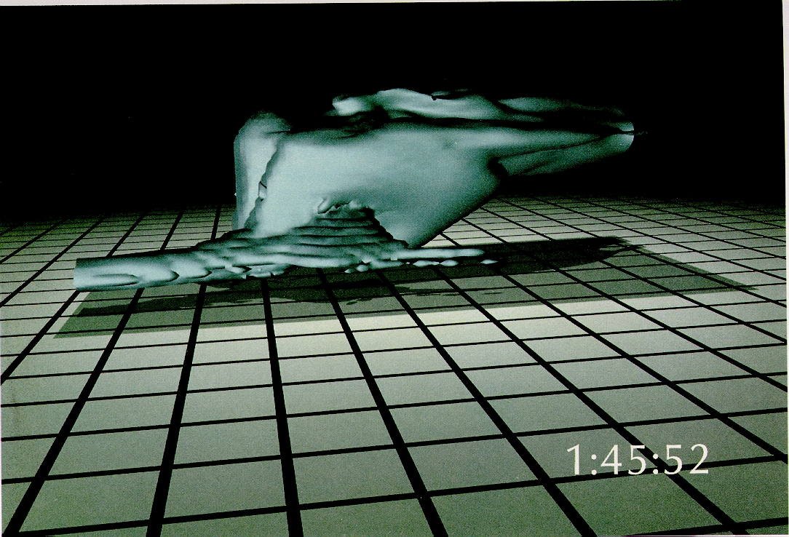
Small multiples: Showing time and change
E. Tufte Visual Display of Quantitative Information
E. Tufte Visual Display of Quantitative Information

Slide 27
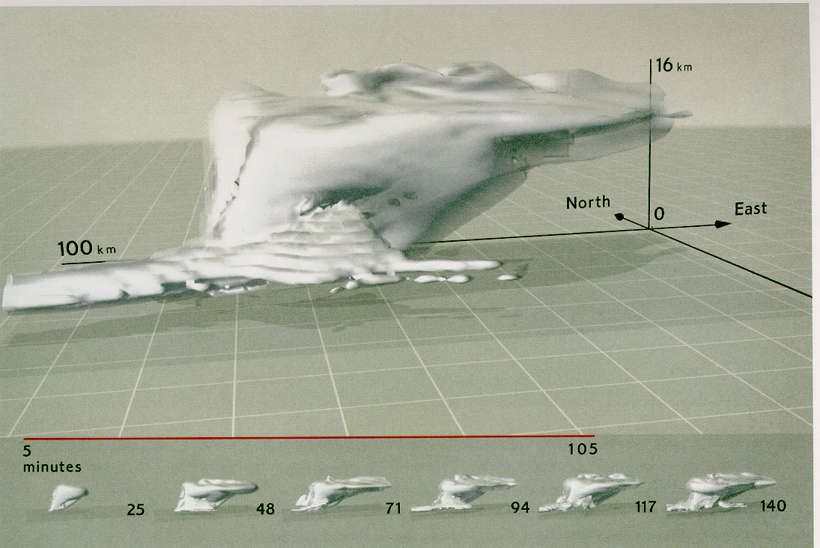
Small multiples: Showing time and change
E. Tufte Visual Display of Quantitative Information

Slide 28
Visual information-seeking mantra
Overview first, zoom and filter, then details on demand
Overview first, zoom and filter, then details on demand
Overview first, zoom and filter, then details on demand
Overview first, zoom and filter, then details on demand
Overview first, zoom and filter, then details on demand
Overview first, zoom and filter, then details on demand
Overview first, zoom and filter, then details on demand
Overview first, zoom and filter, then details on demand
Overview first, zoom and filter, then details on demand
Overview first, zoom and filter, then details on demand
- Ben Shneiderman, Designing the User Interface 3rd Ed. 1997 p523

Slide 29
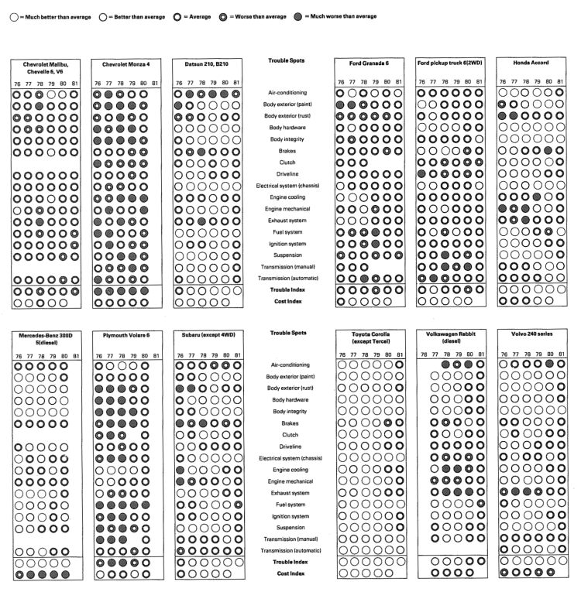
Overview & detail for comparisons using small multiples and data density
E. Tufte Visual Display of Quantitative Information

Slide 30
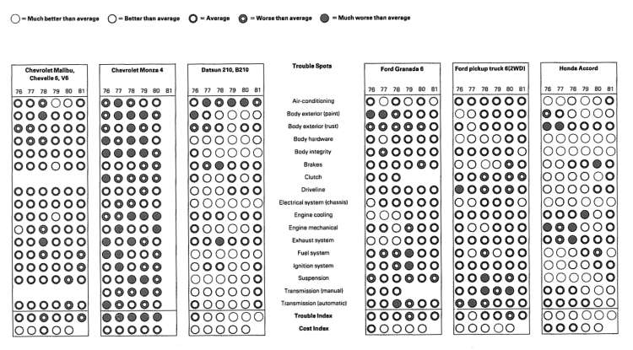
Overview & detail for comparisons using small multiples and data density
E. Tufte Visual Display of Quantitative Information

Slide 31
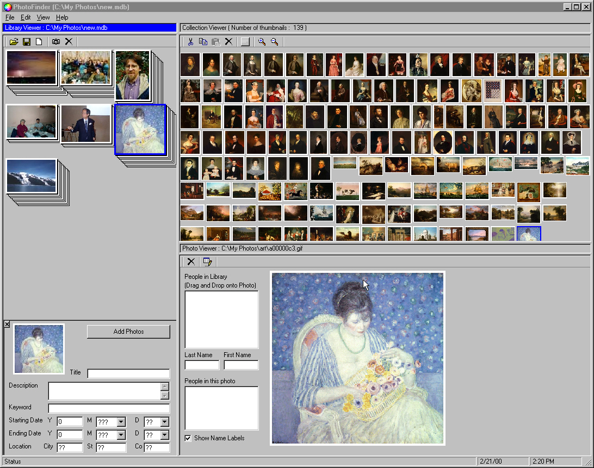
PhotoFinder
University of Maryland Human Computer Interaction Laboratory http://www.cs.umd.edu/hcil/

Slide 32
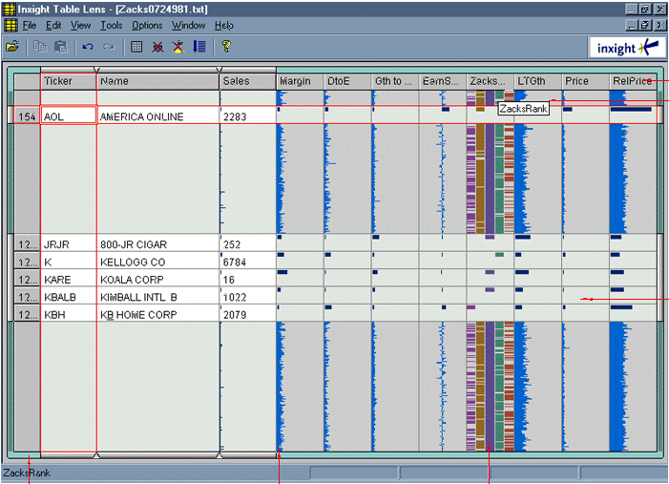
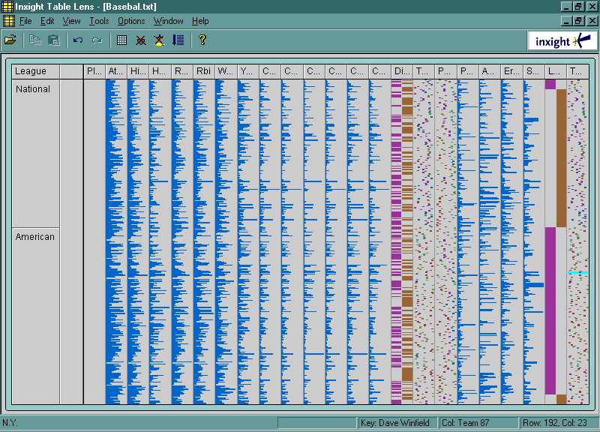
Table Lens
Inxight Table Lens

Slide 33
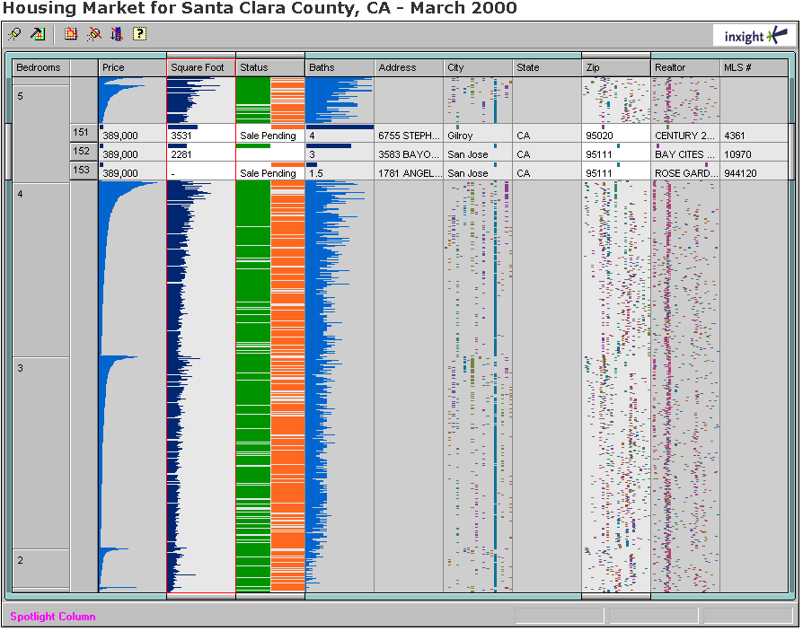
Table Lens
Inxight Table Lens

Slide 34
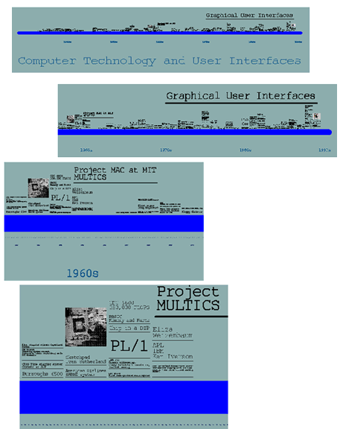
Infinite Zoom
Pad++: A Zoomable Graphical Sketchpad for
Exploring Alternate Interface Physics. Bederson et al
Journal of Visual Languages and Computing 7, 1996

Slide 35
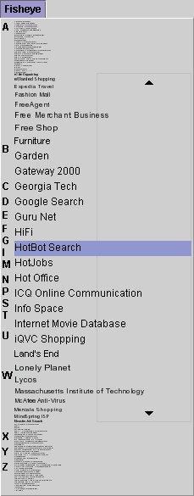
Fisheye Menus
Bederson, B.B. (May 2000) University of Maryland
www.cs.umd.edu/hcil/fisheyemenu/

Slide 36
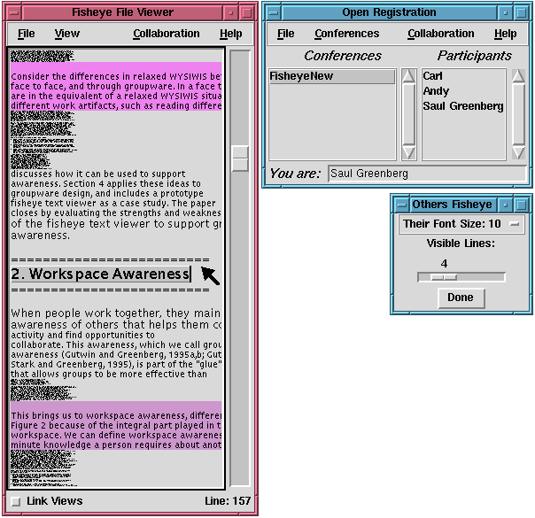
Fisheye
Text
groupware
Carl’s
focus
Saul’s focus
(local user)
Andy’s
focus
Greenberg, Graphics Interface

Slide 37
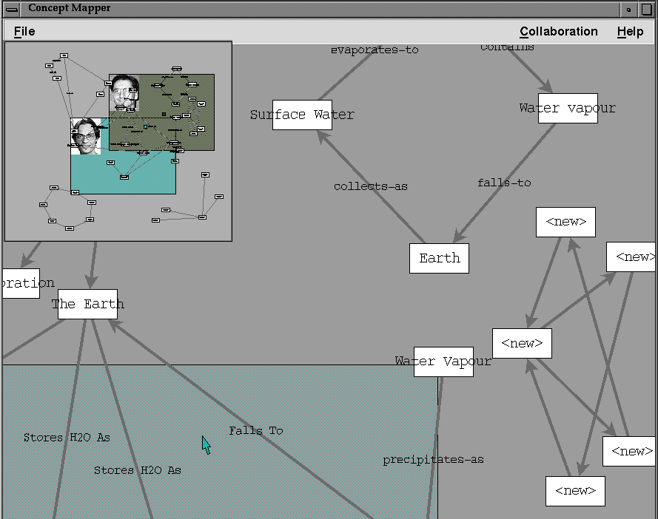

Slide 38
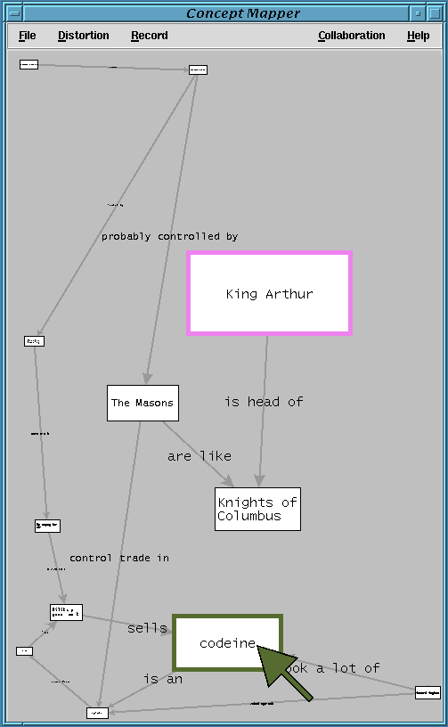
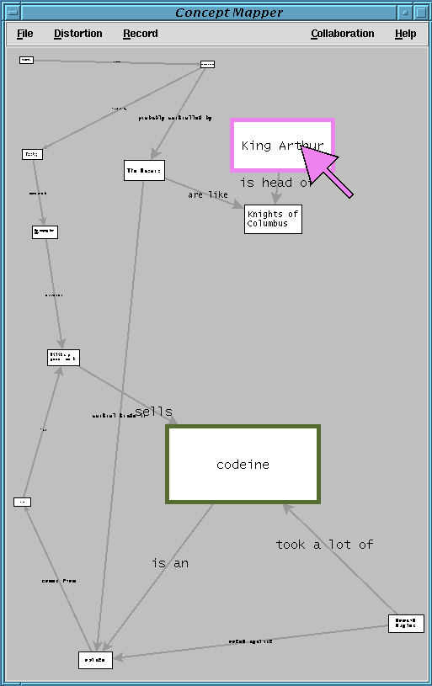

Slide 39
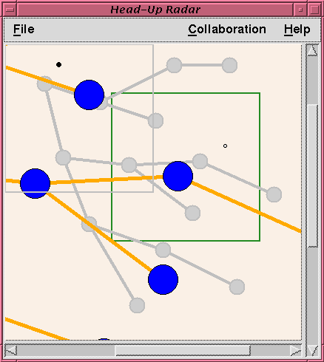
Main view
in foreground
Overview
in background

Slide 40
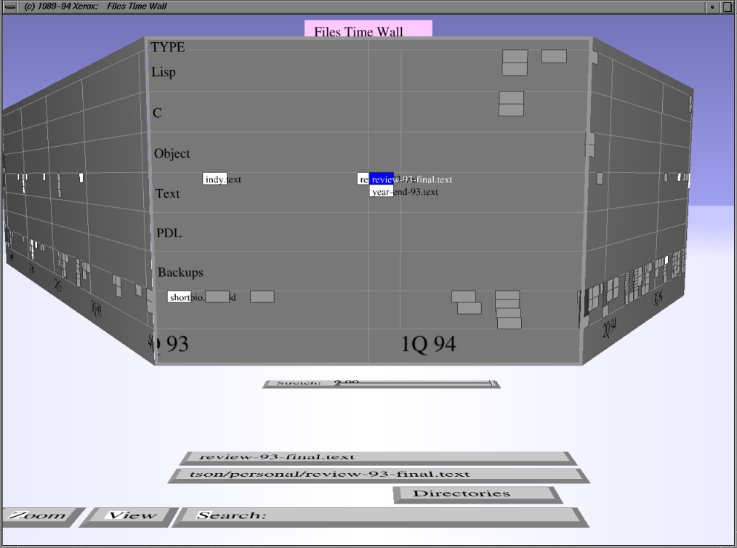
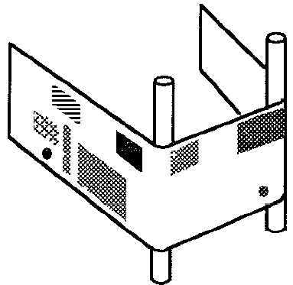
Perspective Wall
Leung and Apperly
TOCHI’94
Mackinlay / Robertson / Card: Proc ACM CHI'91

Slide 41
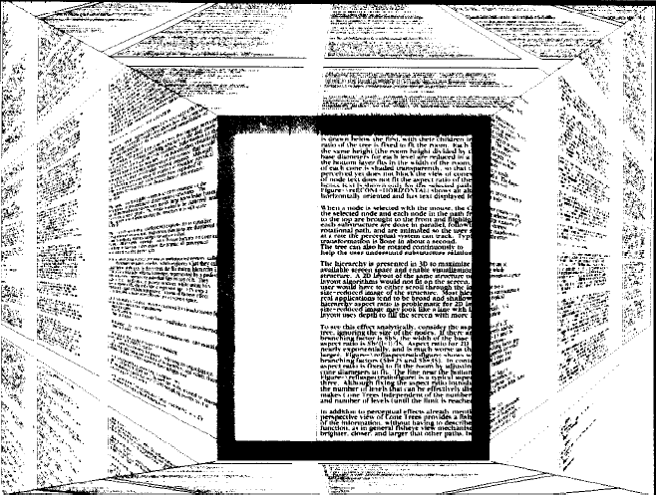
Document Lens
Robertson, Mackinlay ACM UIST 1993

Slide 42
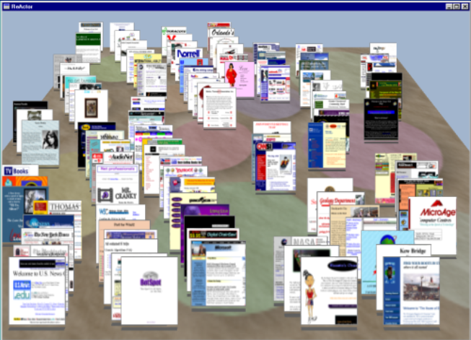
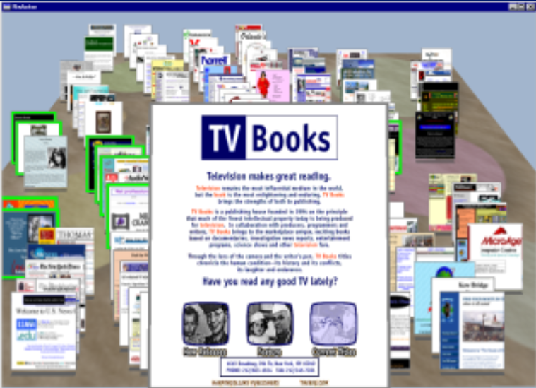
Data Mountain
Robertson / Czerwinski / Larson / Robbins / Thiel / van Dantzich
Data Mountain: Using Spatial Memory for Document Management Proc ACM UIST’98

Slide 43
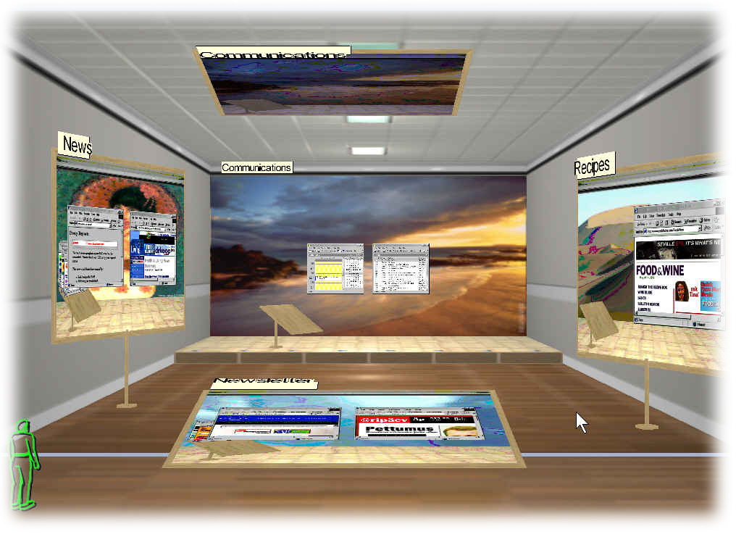
Task Gallery
www.research.microsoft.com/ui/TaskGallery/

Slide 44
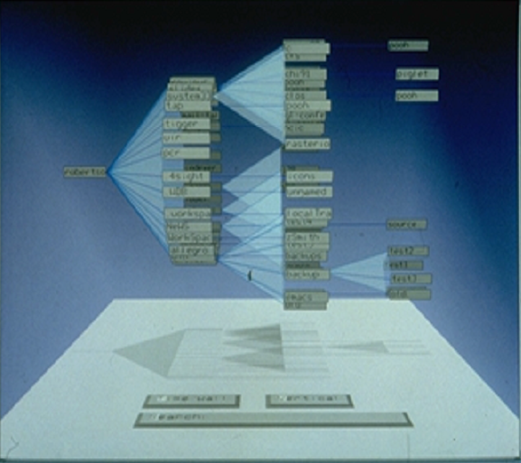
Cone Trees
Robertson / Mackinlay / Card Cone Trees: Animated 3D Visualizations of Hierarchical Information. Proc ACM CHI'91

Slide 45
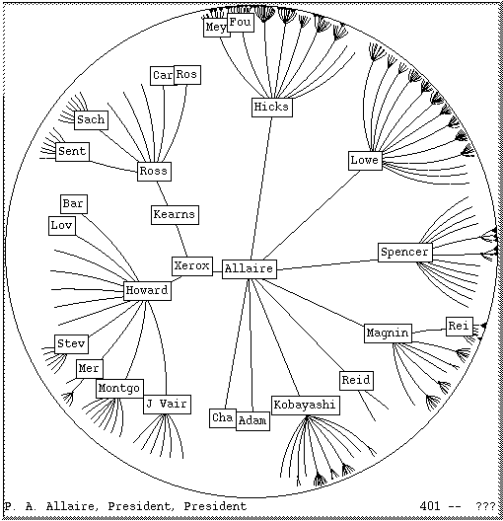
Hyperbolic
Lens
Xerox Parc - Inxight

Slide 46
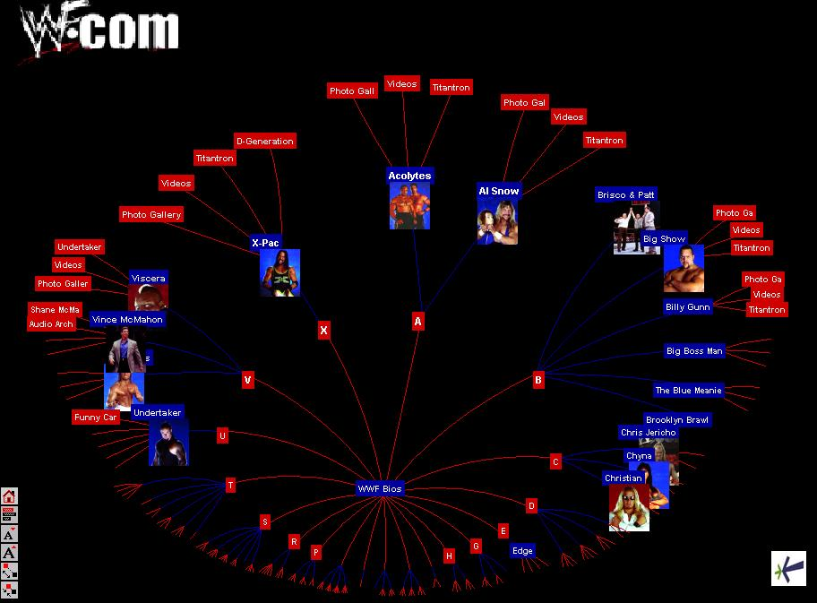
Hyperbolic
Lens
Xerox Parc - Inxight

Slide 47
You know now
Good representations
  captures essential elements of the event / world & mutes the irrelevant
  appropriate for the person, their task, and their interpretation
Information visualization
  Tufte’s principles
  overview first, zoom and filter, then details on demand
  many techniques now available

Slide 48
Interface Design and Usability Engineering
Articulate:
who users are
their key tasks
Brainstorm designs
Refined designs
Completed designs
Goals:
Task centered system design
Participatory design
User-centered design
Psychology of everyday
things
User involvement
Representations
Participatory interaction
Task scenario walk-
through
Graphical screen design
Interface guidelines
Style
guides
Evaluate
tasks
Usability testing
Heuristic evaluation
Field testing
Methods:
low fidelity prototyping methods
high fidelity prototyping methods
Products:
User and task descriptions
Throw-away paper prototypes
Testable prototypes
Alpha/beta systems or complete specification

Slide 49
Primary Sources
This slide deck is partly based on concepts and illustrations as taught by:
  The Visual Display of Quantitative Information, Edward Tufte, 1983
  The Power of Representations. Chapter 3 in Norman, D. Things that Make Us Smart, 43-76, Addison-Wesley. (1993)

Slide 50



Permissions
You are free:
  to Share — to copy, distribute and transmit the work
  to Remix — to adapt the work
Under the following conditions:
Attribution — You must attribute the work in the manner specified by the author (but not in any way that suggests that they endorse you or your use of the work) by citing:
  “Lecture materials by Saul Greenberg, University of Calgary, AB, Canada. http://saul.cpsc.ucalgary.ca/saul/pmwiki.php/HCIResources/HCILectures”
Noncommercial — You may not use this work for commercial purposes, except to assist one’s own teaching and training within commercial organizations.
Share Alike — If you alter, transform, or build upon this work, you may distribute the resulting work only under the same or similar license to this one.
With the understanding that:
Not all material have transferable rights — materials from other sources which are included here are cited
Waiver — Any of the above conditions can be waived if you get permission from the copyright holder.
Public Domain — Where the work or any of its elements is in the public domain under applicable law, that status is in no way affected by the license.
Other Rights — In no way are any of the following rights affected by the license:
  Your fair dealing or fair use rights, or other applicable copyright exceptions and limitations;
  The author's moral rights;
  Rights other persons may have either in the work itself or in how the work is used, such as publicity or privacy rights.
Notice — For any reuse or distribution, you must make clear to others the license terms of this work. The best way to do this is with a link to this web page.

