Slide 1
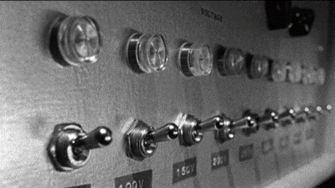
Ethics in User Studies
Lecture /slide deck produced by Saul Greenberg, University of Calgary, Canada
Image from: The Situationist Staff, Dec. 22, 2007 http://thesituationist.wordpress.com/2007/12/22/the-milgram-experiment-today/
Notice: some material in this deck is used from other sources without permission. Credit to the original source is given if it is known,

Slide 2
Overview
Millgram’s obedience to authority experiment
Why ethics?
What you have to do

Slide 3
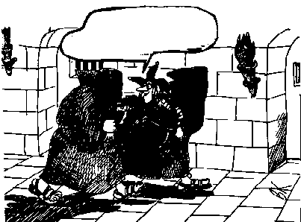
Why Ethics?
...and to think that you want me to test it!!!

Slide 4
Why Ethics?
Ghostbusters (Columbia Pictures) opening scene http://www.youtube.com/watch?v=fn7-JZq0Yxs

Slide 5
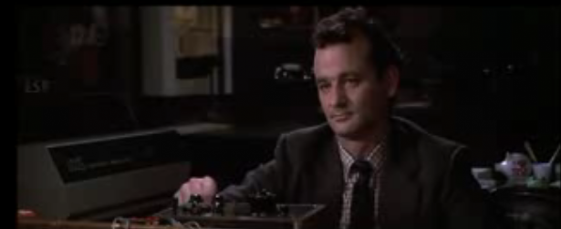
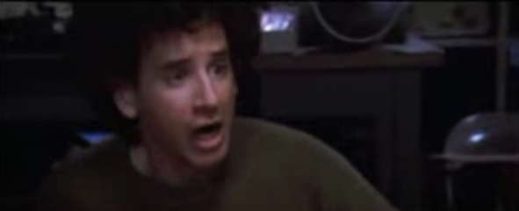
Why Ethics?
Ghostbusters

Slide 6
Milgram's Obedience To Authority
Video from ABC News http://www.youtube.com/watch?v=3f6LLV3fkXg

Slide 7
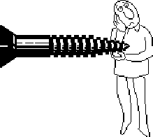
Ethics
Testing can be a distressing experience
pressure to perform, errors inevitable
feelings of inadequacy
competition with other subjects
Golden rule
subjects should always be treated with respect

Slide 8
Ethics – before the test
Don’t waste the user’s time
use pilot tests to debug experiments, questionnaires etc
have everything ready before the user shows up
Make users feel comfortable
emphasize that it is the system that is being tested, not the user
acknowledge that the software may have problems
let users know they can stop at any time
Maintain privacy
tell user that individual test results will be completely confidential
Inform the user
explain any monitoring that is being used
answer all user’s questions (but avoid bias)
Only use volunteers
user must sign an informed consent form

Slide 9
Ethics – during the test
Don’t waste the user’s time
never have the user perform unnecessary tasks
Make users comfortable
try to give user an early success experience
keep a relaxed atmosphere in the room
coffee, breaks, etc
hand out test tasks one at a time
never indicate displeasure with the user’s performance
avoid disruptions
stop the test if it becomes too unpleasant
Maintain privacy
do not allow the user’s management to observe the test

Slide 10
Ethics – after the test
Make the users feel comfortable
state that the user has helped you find areas of improvement
Inform the user
answer particular questions about the experiment that could have biased the results before
Maintain privacy
never report results in a way that individual users can be identified
only show videotapes outside the research group with the user’s permission

Slide 11
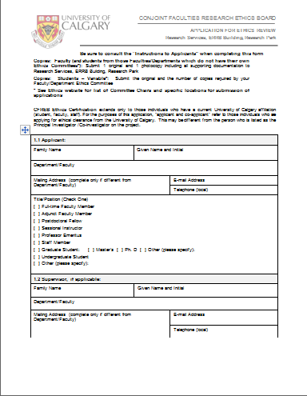
The Ethics Application
Per university / granting agency / industry
but processes are similar
Why?
participant rights
organizational backing
you have to follow your protocol

Slide 12
1. The Applicant
Principle investigator is applicant
Your supervisor
always list
Co-applicants
other people involved in the research

Slide 13
2. Project Details
Title
short but meaningful
Funding
agencies directly funding the specific project
not scholarships, etc.
Title
short but meaningful
List of location(s) where date will be collected
you have to know where you are running your study

Slide 14
2. Project Details
Summary
purpose
objectives / aims
methodology (detailed)
what is required of participants
Include (appendix)
questionnaires
could be samples of seed questions, e.g., if open-ended interview
other test instruments
surveys, etc.

Slide 15
3. Recruitment of Participants
Type
students, children, professionals (which ones), etc.
Renumeration
dollars, food, donuts (if any)…
How
posters, email, snowball sampling, ads, web, etc.
must include example (e.g., email)

Slide 16
4. Informed consent

Slide 17
4. Informed consent
Type
written / signed (the norm), web page checkbox…
Content
researchers, institute, contact information
university ethics contact for complaints
purpose of the study (lay language)
participant expectations
what they will do
benefits (to research, to society)

Slide 18
4. Informed consent
Content (continued)
data collected
measures, observations, quotes, video, audio…
how data will be used e.g.,
anonymity
masked individual information
reported only in aggregate
safe gaurds for data security…
specific permissions
 I agree to be video taped.
 I agree for video-taped segments to be presented as part of disseminating research results
 I grant permission to be quoted in research reporting …

Slide 19
4. Informed consent
Risks (continued)
no / minimal risk
“there is no known risk associated with your participation in this research”
some risk
discomfort, fatigue, emotional stress, identification,…
high risk
you probably want to talk to the ethics chair
Right to withdraw at any time
what will happen to payment / data
Signature / date

Slide 20
5. Privacy, Confidentiality, Anonymity
Raw data: usually
kept in secure location
password protected accounts, locked offices/file cabinets
kept for 3 – 5 years
accessible only by investigators
does not identify participants (except a master sheet)

Slide 21
5. Privacy, Confidentiality, Anonymity
Processed data: usually reported
reported anonymously
in aggregate form
individually (e.g., quotes) but pseudononymous
e.g., participant 2
potentially revealing data (audio, video)
get explicit permission in consent

Slide 22
6. Estimation of Risks
Psychological or emotional manipulations
Questions that may be upsetting
Potential to identify distressed individuals
Physical risk
Is deception involved
Is any information withheld in informed consent?
Social risk
Any chance of harm
Is there potential for coersion?
e.g., recruitment involves managers dictating employee participation

Slide 23
6. Benefits
To
the researcher
the participant
the research community
society
If no clear benefit, you are wasting people’s time

Slide 24
You now know
Ethics is required to protect participant rights
Ethics in research is not optional
Ethics application requires planning
investigators
funding
title/method/project details/data collection
recruitment of participants
informed consent
privacy, confidentiality and anonymity
risks
benefits

Slide 25
Primary Sources
This slide deck is partly based on the Tri-Council ethics review process at the University of Calgary

Slide 26
Permissions
You are free:
to Share — to copy, distribute and transmit the work
to Remix — to adapt the work
Under the following conditions:
Attribution — You must attribute the work in the manner specified by the author (but not in any way that suggests that they endorse you or your use of the work) by citing:
“Lecture materials by Saul Greenberg, University of Calgary, AB, Canada. http://saul.cpsc.ucalgary.ca/saul/pmwiki.php/HCIResources/HCILectures”
Noncommercial — You may not use this work for commercial purposes, except to assist one’s own teaching and training within commercial organizations.
Share Alike — If you alter, transform, or build upon this work, you may distribute the resulting work only under the same or similar license to this one.
With the understanding that:
Not all material have transferable rights — materials from other sources which are included here are cited
Waiver — Any of the above conditions can be waived if you get permission from the copyright holder.
Public Domain — Where the work or any of its elements is in the public domain under applicable law, that status is in no way affected by the license.
Other Rights — In no way are any of the following rights affected by the license:
Your fair dealing or fair use rights, or other applicable copyright exceptions and limitations;
The author's moral rights;
Rights other persons may have either in the work itself or in how the work is used, such as publicity or privacy rights.
Notice — For any reuse or distribution, you must make clear to others the license terms of this work. The best way to do this is with a link to this web page.

